Slide 1
Free Body Diagrams
A phabulous tale chronicling the lives of phorces

Slide 2
Prologue
One day, you and a friend happen upon an ice-rink. The ice is perfectly level; in fact it has been recently been resurfaced with a Zamboni. You brace yourself at the edge of the rink and give your friend a quick push.
Draw a top-down, strobe motion view of your friend’s motion
Sketch qualitative d - t and v - t graphs of their motion
Clearly identify all forces present while you are pushing on your friend
Clearly identify all forces present after the push has occurred on your friend

Slide 3
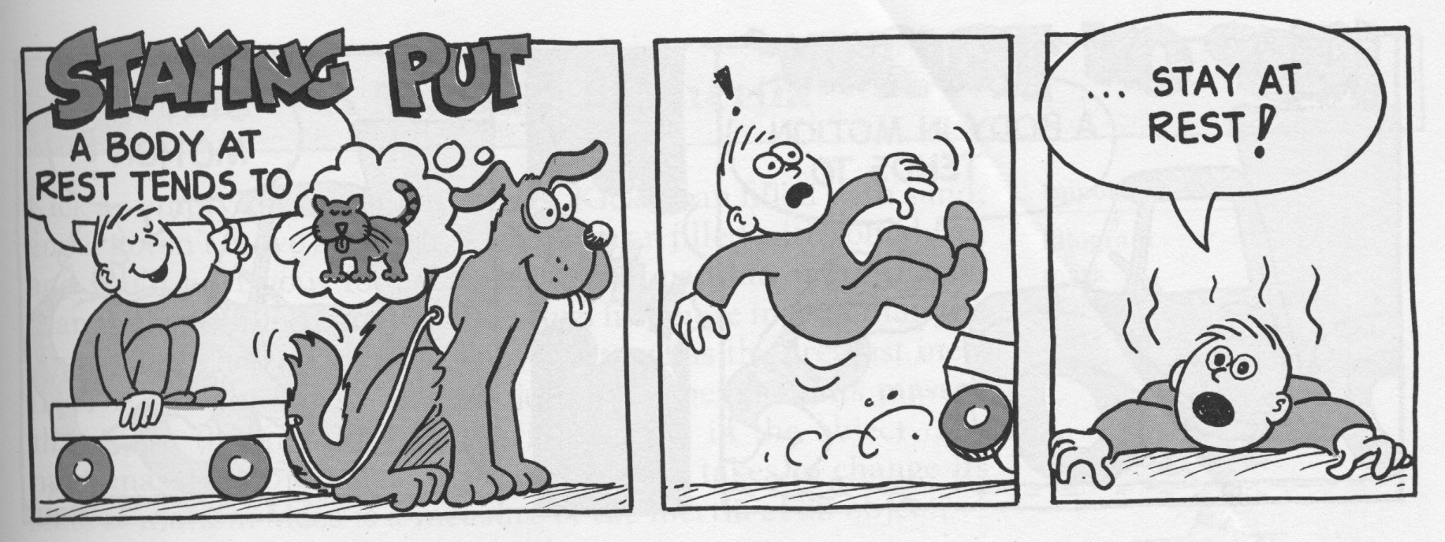
Part I: The Legend
Newton’s 1st Law states
An object at rest will stay at rest unless acted upon by an unbalanced force

Slide 4
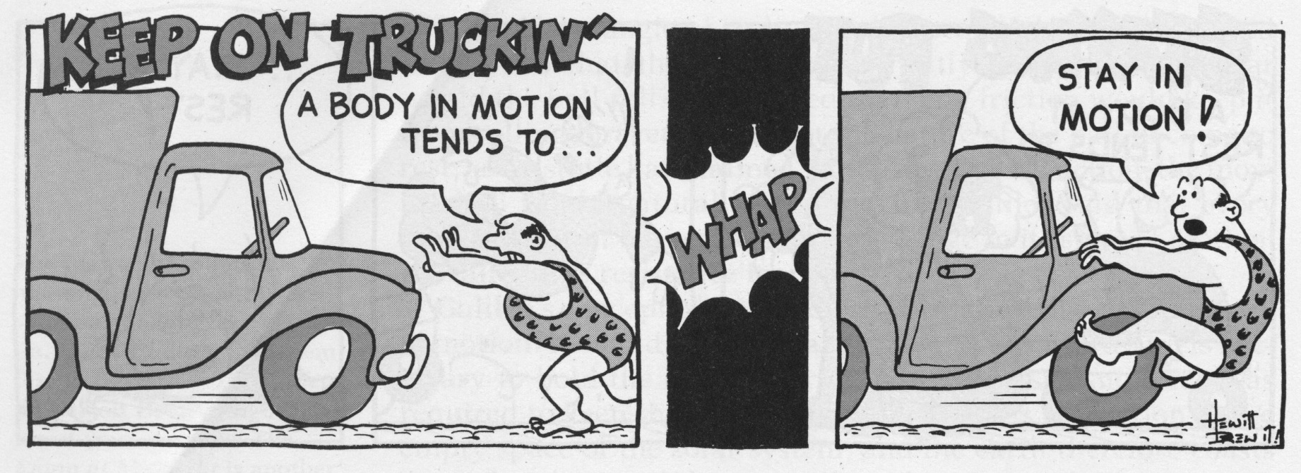
Newton’s 1st Law states
An object in motion will continue in a straight line path at a constant speed unless acted upon by an unbalanced force
Using terminology from Unit 2, we would say if there are no unbalanced forces, objects move with constant velocity

Slide 5
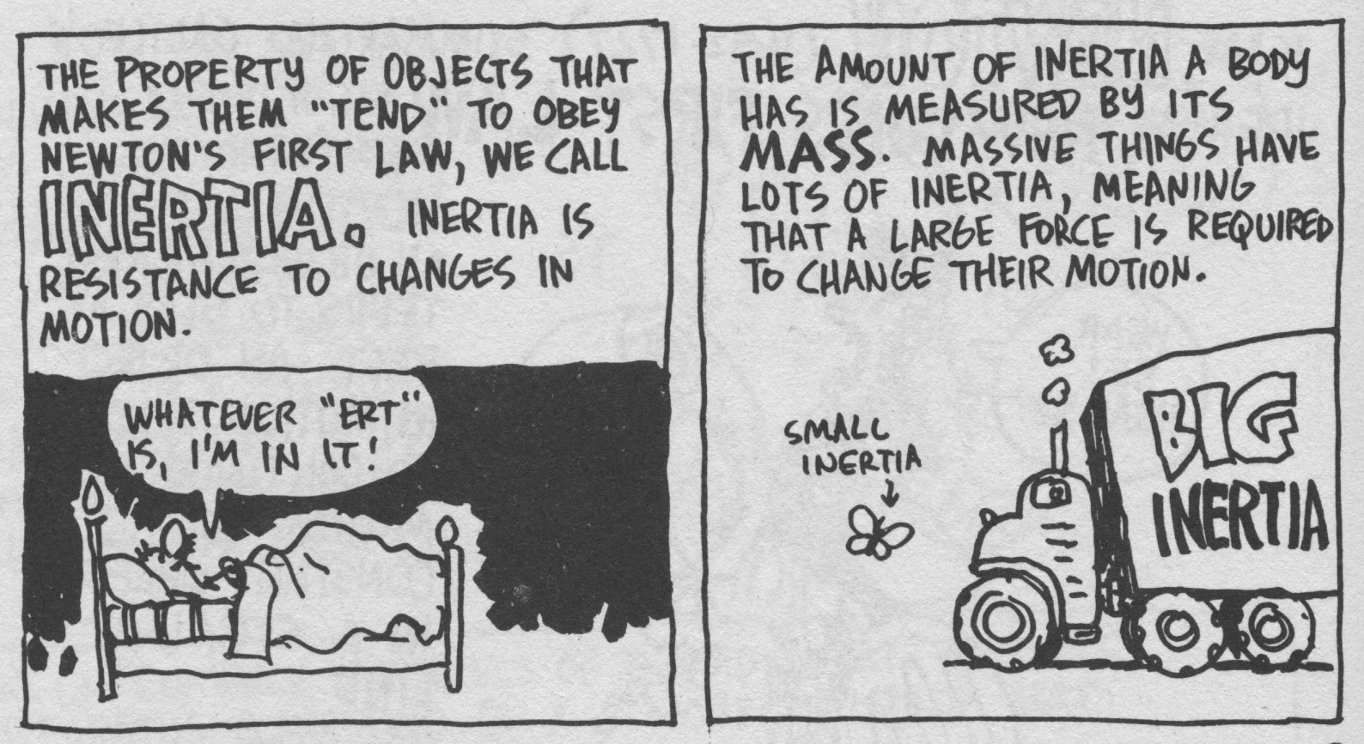
Newton’s 1st Law is also known as the law of inertia
Inertia is an object’s resistance to a change in its motion
Inertia is an inherent quality of an object
More mass ==> more inertia

Slide 6
More precisely, Newton’s 1st Law states:
“An object will remain at a constant velocity if and only if the net force acting on that object is zero.”
The remaining force on an object, which is called the net force (Unit 3 terminology: resultant)
Equilibrium:
An object is in equilibrium if and only if the net force is equal to zero
The object may be at rest OR it may be moving with a constant velocity (acceleration is zero).
Two Types of Equilibrium:
Static Equilibrium: object is at rest
Dynamic Equilibrium: object is moving with constant velocity

Slide 7
Part II: The Characters
A force is any push or pull on an object
A force is a vector quantity, which means that it has magnitude AND direction!
The unit for force is the Newton (N)
Two categories of forces:
Contact Forces: a force that is exerted by touching an object
Examples: friction, pushing an object, pull on a rope, etc.
Field Forces: a force that is exerted from a distance (without contact)
Gravitational force, magnetic forces, and electric forces.
Notes:
Interesting fact: in the English system, Weight is measured in Pounds and mass is measured in slugs!

Slide 8
Types of Forces:
Weight (F_{g}): the force due to gravity; defined as
$\boxed{F_{g}=m∙g}$
MASS (kg) IS NOT THE SAME AS WEIGHT (N)!
Normal (F_{N} or F_{norm}): the force perpendicular to a surface (usually a supporting force, but not necessarily)
Friction (F_{f} or F_{fric}): a force that resists motion resulting from two surface in contact
$\boxed{F_{f}=μ∙F_{N}}$
Tension (F_{T} or F_{tens}): the force resulting from a string, rope, etc. acting on an object
Applied (F_{app}): a force applied by another object
Notes:
Normal is a term used to indicate something is perpendicular, not ordinary

Slide 9
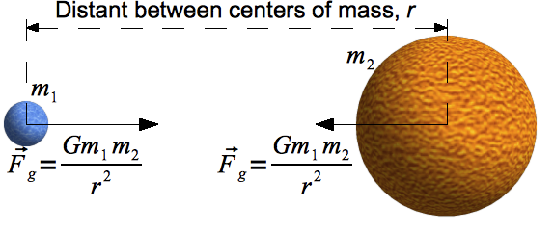
Newton’s Universal Law of Gravitation
Mass attracts mass
The magnitude of the force of attraction is proportional to the product of their masses and the inverse of the square of the distance between them
$$\boxed{F_{G}=\frac{G{∙m}_{1}∙m_{2}}{r^{2}}}$$
$$G=\text{6.67 × 10}\text{−11} \frac{m^{3}}{{kg∙s}^{2}}$$
F = gravitational force between two objects
m₁ = mass of first object
m₂ = mass of second object
r = distance between objects
G = universal constant of gravitation

Slide 10
Interlude
Draw a model of the forces acting on a 3 kg physics book sitting on a desk with you pushing on it with a 2 N force horizontally.
Compare your model with your table partners
2 N

Slide 11
Part III: The Hero
Whoa! We need to have a way to organize our information about forces acting on an object!
Never fear, Free Body Diagrams are here!
A Free Body Diagram (FBD) is used to identify all the forces acting ON an object.
A FBD is used to:
LABEL the forces acting on an object
DETERMINE which forces cancel out
FIND the remaining force on an object, which is called the net force

Slide 12
Part IV: The Decree
Here are some important rules for using FBDs:
Draw the object as a box or large dot (generally)
Indicate all forces acting on the object with arrows going away from the object
Arrow length represents the relative magnitude of the force
ALWAYS label the types of force
Remember: Forces are measured in NEWTONS (N)!!
We only draw forces on FBDs, no velocity or acceleration
F_{app}
F_{g}

Slide 13
Epilogue
Draw a FBD for YOU sitting in your seat
F_{N}
F_{g}

Slide 14
Let’s try this again, this time with a FBD:
Draw a FBD for a 3 kg physics book sitting on a desk with you pushing on it with a 2 N force horizontally (ignore friction).
2 N
F_{N}
= F_{g} ≈ 30 N
F_{app}
= 2 N
F_{g}
= (3 kg) (9.80 ^{m}/s²) ≈ 30 N

Slide 15
Imagine you have a 1 kg mass hanging at rest on a string. You pull down with a force of 12 N. Draw the resulting FBD.
F_{T}
= F_{g} + F_{app} ≈ 10 N + 12 N ≈ 22 N
F_{g}
= (1 kg) (9.80 ^{m}/s²) ≈ 10 N
F_{app}
= 12 N

Slide 16
Prologue (Revisited)
One day, you and a friend happen upon an ice-rink. The ice is perfectly level; in fact it has been recently been resurfaced with a Zamboni. You brace yourself at the edge of the rink and give your friend a quick push.
Draw a top-down, strobe motion view of your friend’s motion
Sketch qualitative d - t and v - t graphs of their motion
Clearly identify all forces present while you are pushing on your friend
Clearly identify all forces present after the push has occurred on your friend

Slide 17
Prologue (Answers)
At first your friend accelerates (during the push), but then no unbalanced force (since you’re not touching them, there’s not an applied force) so constant velocity.
a. Push Not Touching
b. d-t v-t
c. F_{app} (push), F_{g} , and F_{N}
d. F_{g} and F_{N}

Slide 18
The Story Continues…
Phun with Phree Body Diagrams
Tape and complete in your journal
Remember to follow our new FBD rules!
Due Thursday

