Slide 1
Free Fall Motion
Vertical Kinematics ☺

Slide 2
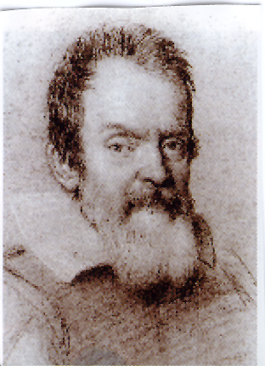
Galileo Galilei
Did You Know?
Galileo was the first to analyze motion in terms of measurements and mathematics.
He described acceleration to be the rate of change of speed (should be velocity… he didn’t know about vectors yet )
Galileo, age 60, drawn by Ottavio Leoni in 1624.

Slide 3
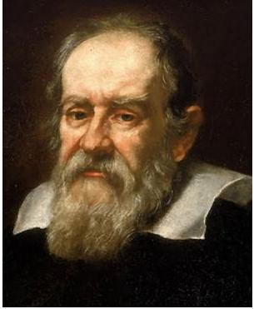
Galileo was the first person to show that all objects fall to earth with a constant acceleration.
No matter what the mass of the object is or where its dropped from the acceleration due to gravity is the same.*

Slide 4
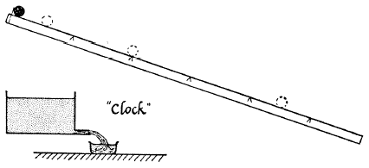
Galileo’s Ball and Channel Experiment ☺
If the free fall motion has a constant acceleration, what is this acceleration and how was it found?
He varied the starting position of the ball along the channel.
He measured the times for the ball to travel the various lengths.
He raised the channel until it was steep enough to simulate free fall.
Notes:
He varied the starting position of the ball along the channel.
He measured the times for the ball to travel the various lengths.
He raised the channel until it was steep enough to simulate free fall.

Slide 5
Galileo’s Finding
“ We compared the time for the whole length with that for the half, or with that for two-thirds, or three-fourths, or indeed for any fraction; in such experiments, repeated a full hundred times, we always found that the spaces traversed were to each other as the squares of the times, and this was true for all inclinations of the plane, i.e., of the channel, along which we rolled the ball.
-Galileo “Two New Sciences”
http://galileoandeinstein.physics.virginia.edu/lectures/gal_accn96.htm

Slide 6
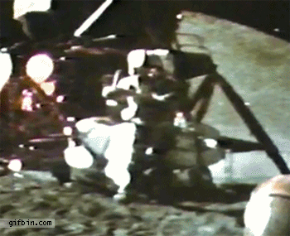
Dropping Objects in a Vacuum
The Moon has no atmosphere (there’s no air up there). This is called a vacuum!
When Apollo 15 went to the Moon, they did an experiment with a hammer and a feather.
Without air they dropped at the same rate - just as Galileo predicted!
Notes:
Demo: feather and coin

Slide 7
Acceleration Due to Gravity
In free fall, the acceleration of an object is constant.
On earth* a free falling object has an acceleration due to gravity of:
$$g=−9.80 m/{s^{2}}$$
*Quick Note: $g$ varies by location
Southern Florida: $−9.790 m/{s^{2}}$
Northern Maine: $−9.810 m/{s^{2}}$
Top of Pike’s Peak: $−9.789 m/{s^{2}}$
In our class we’ll use the “typical value”: $−9.80 m/{s^{2}}$

Slide 8
Observations About Free Fall
Falling Down:
The object begins a rest
Soon acquires downward speed
Covers more and more distance each second (speeds up)
Throwing Up:
Starts with upward velocity
Covers less and less distance each second (slows down)
Rises to a certain height
Comes briefly to a stop
Descent has “falling down” observations
Notes:
Demonstration: Drop Ball
Demonstration: Toss Ball

Slide 9
Observations About Free Fall
Now for the physics-y words
Falling Down:
Motion is in the negative (downward) direction
Velocity increases → constant acceleration
$g=−9.80 m/{s^{2}}$
$v_{1}=0m/s$
Throwing Up:
Motion is in the positive (upward) direction
Velocity decreases → constant acceleration
$g=−9.80 m/{s^{2}}$
$v_{top}=0m/s$
Rises to a certain maximum height
Notes:
Demonstration: Drop Ball
Demonstration: Toss Ball

Slide 10
Dropping - Falling Downward
$v_{1}=0m/s$
Velocity increases
Constant acceleration
Motion in - direction
Notes:
Demo: ball drop with hand timer
Demo: inclined plane and bowling ball

Slide 11
Throwing - Falling Upward
$v_{top}=0m/s$
Velocity decreases
Constant acceleration
Motion in + direction
Notes:
Demo: ball drop with hand timer
Demo: inclined plane and bowling ball

Slide 12
Objects moving upward slow down until their direction is reversed and then they accelerate downward.
At the top of their path the upward speed is zero. Only instantaneously.
A constant acceleration means the speed is changing all the time, so the speed only passes through the value of zero at the top of the path.

Slide 13
UPDATE TO EQUATIONS!
$v_{2}=v_{1}+at$
$v_{1}$ or $v_{2}$ will be 0
$a=g=−9.80m/{s^{2}}$
$d=v_{1}t+\frac{1}{2}at^{2}$
$v_{1}$ will be 0
$a=g=−9.80m/{s^{2}}$
$$v=gt$$
$$d=\frac{1}{2}gt^{2}$$

Slide 14
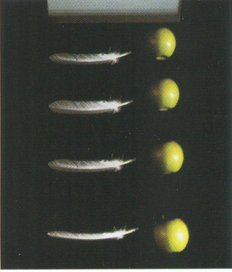
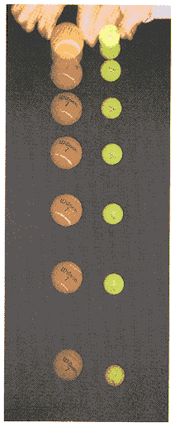
*Dropping Objects on Earth
In air, the larger the object is and the faster it is falling the greater the air’s resistance to its motion, as skydivers all know…
When most of the air is removed from a container, feathers and apples fall almost side-by-side.
Notes:
Demo: feather and coin

