Slide 1
Light and Color
More on The visible Spectrum

Slide 2
The Visible Spectrum
Spectrum is the term Sir Isaac Newton assigned to the pattern produced when sunlight went through a prism.
Newton was very fascinated with light. In fact he created an entire field dedicated to its study: optics
White light is composed of all the colors of the spectrum → ROYGBIV
Longest wavelength: red (700 nm)
Shortest wavelength: violet (400 nm)

Slide 3
Continuous Visible Spectrum
The visible spectrum is a continuous spectrum, meaning that it is a smooth distribution of wavelength with no gaps:

Slide 4
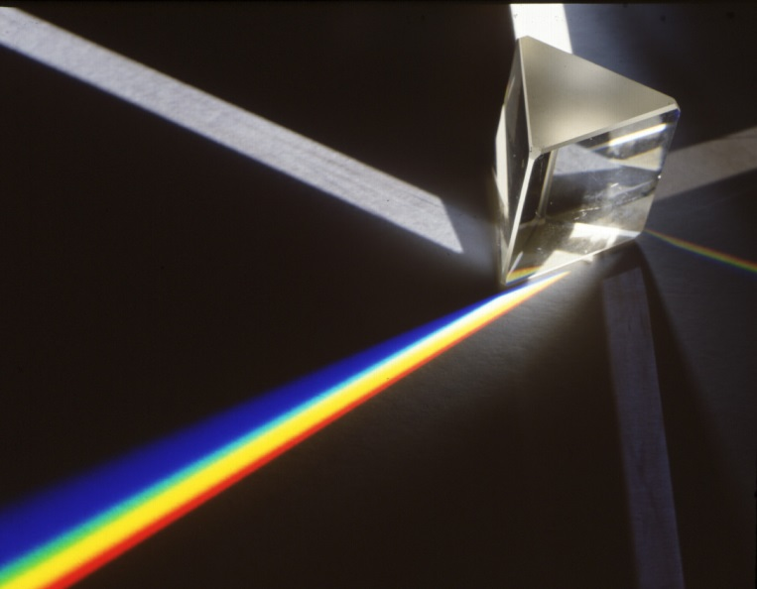
Light Passing Through a Prism
We can prove that white light is composed of all the colors of light by passing it through a prism
When light passes into the glass
prism, it is refracted.
The refractive index (n) of many
materials, like glass, depends on
wavelength.
This phenomena is known as dispersion and it causes the different colors of light to refract at different angles; thus creating the visible spectrum!

Slide 5
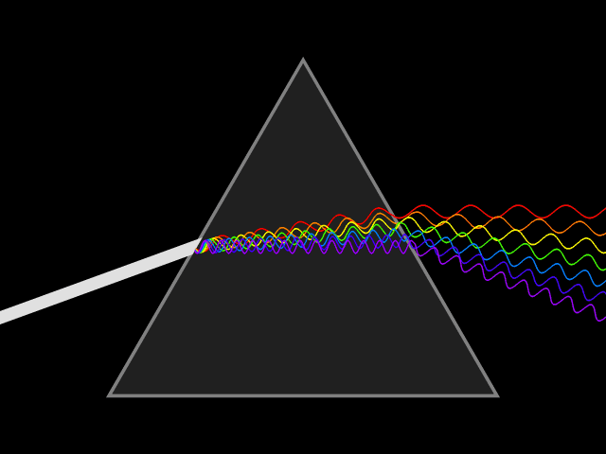
Dispersion of Light Through a Prism

Slide 6
How Do Our Eyes Work?
Light enters our eyes through the lens. It is refracted and as a result, the focused image projected on the retina is smaller and inverted:

Slide 7
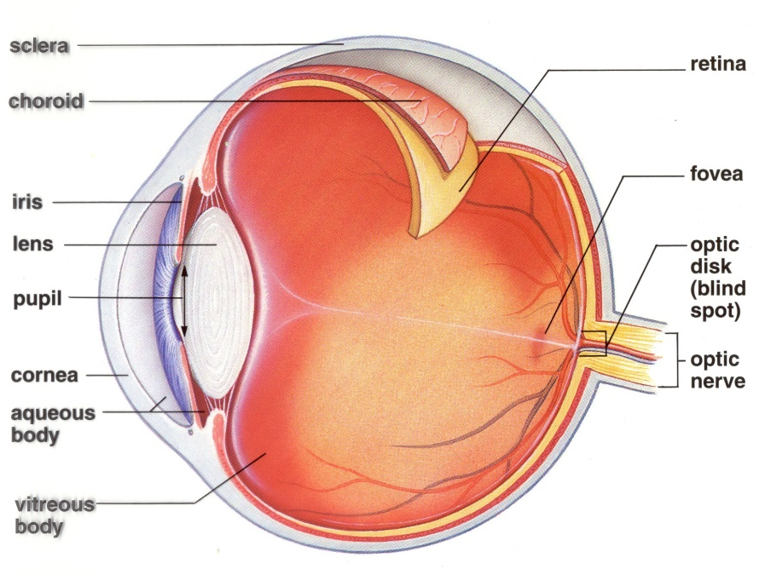
How Do Our Eyes Work?
The image is projected on the retina
The retina has two types of photoreceptors: rods and cones
Rod cells receive low levels of
light, allowing us to see in the dark
Cone cells receive light and allow
us to see in color
3 types of cones each respond to
the primary colors of light

Slide 8
Color Mixing!
Primary colors are colors that cannot be created by combining other colors
For light, the primary colors are RED, BLUE, and GREEN
Secondary colors are colors that are created by mixing two primary colors
Secondary colors of light: CYAN, MAGENTA, and YELLOW
Complementary colors are a pair of colors consisting of a primary color and the secondary color created by combining the two remaining primary colors
RED and CYAN
BLUE and YELLOW
GREEN and MAGENTA

Slide 9
YELLOW
GREEN
RED
WHITE
CYAN
MAGENTA
BLUE
COPY INTO YOUR JOURNALS!

Slide 10
Additive Color Mixing
The colors that we see are the result of light REFLECTING off a surface
If blue light and green light are reflected off a surface, we see cyan
If red and green light are reflected, we see yellow
And if red and blue light are reflected, we see magenta
This is called additive color mixing because we are adding light together upon reflection off the surface
This type of color mixing is used in televisions, computers, and projectors

Slide 11
Subtractive Color Mixing
Since we see reflected colors, that means some colors of light didn’t reach our eyes
Otherwise we would see white light all the time… boring…
Because we see “left overs” have been subtracted from the white light, this is known as subtractive color mixing
This is utilized in dyes, pigments, and printing
A dye is a molecule that will absorb certain wavelengths of light and either transmits or reflects others
A pigment is a colored material (larger than molecule) that absorbs certain colors and transmits or reflects others

Slide 12
Subtractive Color Mixing
Primary color for pigment absorbs one color of light and reflects the other two:
Cyan: absorbs red light, reflects blue and green light
Magenta: absorbs green light, reflects red and blue light
Yellow: absorbs blue light, reflects red and green light
Secondary color for pigment absorbs two primary colors of light and reflects the one remaining:
Red: absorbs blue and green light
Blue: absorbs red and green light
Green: absorbs blue and red light
When all three primary pigments are mixed together, ALL light is absorbed, and NO light is reflected. Therefore we see BLACK.

Slide 13
A
COPY INTO YOUR JOURNALS!
Additive Color Mixing
Subtractive Color Mixing
YELLOW
YELLOW
GREEN
RED
WHITE
GREEN
RED
CYAN
MAGENTA
BLACK
BLUE
CYAN
BLUE
MAGENTA
(Light)
(Pigments/Dyes)

Slide 14
After Images
We’re going to see proof of our eyes in action!
Stare at the following images for the full 45 seconds asked
I will then flip to a blank slide at which time you should record what you observe
Ready? GO!

Slide 21
So What Just Happened!?
When we expose our eyes to a color of light for an extended period of time, the cones in our eyes become fatigued
They adapt to the overstimulation and lose sensitivity to that wavelength of light
When we remove the color, an illusion of the complementary color appears
This is because the other two types of cones are not fatigued, so they send out a strong signal that is interpreted as the combination of the two colors, aka – the complementary color of the original stimulus.
As the cones are given time to rest, they are no longer fatigued and the illusion fades

Slide 22
Doppler Effect for Light
The Doppler effect also comes into play with light!
Instead of a change in pitch as with sound, we see a change in color (wavelength) for light.
If an object moves towards us, the wavelength is shorter, thus more blue.
We call this blue shift
If an object moves away from us, the wavelength is longer, thus more red.
We call this red shift
Astronomers used this idea to determine the universe is expanding at an accelerating rate

Slide 23
