Slide 1
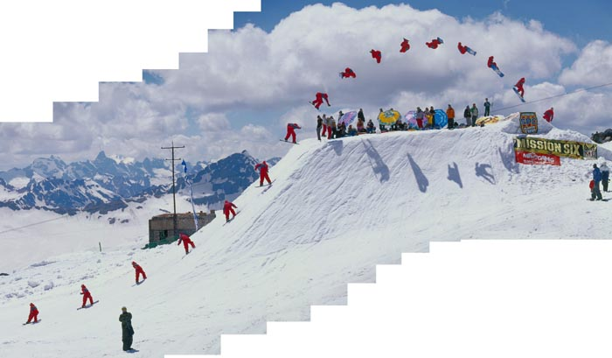
Projectile Motion

Slide 2
Projectile Motion
Describes the motion of an object in TWO dimensions
We’ll keep it simple by considering motion close to the surface of the earth (for the time being)
Neglect air resistance to make it simpler
Ties together all physics concepts learned this semester

Slide 3
Projectile Vocabulary
Range: the horizontal displacement of a projectile
Trajectory: The path the projectile follows while in the air
Flight Time (or Hang Time): The total amount of time the projectile is in the air.
Maximum Height: The vertical displacement a projectile has reached when its vertical velocity is zero.

Slide 4
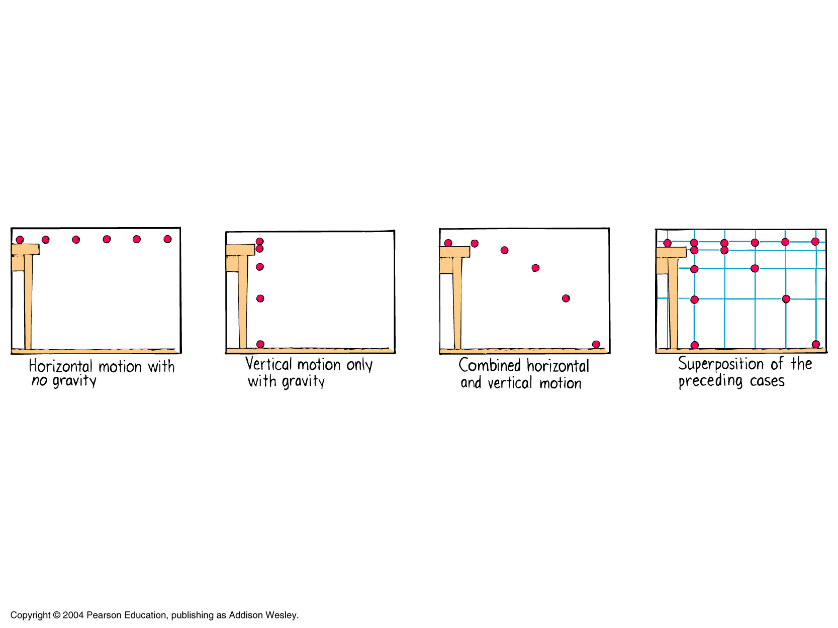
Horizontal vs. Vertical Components
The ball is in free fall vertically and moves at constant speed horizontally!!!

Slide 5
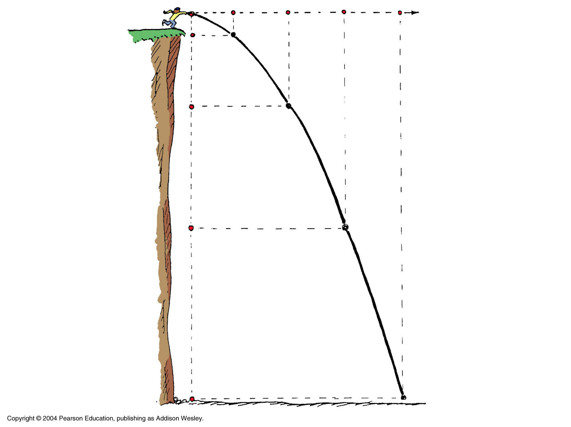

Slide 6
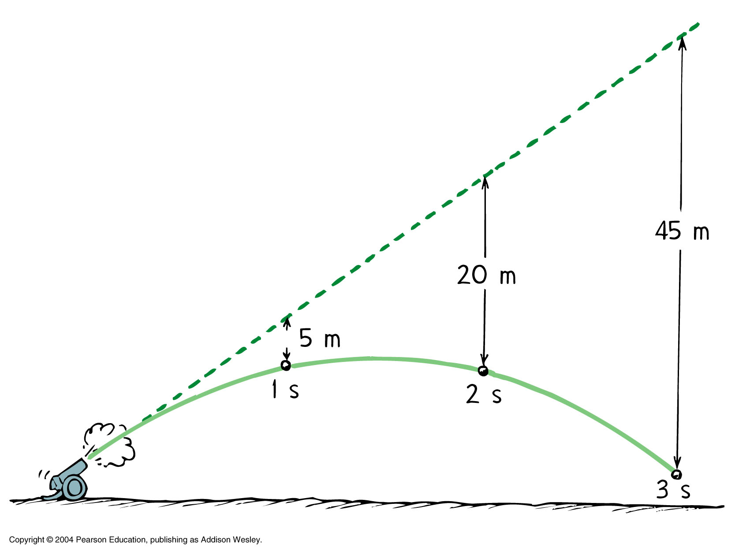
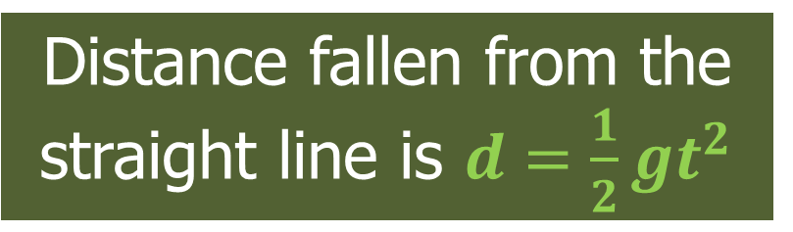
Distance fallen from the straight line is $d=\frac{1}{2}gt^{2}$

Slide 7
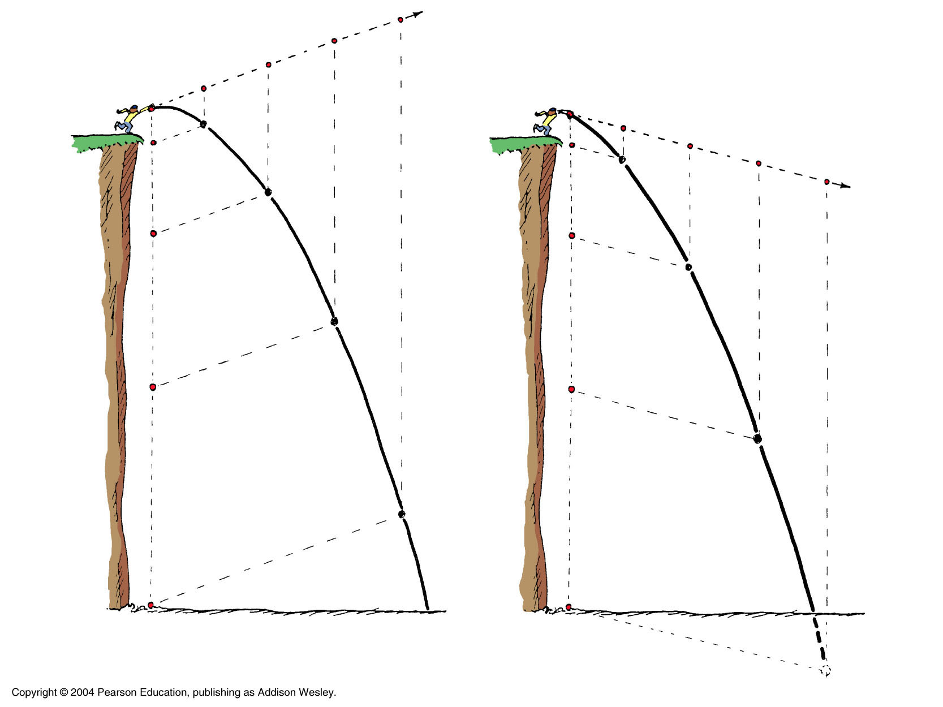

Slide 8
Velocity Components
Projectile motion can only be analyzed by breaking the initial velocity into its horizontal and vertical components:
Just like with horizontal launches, the horizontal velocity will remain constant, while the vertical motion will be affected by gravity
v
θ

Slide 9
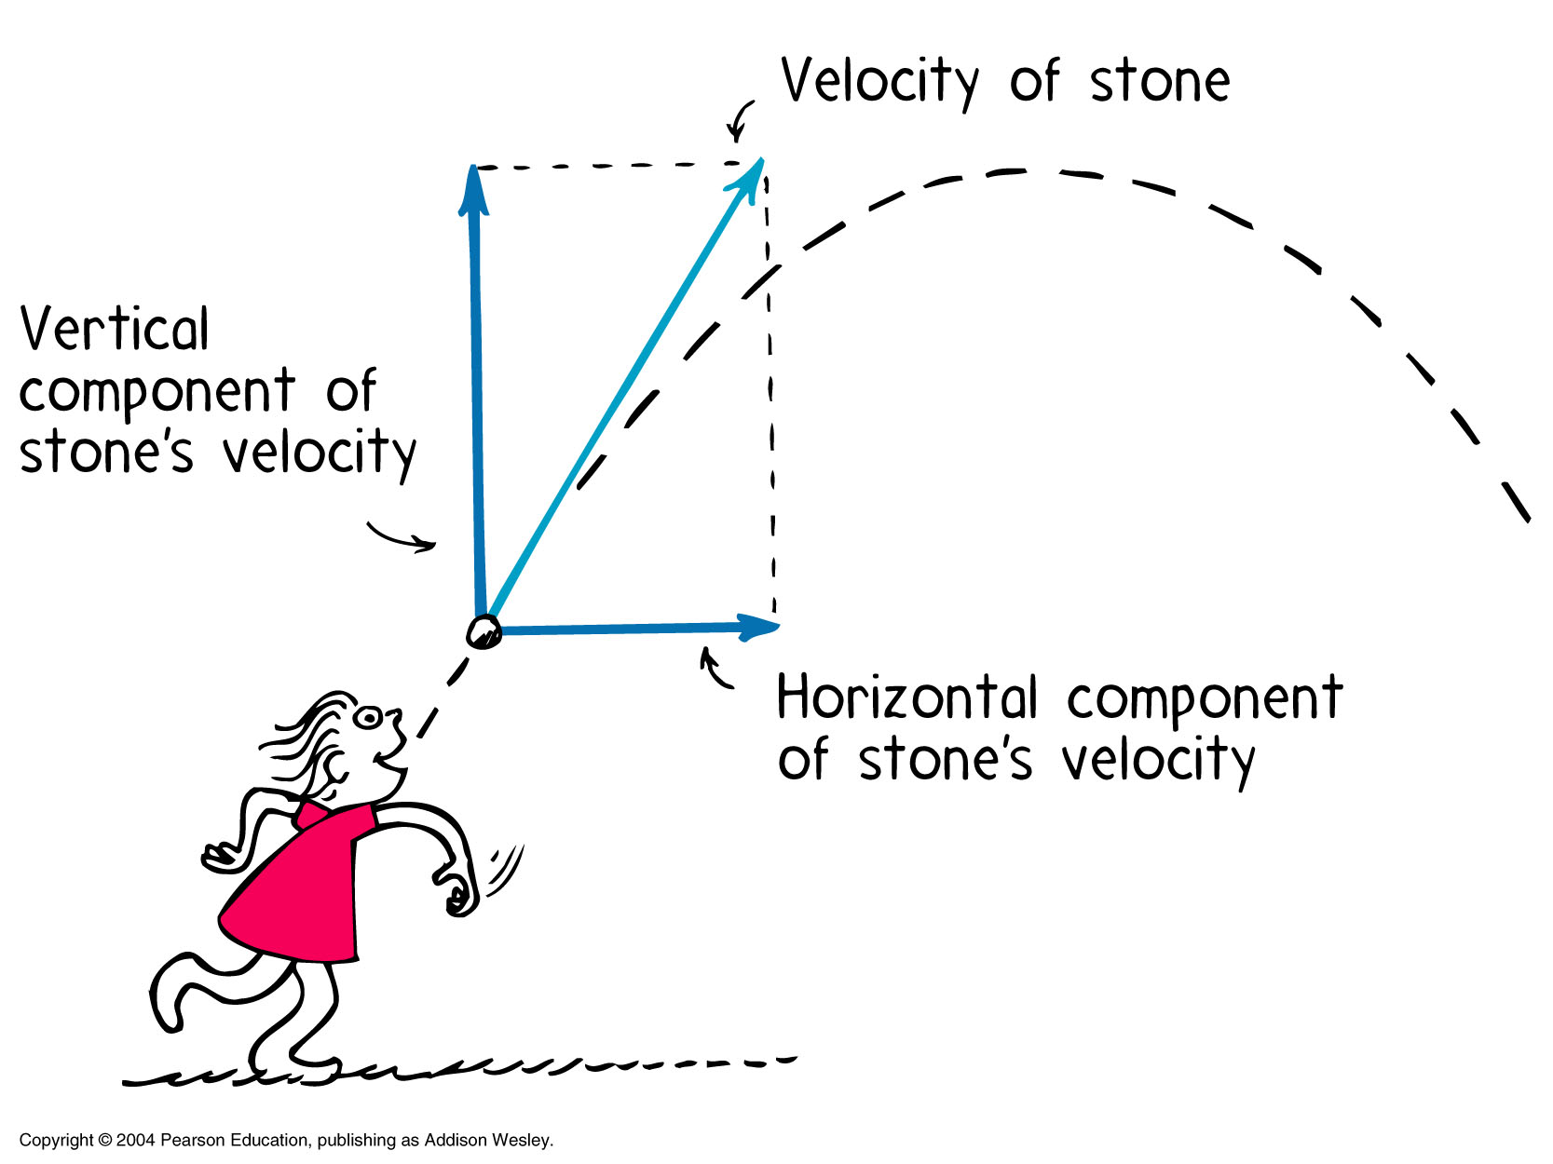
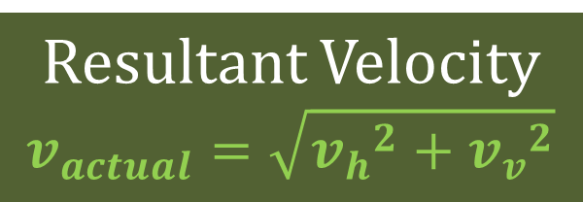
Resultant Velocity
$$v_{actual}=\sqrt{{v_{h}}^{2}+{v_{v}}^{2}}$$

Slide 10
Problem Solving Technique:
Just like with horizontally launched projectiles, you must separate all variables into the appropriate direction:
* IF returning to same vertical level
Horizontal
(x-direction)
Vertical
(y-direction)

Slide 11
Horizontal Equations
Constant velocity due to inertia and air drag is assumed negligible
Horizontal Velocity
Horizontal Displacement (Range)

Slide 12
Vertical Equations
Behaves like an object in free fall

Slide 13
Range Equation
The kinematic equations for the vertical and the horizontal directions can be combined mathematically in order to solve for the horizontal range WITHOUT KNOWING THE TIME IN THE AIR!
R = range (m)
V_{i} = overall launch velocity (the total vector quantity) (m/s)
g = 9.80 m/s² → IMPORTANT: this is NOT negative!

Slide 14
What Influences an Objects’ Range?
Launch Angle
  Near vertical launch angle results in greater height
  Near horizontal decreases the time to fall
Vertical Velocity
Horizontal Velocity
Vertical position

Slide 15
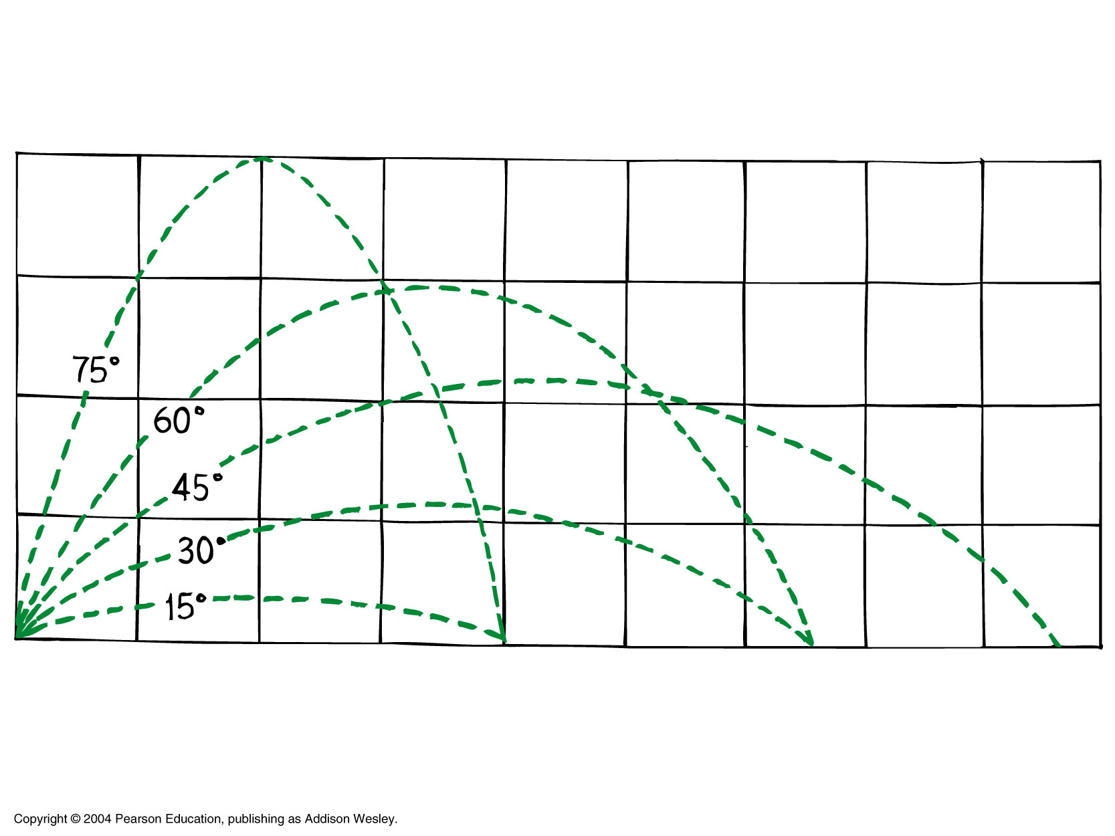

Slide 16
Projectile Motion
The trick to maximum range is just to keep the object off the ground for as long as possible.
This allows the horizontal motion to be a maximum since d_{h}=v_{h}∙t
Make range longer by going higher for your starting point
Make range longer by having more velocity

Slide 17
