Slide 1
Wave Behavior in Sound Waves and Resonance!

Slide 2
Reflection
When a sound wave reflects, we hear an echo!
When we create sound electronically, we mimic this echo with something called reverb.
Hard surfaces reflect sound the best
This is why bathrooms have awesome acoustics!
Soft, air-filled object absorb sound.
Higher frequency sounds are absorbed more, which is why noise from adjacent rooms sounds lower
Sound that passes through walls is transmitted

Slide 3
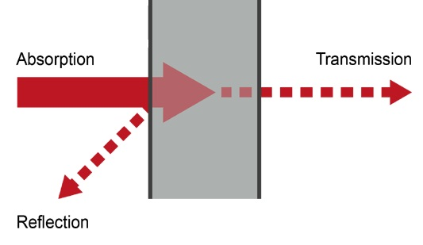

Slide 4
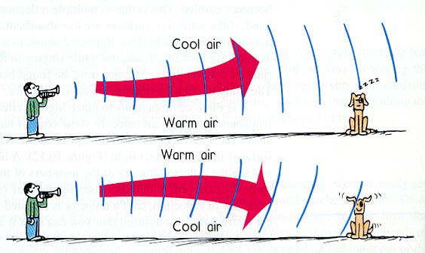
Refraction
Sound is also refracted when it changes mediums!
One common way sound is refracted occurs when air is at different temperatures.
Remember:${ v}_{sound}=331+0.6 T$

Slide 5
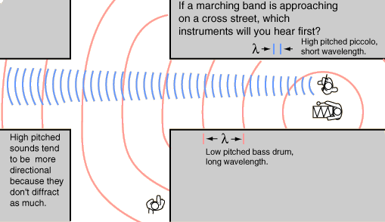
Diffraction
Sound can also be diffracted
That’s why we can still hear people talking when they’re around the corner!

Slide 6
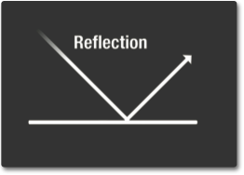
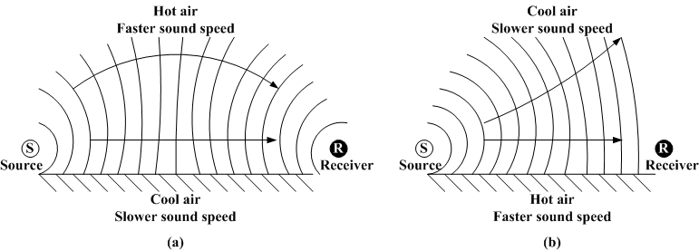
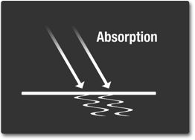
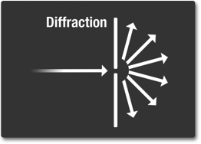
Quick Review!
Refraction

Slide 7
Interference
Interference occurs when two sounds of difference frequency are heard superposed.
Constructive interference causes louder sound and destructive inference cause fainter sound.
This alternating pattern produces a beat.

Slide 8
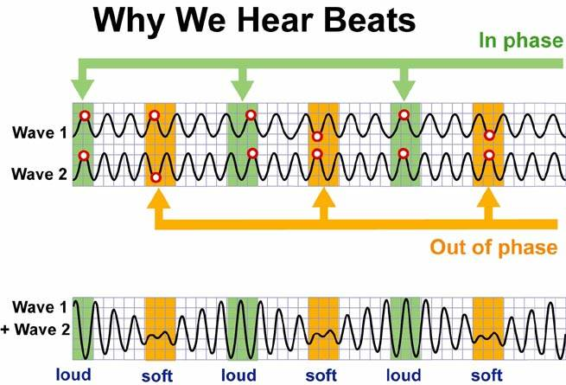
The number of beats you hear per second gives the beat frequency.
The beat frequency is equal to the difference in pitch of the two sound waves!

Slide 9
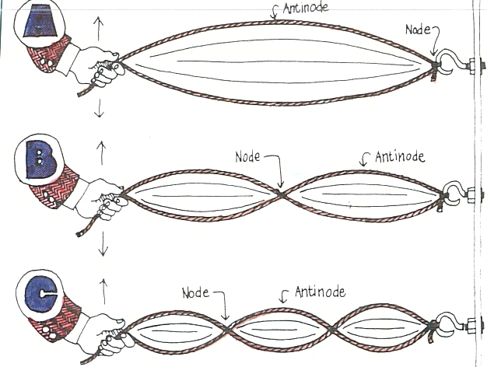
Standing Waves
A standing wave occurs when a wave reflects upon itself and interference causes the pattern
The material must have definite boundaries
Nodes remain stationary due to destructive interference
Anti nodes occur half way between nodes and are points of maximum displacement

Slide 10
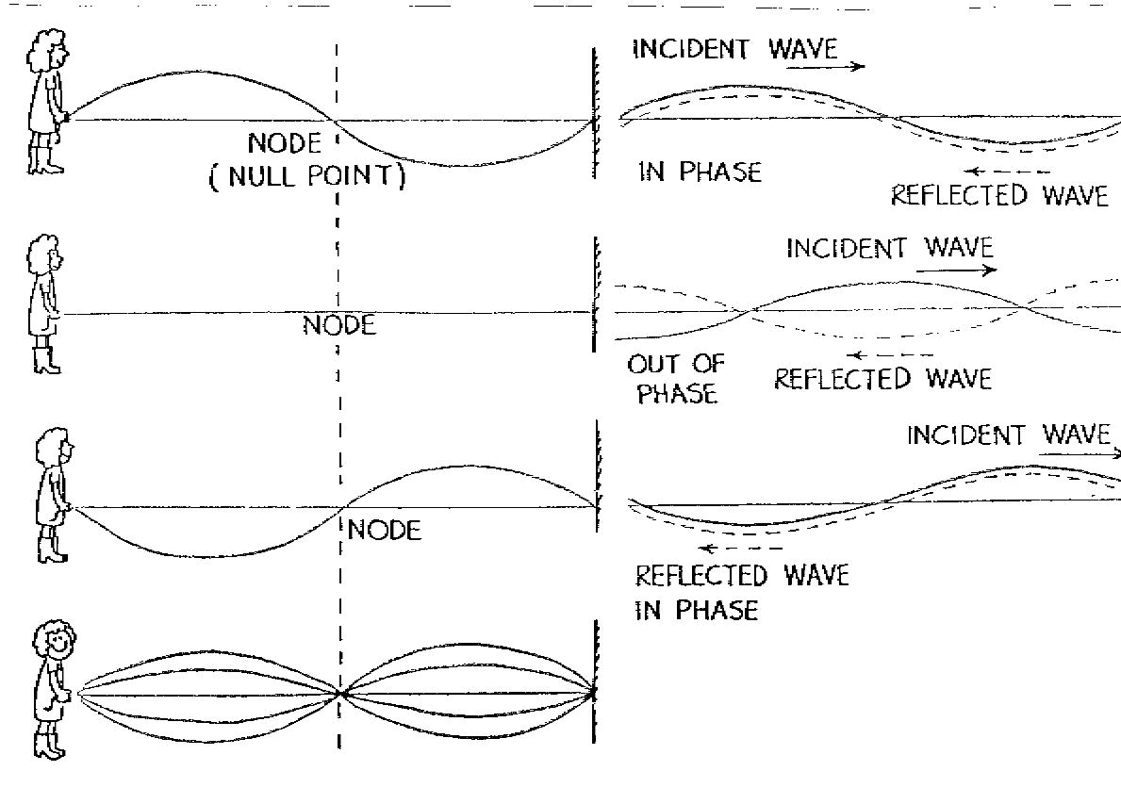
Standing Waves
For a standing wave to occur, the interfering waves must have the same amplitude and wavelength and must be traveling in opposite directions
Increasing the frequency of the wave creates more nodes and anti-nodes!

Slide 11
What is Resonance?
Most objects have a natural frequency, which is the frequency at which they will naturally vibrate.
If some wave source, like a sound speaker, is placed near an object, the sound waves from the speaker will transfer energy to it and cause it to begin vibrating.
If the frequency of the sound wave is exactly the same as the object’s natural frequency, standing waves will form in the object.

Slide 12
What is Resonance?
Because the wave frequency of the wave source matches the natural frequency of the object, it will vibrate (oscillate) at a maximum amplitude
If the amplitude of the incoming sound wave is increased, then the amplitude of the standing wave in the object will also increase
Resonance will also occur at other regular multiples of the natural frequency…

Slide 13
Harmonics
Fundamental Frequency: (a.k.a. first harmonic)
The lowest frequency that will cause a standing wave to form on a string or in a column of air
Harmonic Frequencies: (a.k.a. resonant frequencies, overtones)
Any frequency that causes a string or a column of air to resonate (a standing wave is formed)
Will be some whole number multiple of the fundamental frequency
The presence and intensity of overtones determines the quality of the music/tone

Slide 14
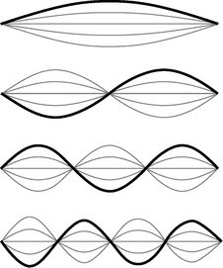
Harmonics on a String
In your journals, sketch the appearance of the string for the following harmonics:
1st Harmonic/Fundamental Frequency:
2nd Harmonic/1st Overtone:
3rd Harmonic/2nd Overtone:
4th Harmonic/3rd Overtone:
List the wavelength (λ), in terms of the length of the string (L) for EACH of these harmonics.

Slide 15
Harmonics on a String
1st Harmonic/Fundamental Frequency
Wavelength (λ) = 2L
Frequency = f_{o}
2nd Harmonic/1st Overtone
Wavelength (λ) = $L$
Frequency = 2f_{o}
3rd Harmonic/2nd Overtone
Wavelength (λ) = $\frac{2L}{3}$
Frequency = 3f_{o}
4th Harmonic/3rd Overtone
Wavelength (λ) = $\frac{L}{2}$
Frequency = 4f_{o}

Slide 16
Harmonics on a String
General Relationship for standing waves on a string:
$$L=\frac{n∙λ}{2}$$
n = harmonic number (1, 2, 3, …)
L = length of string

Slide 17
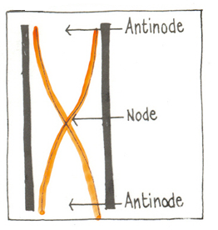
Open End Resonance
Open End Resonator:
Any column of air that is open at both ends
Antinodes will always be found at both ends
At the fundamental frequency:
$$L=\frac{λ}{2}$$

Slide 18
Harmonics in an Open Pipe
2nd harmonic 3rd harmonic 4th Harmonic
Sketch the waveforms that would represent the displacement of the air molecules within the air column. What, in terms of the length of the pipe (L), is the wavelength (λ) for each of these?

Slide 19
Harmonics in an Open Pipe
Wavelength (λ) = 2L
$$L=\frac{n∙λ}{2}$$
Wavelength (λ) = L
Wavelength (λ) = $\frac{2}{3}$ L
Wavelength (λ) = $\frac{1}{2}$ L

Slide 20
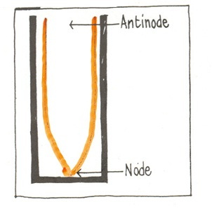
Closed End Resonance
Closed End Resonator:
Any column of air that is closed at one end only.
It is open at the other end
Nodes will ALWAYS be found at the closed end
Antinodes will ALWAYS be found
at the open end
At the fundamental frequency:
$$L=\frac{λ}{4}$$

Slide 21
Harmonics in a Closed Pipe
3rd Harmonic 5th Harmonic 7th Harmonic
NOTICE: Only odd harmonics are present!
Sketch the waveforms that would represent the displacement of the air molecules within the air column. What, in terms of the length of the pipe (L), is the wavelength (λ) for each of these?

Slide 22
Harmonics in an Closed Pipe
Wavelength (λ) = 4L
Wavelength (λ) = $\frac{4}{3}$ L
$$L=\frac{n∙λ}{4}$$
Wavelength (λ) = $\frac{4}{5}$ L
Wavelength (λ) = $\frac{4}{7}$ L

