Slide 1
Sound Waves
How sound travels and how we hear it!

Slide 2
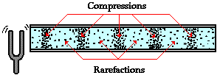
Properties of Sound
Sound waves are longitudinal waves
When a tuning fork vibrates, it creates areas of high pressure (compressions) and low pressure (rarefactions).
As the tines of the fork vibrate back and forth, they push on neighboring air particles to the right.
The backward retraction of the tine creates a low-pressure area allowing the air particles to move back to the left

Slide 3
Speed of Sound
Sound needs a medium to travel: solid, liquid, gas
The speed of sound in air depends on its temperature:
$$v_{sound}=331+0.6 T$$
We’ll generally use 343 $m/s$ (sea level, room temperature: 20°C)
Faster in solids and liquids than in gases

Slide 4
Speed of Sound
Medium | Velocity (m/s)
Air (0°C) | 331
Air (20°C) | 343
Water (25°C) | 1493
Sea Water | 1533
Copper | 3560
Iron | 5130
Glass | 5640
Diamond | 12,000

Slide 5
Sound Loudness
Related to the amplitude of the sound wave
Amplitude is the measure of the variation in pressure along the wave
Small pressure variations are perceived as softer sounds than those with large pressure variations
The larger the pressure variation, the more it "hurts" to listen to the sound.
Loudness is perceived differently by different people.

Slide 6
Sound Intensity
Intensity is the power of the sound per unit area
AKA sound level – depends on energy of wave
Measured in decibels (dB)
Measured by comparing the pressure variation of a sound to the pressure variation of the softest audible sound (0 dB)
A 10 dB increase in sound is typically perceived as “twice as loud.”

Slide 7
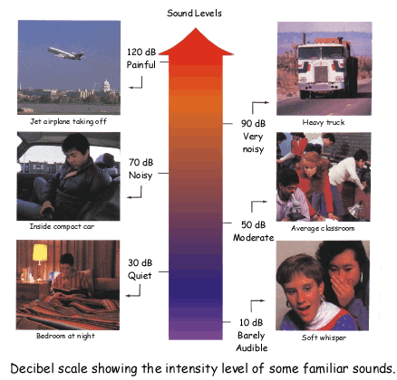
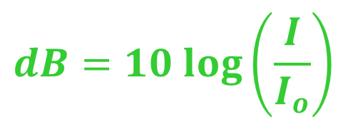
The Decibel Scale
$$dB=10 log⁡\left(\frac{I}{I_{o}}\right)$$
$$I_{o}=1×{10}^{−12}W/{m^{2}}$$

Slide 8
Think-Pair-Share!
Rank the following from highest to lowest on the decibel scale:
Threshold of Hearing
Threshold of Pain
Fire Alarm at School
Vacuum Cleaner
Jack Hammer
Rock Concert
Rustling Leaves
Excited Crowd at a Sporting Event
iPod at Maximum Volume
Rifle Shot
Dishwasher
Light Rainfall
Alarm Clock

Slide 9
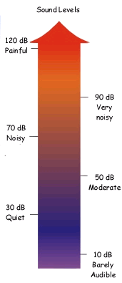
Rock Concert (~150 dB)
Rifle Shot (~140 dB)
Excited Crowd (127 dB)
Threshold of Pain (120 dB)
iPod at Max Volume (120 dB)
Fire Alarm at School (105 dB)
Jack Hammer (100 dB)
Alarm Clock (75 dB)
Running Dishwasher (55 dB)
Vacuum Cleaner (60 dB)
Light Rainfall (40 dB)
Rustling Leaves (30 dB)
Threshold of Hearing (0 dB)

Slide 10
Pitch
The pitch of a sound is associated with its frequency
When particles vibrate more quickly, a higher sound is produced
Thus, higher frequency means higher pitch
PREDICT: Which tuning fork will have a higher pitch? How do you know?

Slide 11
Range of Hearing
The maximum range for human hearing is between 20 Hz and 20 kHz (20,000 Hz)
Most sensitive to 400 Hz to 7,000 Hz
Elephants can hear 16 Hz – 12 kHz
Dogs can hear 50 Hz – 35 kHz
Cats can hear 45 Hz – 85kHz
Bats can hear over 100 kHz!

Slide 12
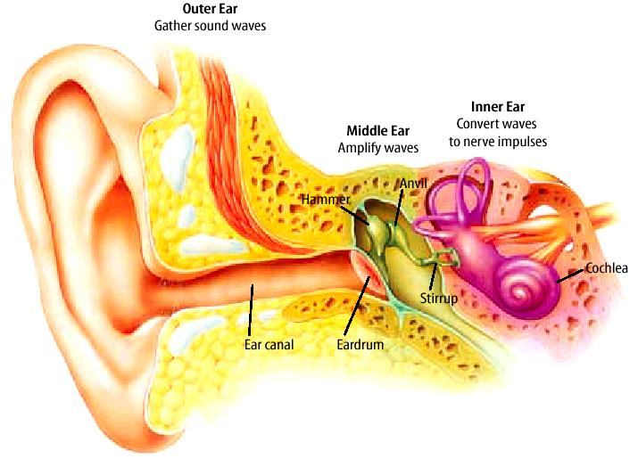
How Do We Hear?
5. Nerves carry the energy to your brain, these nerves correspond to frequency! The brain interprets these signals as sound!
4. The fluid in the cochlea moves
1. Sound enters your ear!
3. The bones in your ear vibrate
2. Sound vibrates your ear drum

Slide 13
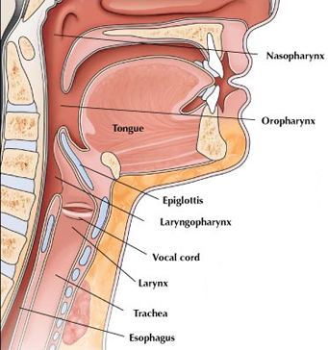
How Do We Make Sound?
Air from the lungs flows through the windpipe and into the voice box (where the vocal cords are).
Then the air pushes the vocal cords apart making them vibrate.
The vibrations create a series of sound waves that exit through your mouth.
The change of shape of the vocal cords changes the sound and its pitch.
If you can’t talk because of a cold or laryngitis, it is because your vocal cords are swollen and inflamed.

Slide 14
Out of Range
Infrasonic frequencies are those that are LOWER than 20 Hz – “felt” vs. heard
i.e. – some sub-woofers, thunderstorms, earthquakes, elephants
Ultrasonic frequencies are HIGHER than 20 kHz
i.e. – sonar, medical ultrasounds, bats, whales, and dolphins
Echolocation – process in which echoes are used to determine the distance between objects
Used to determine size/shape of buried objects or to observe a fetus in the womb

Slide 15
Doppler Effect
The Doppler Effect is the APPARENT change in the frequency as a result of relative movement between the source of sound and the observer
i.e. – sirens, trains, planes, etc.
Since velocity is constant, apparent change in wavelength causes an apparent change in frequency
When the source is moving TOWARDS you, the pitch you hear will be HIGHER than the source
When it is moving AWAY from you, the pitch will sound LOWER than the source

Slide 16
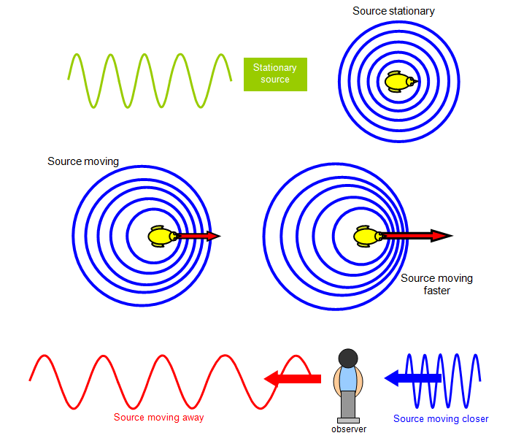

Slide 17
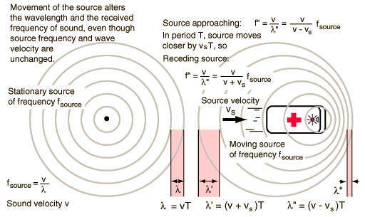
$$λ_{observer}=\frac{v_{sound}±v_{source}}{f_{source}}$$
$$f_{observer}=\frac{v_{sound}}{v_{sound}±v_{source}}{ f}_{source}$$

Slide 18
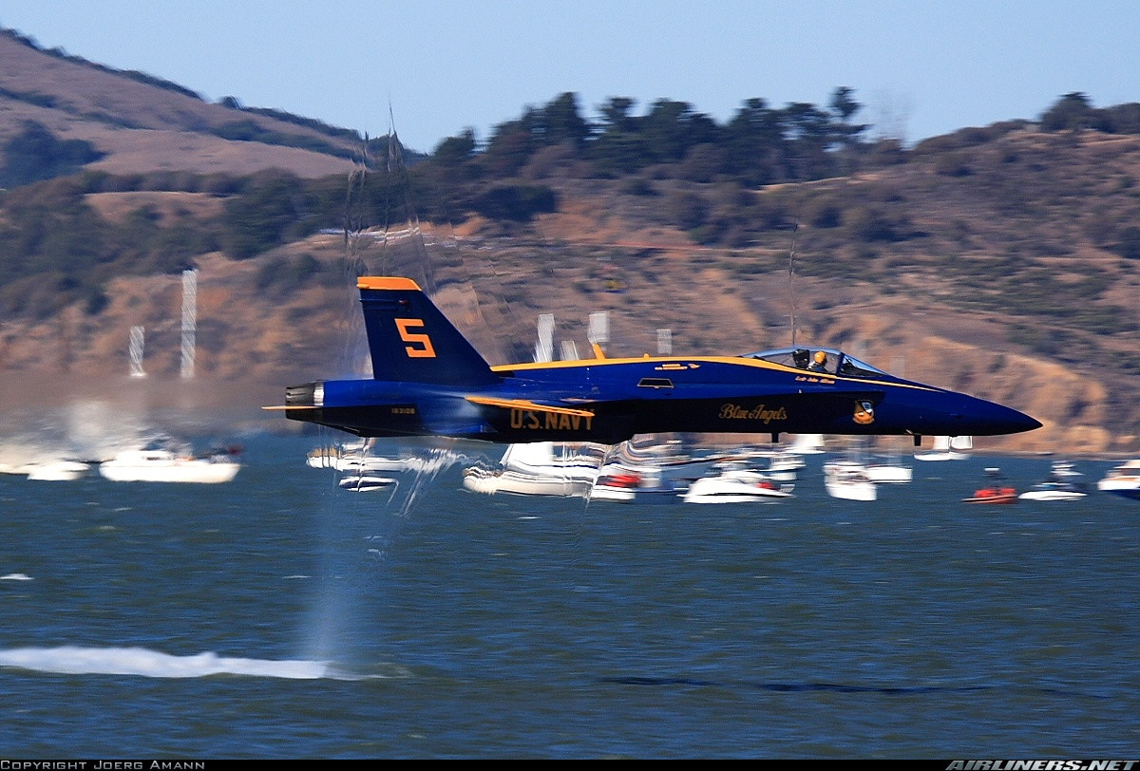
Sonic Boom
If the source is moving at the speed of sound (or faster!), the sound waves “pile up” into a shock wave called a sonic boom
Supersonic is
faster than sound
Subsonic is
slower than sound
Sonic booms
sound much like
pressure waves
from explosions!

Slide 19
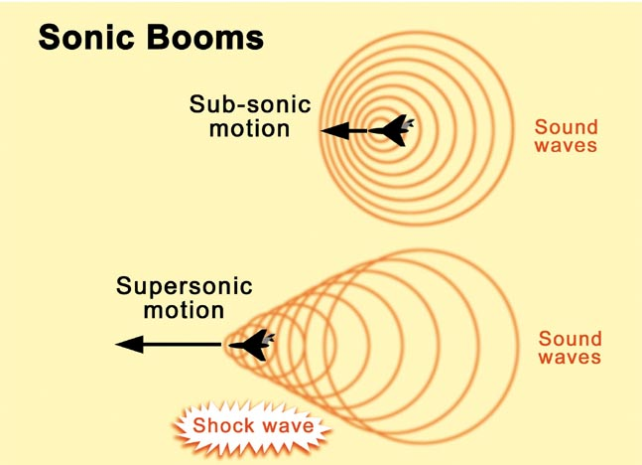

Slide 20
Mach Travel
Mach speeds are speeds at or above the speed of sound
Mach 1 = speed of sound
Mach 2 = twice the speed of sound
To find the Mach number, find the ratio of an objects velocity to the speed of sound (how many times faster than the speed of sound):
$$M=\frac{v}{v_{sound}}$$

