Slide 1
Ultraviolet Radiation

Slide 2
Light from the Sun
The sun emits radiation of different wavelengths.
Some radiation has wavelengths (the visible spectrum) to which our eyes respond.
Beyond these wavelengths is radiation in the ultraviolet (UV) and infrared range that our eyes cannot see.
Unprotected exposure to UV radiation can cause skin and eye damage.

Slide 3
Types of Ultraviolet Radiation
 | UV-A | UV-B | UV-C
Wavelength (nm) | 315-400 | 280-315 | 100-280
Absorbed by ozone layer? | Not absorbed | Mostly absorbed | Near complete absorption
Percent on Earth’s Surface | > 98% of UV is UV-A | < 2% of UV is UV-B | Negligible amount
Human Impact | Causes tanning Contributes to: Skin cancer Aging Wrinkles Eye Damage | Causes sunburn Induces: Skin cancer Melanoma Aging Wrinkles Cataracts | None on Earth

Slide 4
Factors that Influence UV Intensity:
Position of the sun which varies with time of the year, time of the day and the latitude.
The higher the sun's position, the higher the UV intensity.
Amount of ozone in the atmosphere.
Ozone absorbs UV radiation. The more abundant the ozone in the atmosphere, the less the amount of UV radiation reaching the Earth's surface.
Clouds and haze.
UV radiation is both absorbed and scattered by clouds and haze.

Slide 5
Factors that Influence UV Intensity:
Ground reflection.
Most natural surfaces such as grass, soil, and water reflect less than 10% of UV. However, fresh snow strongly reflects (80%) UV. Sand also reflects 10-25% of UV.
Altitude above the sea level.
The higher the altitude, the higher the UV intensity. This is because the depth of the atmosphere and therefore the amount of ozone available to absorb UV radiation is reduced.

Slide 6
UV and Cancer
By damaging the skin's cellular DNA, excessive UV radiation produces genetic mutations that can lead to skin cancer.
Both the U.S. Department of Health and Human Services and the World Health Organization have identified UV as a proven human carcinogen.
A tan results from injury to the skin's DNA; the skin darkens in an imperfect attempt to prevent further DNA damage.

Slide 7
UV and Cancer
UV radiation is considered the main cause of non-melanoma skin cancers.
These cancers strike more than 1.25 million per year.
Many experts believe that UV radiation also frequently plays a key role in melanoma
This kills more than 8,000 Americans each year.

Slide 8
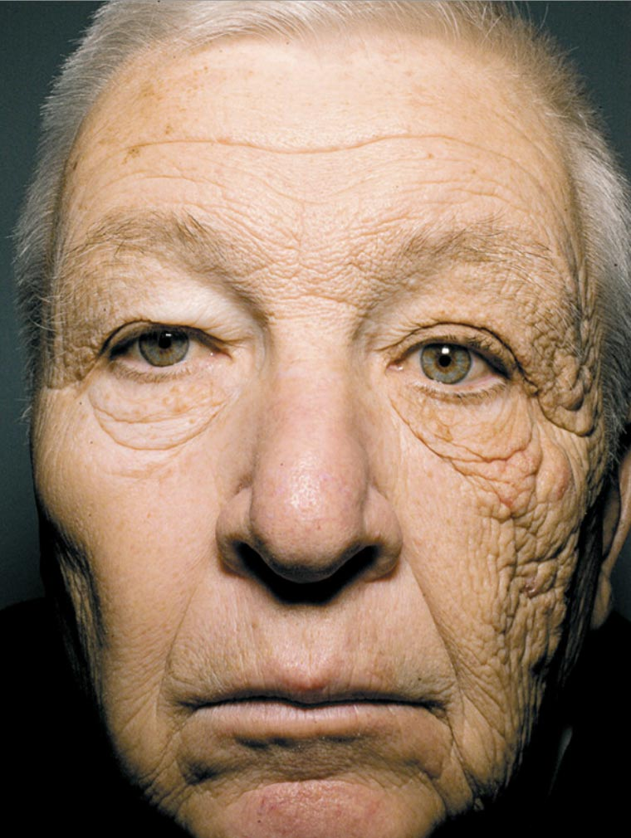
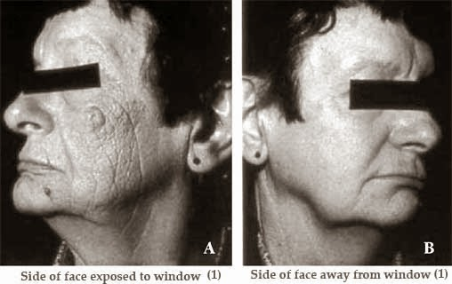
Aging Due to Prolonged UV Exposure
These are people who drive for a living… this is due to UVA exposure through their side car windows..

Slide 9
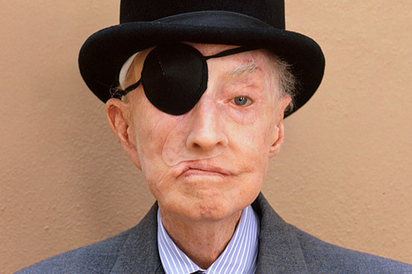
Damage from UV Lamps
Harold Smith contracted a dry-skin condition and allowed himself to be subjected to experimental treatments. Smith was covered with oil and exposed to full-body ultraviolet light, which developed into skin cancer throughout his body. Eventually he lost a lung, his right eye and finally his nose, along with all sense of smell.

Slide 10
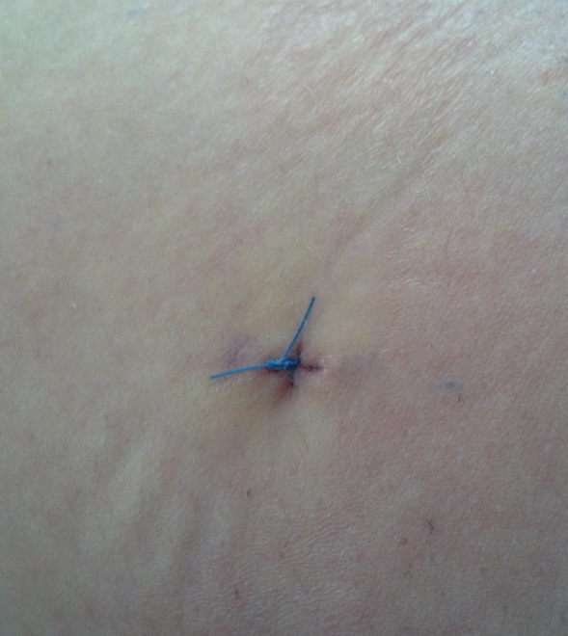
Real Story
First, it looked like a pimple
Then it started bleeding
And then it formed a scar…
So a biopsy was necessary
And got a cool scar

Slide 11
Prevention Tips
Seek the shade, especially between 10 AM and 4 PM.
Do not burn and avoid tanning.
Cover up with clothing, including a broad-brimmed hat and UV-blocking sunglasses.
Use a broad spectrum (UVA/UVB) sunscreen with SPF15 or higher every day. For extended outdoor activity, use a water-resistant, broad spectrum (UVA/UVB) sunscreen with SPF30 or higher.
Apply 1 ounce (2 tablespoons) of sunscreen to your entire body 30 minutes before going outside. Reapply every two hours, or immediately after swimming or excessive sweating.
Examine your skin head-to-toe every month.

