Slide 1
Vectors and Scalars
Section 1.3: Pages 18-23
A.S. 1.3.1 – 1.3.4

Slide 2
Properties of Scalar Quantities
Those values, measured or coefficients, that are complete when reported with only a magnitude
Examples of Scalar measurements:
the table is 2.5 m long.
He ran the 100. m race in 12.65 s.

Slide 3
Properties of Vector Quantities
Direction is required
i.e. Left, Right, North, South, 40.0° above the horizontal, 32° West of North, (-) or (+)
Magnitude of a vector: implies that just the value is reported, but no direction reported
Represented by a straight arrow pointing in the appropriate direction
Tip of the vector
Tail of the vector

Slide 4
Examples of Vectors and Scalars
Vector Quantities | Scalar Quantities
Displacement | Distance
Velocity | Speed
Acceleration | Mass
Force | Time
Electric Field | Electric Potential
Gravitational Field | Gravitational Potential
Magnetic Field | Density
Torque | Temperature
Momentum | Volume
Angular Velocity | Energy
Angular acceleration | Frequency
Highlighted quantities are those that we’ll use during the mechanics unit (but you should know all of these)
Notes:
Highlighted quantities are those we’ll be using during the mechanics unit. Kids should be aware of all of them, though.

Slide 5
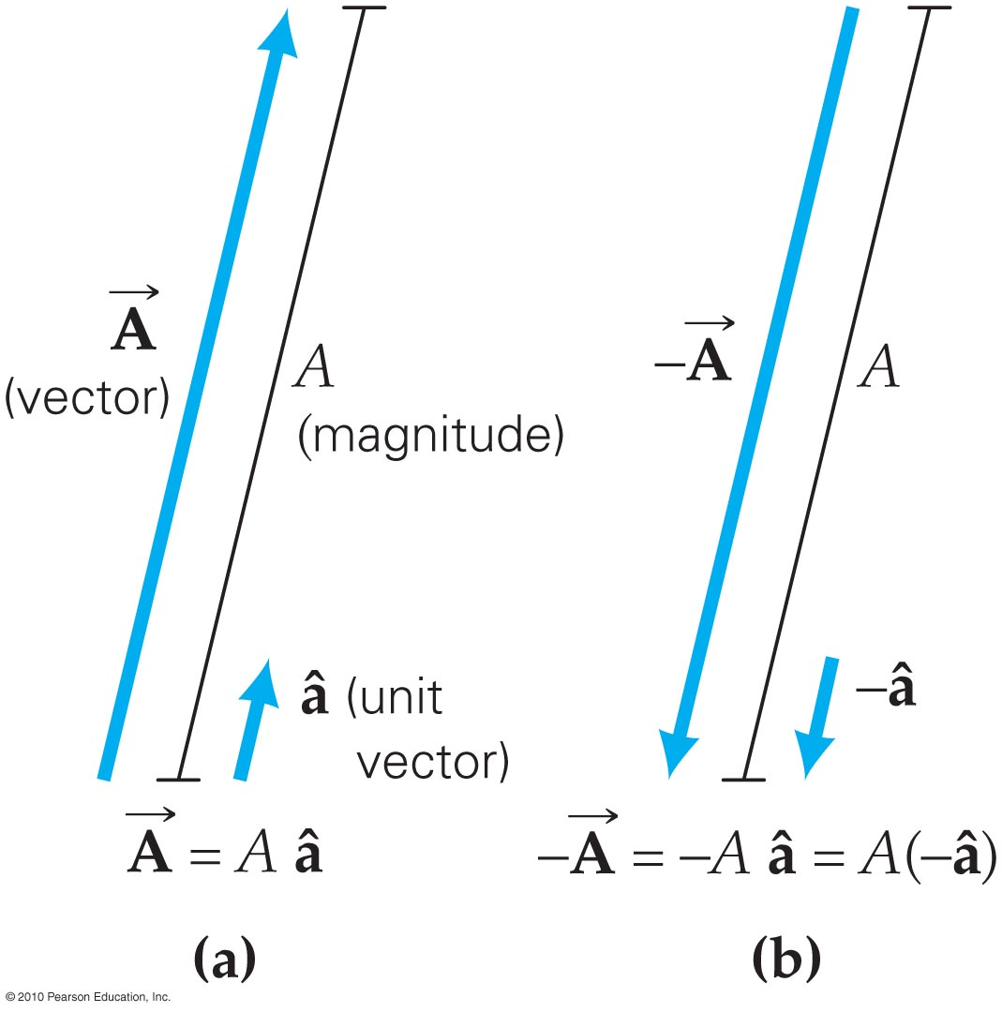
Basic Vector multiples:
Multiplying vectors by a constant or coefficient (i.e. 2*v)
Only changes the magnitude—represented by a longer arrow
Does NOT affect the direction of the vector
Negative Vectors
Same magnitude, but 180° in the opposite direction

Slide 6
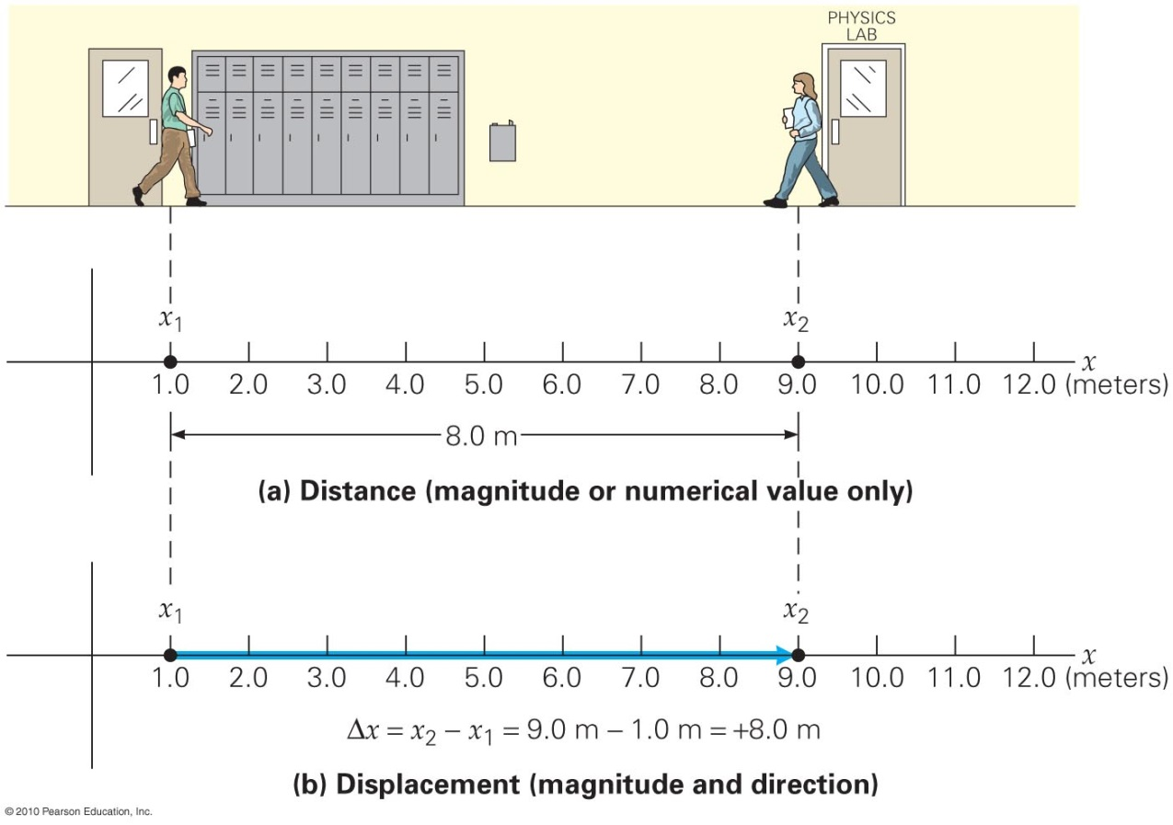
Displacement (just the first of many vectors we’ll be using in measurements)
The change in position of an object
A straight-line distance representing where you ended relative to where you began
Symbols:
Δx horizontal displacement
Δy vertical displacement
s any displacement (as in data booklet)

Slide 7
Vector addition—Parallelogram Method
Parallel Transport: The property of vectors that allows us to “pick up” and move a vector, as long as we do not change the direction or the length. A vector that is just “moved” is still the same vector
This allows us to graphically draw vectors and add them together!
Parallelogram Method:
Requires drawing the vectors to scale
Can be used to find the sum or difference of 2 vectors at a time.

Slide 8
Vector Addition—Parallelogram Method
Step 1: Position both vectors with their tails together
Step 2: Make a parallelogram
Step 3: Draw the diagonal
Resultant = the resulting vector (in this case, equal to the diagonal)

Slide 9
Vector Addition—Tip-to-Tail Method
Step 1: Position the first vector at the “origin”
Step 2: “pick up” and move the next vector so that it begins at the tip of the first.
Step 3: Draw the resultant starting at the tail of the first and going straight to the tip of the last vector
Benefit: it’s possible to add more than 2 vectors at a time with this method.

Slide 10
Vector Components
Vectors can be treated like the hypotenuse of a right triangle
The two perpendicular legs of that right triangle are the components of the vector
Horizontal (parallel to a surface) is the x-component
Vertical (perpendicular to a surface) is the y-component

Slide 11
Example Problem:
15.5 m s⁻¹
32.0°
A soccer ball is kicked with a velocity of 15.5 m·s⁻¹ at an angle of 32.0° to the horizontal.
What is the soccer ball’s initial horizontal velocity?
What is the soccer ball’s initial vertical velocity?
$$v_{x}=v\cos{θ}=15.5\cos{32.0}=13.1 m s^{−1}$$
$$v_{y}=v\sin{θ}=15.5\sin{32.0}=8.21 m s^{−1}$$

Slide 12
Vector addition—Component Method
Step 1: Determine both the vertical and horizontal components for all vectors that are being added together
Step 2: Find the sum of all horizontal components →this sum is equal to the horizontal component of the resultant vector
Step 3: Find the sum of all vertical components → this sum is equal to the vertical component of the resultant vector
Step 4: Using the Pythagorean Theorem, determine the magnitude of the resultant vector
Step 5: Using a trig function (i.e. tangent), determine the angle (direction) of the resultant vector

