Slide 1
Accuracy vs. Precision

Slide 2
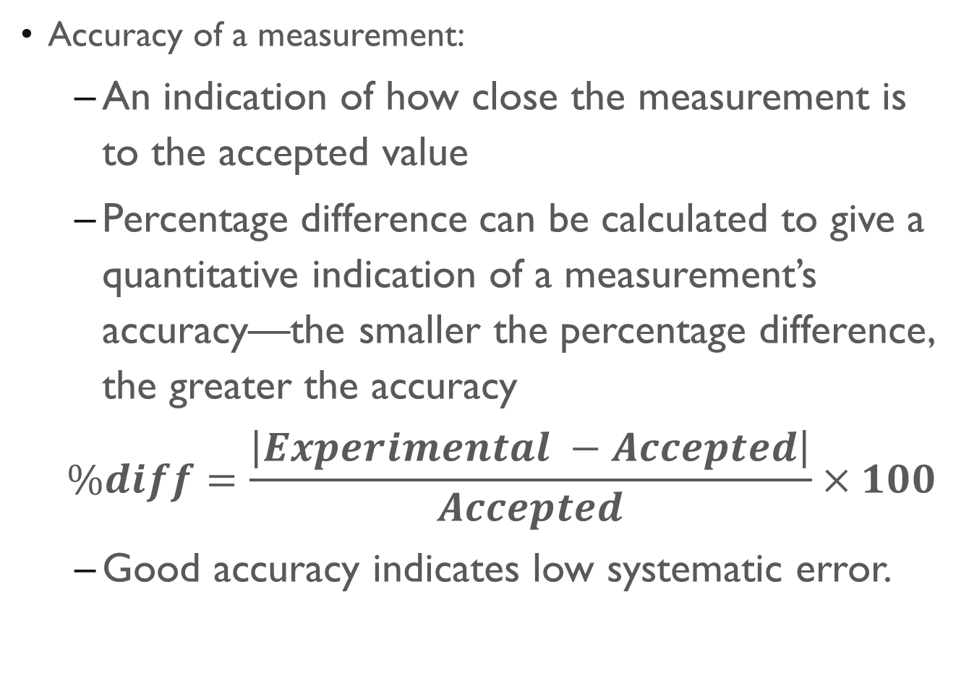
Accuracy
Accuracy of a measurement:
An indication of how close the measurement is to the accepted value
Percentage difference can be calculated to give a quantitative indication of a measurement’s accuracy—the smaller the percentage difference, the greater the accuracy
$$\%diff=\frac{\left|Experimental −Accepted\right|}{Accepted}×100$$
Good accuracy indicates low systematic error.

Slide 3
Precision of a Data Set
an indication of the agreement among a number of measurements made in the same way (i.e. with the same measuring tool and procedure)
The more consistent your results are, the higher the precision is
High precision implies a small amount of random error

Slide 4
Precision of a Measurement
An indication of how “exactly” you can measure a piece of data
More precise measurements are those that are measured to a smaller increment of a unit of measure (i.e. more decimal places)
Example: a thickness of wire measured with a meter stick will be precise to 0.05 cm; using a micrometer can increase the precision to 0.0005 cm
ALWAYS use a measuring tool that will give you the most appropriate precision.
Absolute uncertainty can be used to indicate the precision of your measurement—more on that to come soon…

Slide 5
Think about this: Which of these are “experimental errors”?
Misreading the scale on a triple-beam balance
Incorrectly transferring data from your rough data table to the final, typed, version in your report
Miscalculating results because you did not convert to the correct fundamental units
Miscalculations because you use the wrong equation

Slide 6
Were they “experimental errors”?
NONE of these are experimental errors
They are MISTAKES
What’s the difference?
You need to check your work to make sure these mistakes don’t occur…ask questions if you need to (of your lab partner, me, etc.)
Do NOT put mistakes in your error discussion in the conclusion

Slide 7
Experimental Errors:
Random Errors:
A result of variations in the performance of the instrument and/or the operator
Do NOT consistently occur throughout a lab
What are some examples you and your table group can think of?

Slide 8
random Errors:
So what can be done to reduce the effects of random errors?
Don’t rush through your measurements! Be careful!
Take as many trials as possible—the more trials you do, the less likely one odd result will impact your overall lab results
Standard number of trials for an IB lab = 5 per manipulation (with at least 8 manipulations)

Slide 9
Experimental Errors:
Systematic Errors:
Errors that are inherent to the system or the measuring instrument
Results in a set of data to be centered around a value that is different than the accepted value
Some Examples:
Non-calibrated (or poorly calibrated) measuring tools
A “zero offset” on a measuring tool, requiring a “zero correction”
A warped ruler—results in non-symmetrical divisions

Slide 10
Systematic Errors:
What can be done to the effects of these?
Unfortunately, nothing directly…unless you repeat the experiment with another piece of equipment
We can account for the systematic errors sometimes:
i.e. if there’s a zero offset, make sure all your data has been adjusted to account for that.
Recognizing systematic errors will impact the size of your absolute uncertainty (details to come!)

