Slide 1
Introduction to Mechanics
Displacement and Velocity

Slide 2
Distance vs. Displacement
Distance: the total length of the path taken to move from a starting point to an ending point, regardless of how many turns and changes of direction occur. (scalar quantity)
Displacement: The length of a straight line path between a starting point and an ending point. (vector quantity)
The change in position between an object’s initial position and final position.

Slide 3
Distance from Skyline to the airport = 41.2 km, according to Google Maps.
Displacement is much less…

Slide 4
Linear Distance:

Slide 5
Displacement:

Slide 6
Speed vs. Velocity
Average Speed: the rate at which a distance is traveled:
In this case, d represents a TOTAL DISTANCE covered in a total time, t
Units for average speed = m∙s⁻¹

Slide 7
Speed vs. Velocity
Average Velocity: the rate of a change in position.
In other words…the rate at which a DISPLACEMENT is traveled:
s represents DISPLACEMENT

Slide 8
Why is this not called a Velocitometer?
What is this called?

Slide 9
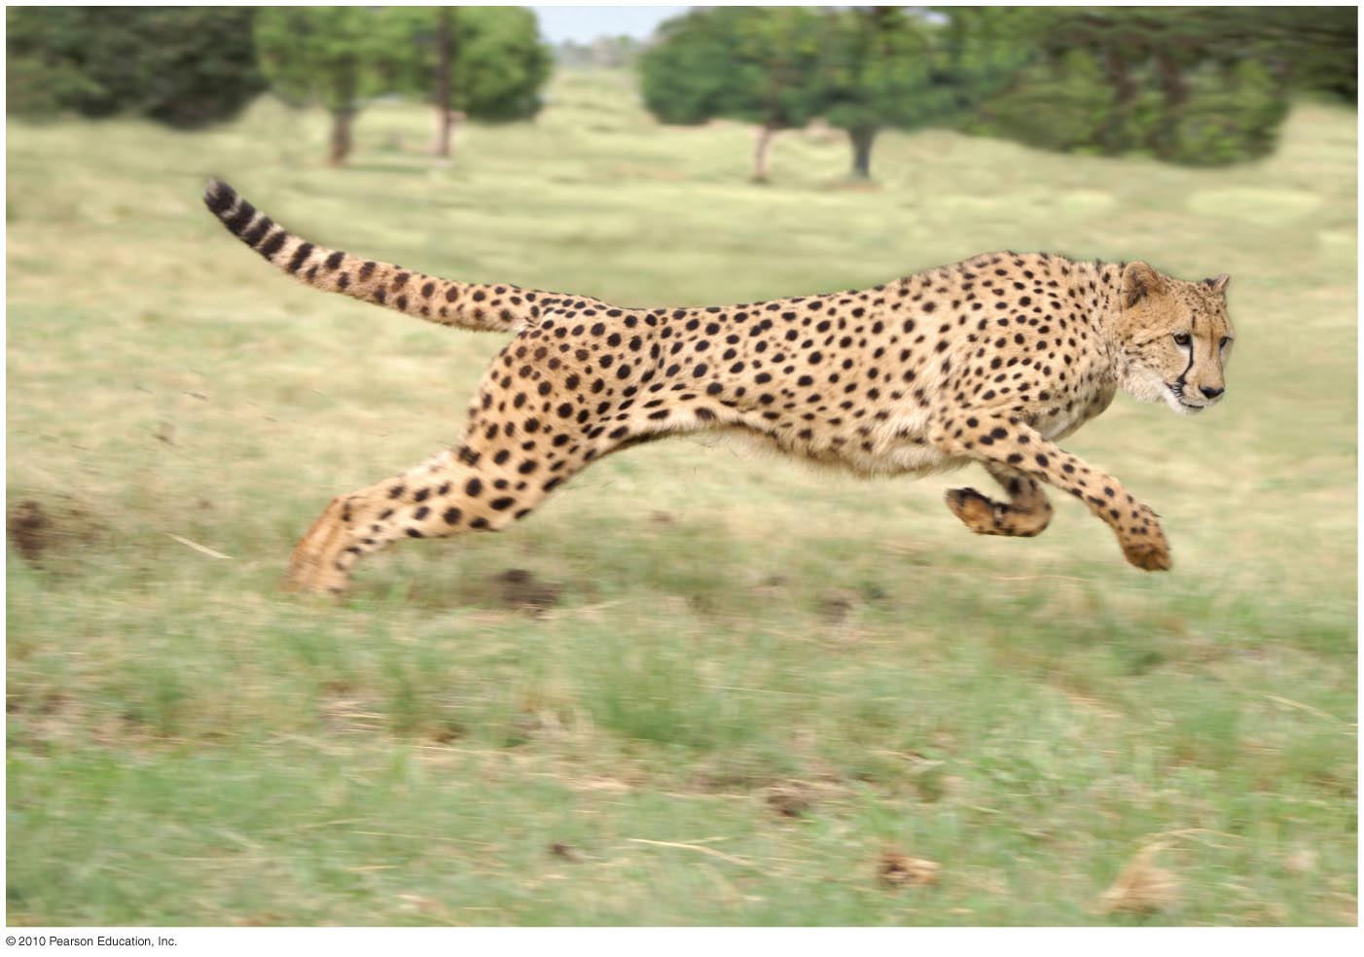
Sample Problem:
While chasing an impala, a Cheetah runs 275 m at an average speed of 70.0 mi/h. Assuming that the impala is caught at the end of the 275 m, how much time elapses between when the cheetah begins its sprint and when he catches his prey?

Slide 10
Sample problem 2
A right-handed baseball player hits a home run and takes 25.0 s to jog around the bases. Assume that the total distance he runs is 115 m (he rounds the bases widely).
What is his average speed for his trip around the bases?
What, approximately, is his average velocity?

Slide 11
lab: Paper river
Form groups of 3 (2 is tricky, but doable)
Read through the procedure and make a plan for how you are going to proceed .

Slide 12
Instantaneous Velocity
Average velocity will be used to describe the total displacement traveled in a total amount of time
Instantaneous velocity describes how fast an object is traveling at one given instant of time.
Examples:
The most common instantaneous velocities we will be using this year are:
Initial Velocity (v_{i} or v₀ or u)
Final Velocity (v_{f} or v)

Slide 13
Relative Velocity
The velocity of one object relative to another’s point of view
Reference Frame: the frame of reference for the observer’s point of view—the observer will always be at rest in his/her frame of reference
Relative velocity of an object moving relative to an observer is determined by subtracting vectors

Slide 14
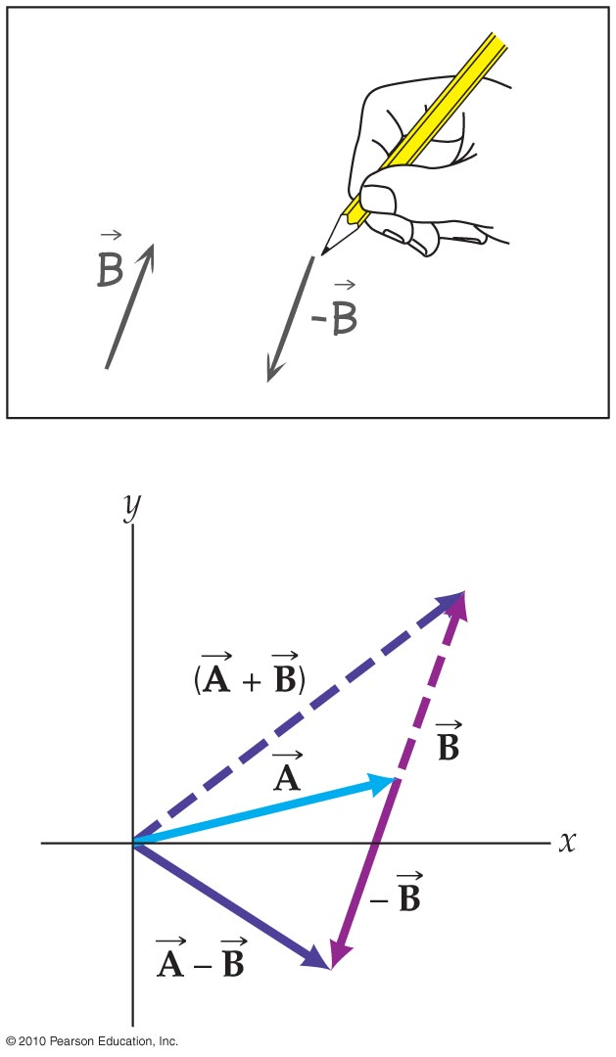
Subtracting Vectors
The second vector quantity’s direction is 180° from it’s given direction
Once you’ve altered the direction, it becomes basic vector addition

Slide 15
Sample problem 1:
What is the velocity of:
Car B relative to A?
Car C relative to A?
Car C relative to B?
Car B relative to C?
Car A relative to C?
Car A relative to B?

Slide 16
Warm up
What is the velocity of:
Car B relative to A?
Car C relative to A?
Car C relative to B?
Car B relative to C?
Car A relative to C?
Car A relative to B?

Slide 17
Practice Problem 2:
Car P moves to the left with a speed of 40.0 km·h⁻¹ (with respect to the road) and Car Z moves to the right with a speed of 60.0 km·h⁻¹ (with respect to the road). Find the velocity of car Z relative to car P. (Assume left is (-))

