Slide 1
Warm-up (03/04/19)
Which of the following do you believe are examples of when you would be doing work? Why did you choose those examples?
Shoveling snow
Pushing a lawn mower
Stocking shelves at a store
Holding heavy bags
Carrying a bag by its handles to your car
Lifting a baby
Carrying a baby in your arms

Slide 2
Today’s assignment
Use the rest of this presentation to complete the worksheet passed out in class (Work/Energy/Power notes)

Slide 3
Work, Energy and Power
Read pages 61-72

Slide 4
What is Energy?
Energy is a measure of an object’s ability to cause a change in itself and/or its surroundings

Slide 5
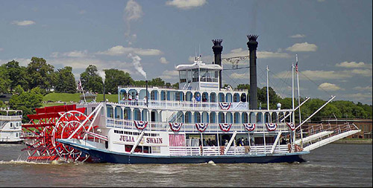
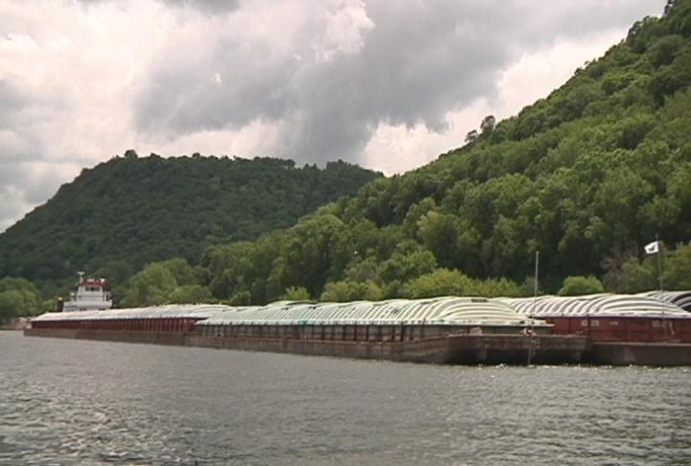
Which is using more energy? Why?
Mississippi River Cargo Barge
Mississippi River Paddleboat (the Julia Belle Swain)

Slide 6
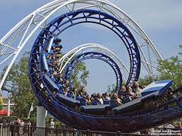
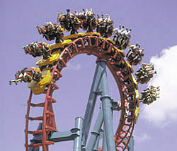
Which train carries more energy? Why?
End of a corkscrew
Top of a loop

Slide 7
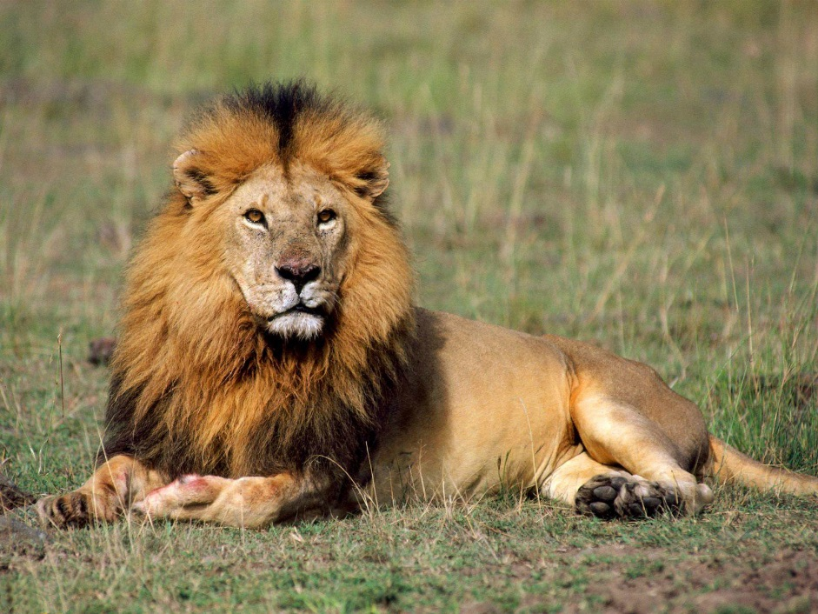
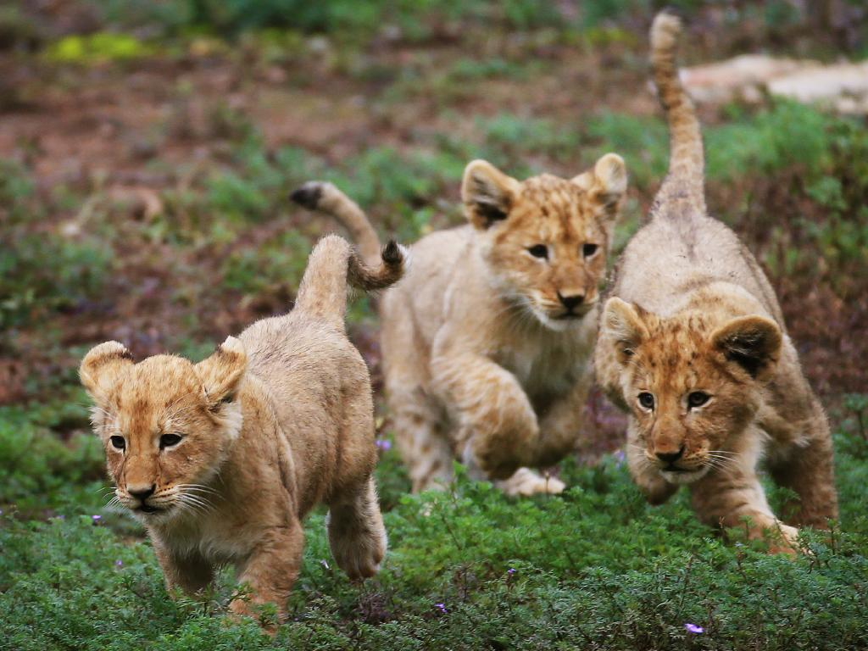
Which is using more energy? Why?
Adult Male Lion
Lion cubs

Slide 8
Types of Energy
Mechanical
energy an object carries because of its motion and/or its position relative to another object.
Kinetic energy—energy of motion
Rotational: energy of motion as an object spins around an axis
Translational: energy of motion as an object moves in a forward/backward direction
Potential energy—energy related to a position
Gravitational potential energy
Elastic Potential energy

Slide 9
Other Types of Energy:
Radiant Energy:
Energy carried by photons within the spectrum of electromagnetic energy.
In other words, “light” energy (but not just visible light)

Slide 10
Other Types of Energy:
Thermal Energy:
Energy associated with the kinetic energy of molecules within a substance and the transfer of that energy between molecules.
We commonly connect thermal energy with “Heat”. Thermal energy is transferred between objects of different temperatures.

Slide 11
More Types of Energy:
Electrical Energy:
Energy associated with the movement of and kinetic energy of electrons. Associated with both electrical potential (voltage) and with electric currents.
Chemical Energy:
Energy associated with and contained within the bonds between atoms.
Nuclear Energy:
Energy associated with the nucleus of atoms.
Nuclear energy holds atoms together, and is released during nuclear reactions (i.e. fission and fusion reactions)

Slide 12
Work
The transfer of energy through motion
Calculated by multiplying the magnitude of the applied force by the displacement covered in the direction of the force :
Units = Newton-meter (N·m) = Joule (J)
s
F
θ
s
F·Cosθ

Slide 13
Question 5.2a Friction and Work I
A box is being pulled across a rough floor at a constant speed. What can you say about the work done by friction?
a) friction does no work at all
b) friction does negative work
c) friction does positive work
Notes:
Answer: b

Slide 14
Question 5.2b Friction and Work II
Can friction ever do positive work?
a) yes
b) no
Notes:
Answer: a

Slide 15
Work done by a non-constant force
Example: work done by a compressed or stretched spring.
Calculate using a Force-displacement graph
Calculate the area under the line (integral)

Slide 16
Question 5.2c Play Ball!
In a baseball game, the catcher stops a 90-mph pitch. What can you say about the work done by the catcher on the ball?
a) catcher has done positive work
b) catcher has done negative work
c) catcher has done zero work
Notes:
Answer: b

Slide 17
Question 5.3 Force and Work
a) one force
b) two forces
c) three forces
d) four forces
e) no forces are doing work
A box is being pulled up a rough incline by a rope connected to a pulley. How many forces are doing work on the box?
Notes:
Answer: c

Slide 18
Work-Energy Theorem
When NET work is done to an object (positive or negative), there has been energy added to (or taken away from) the object.
The Work-Energy theorem quantifies this idea—the net work done to the object is equivalent to the amount of energy added to or removed from the object:
$$W=∆E$$
Note: This works for mechanical energy. It’s not an all-inclusive law of physics.

Slide 19
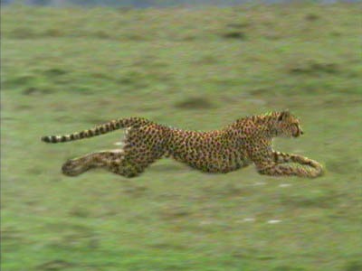
Kinetic Energy (E_{K})
The energy a body has because it is moving
If a cheetah has a mass of 47.0 kg, and accelerates from rest to a speed of 26.8 m/s in 3.50 s, what is her change in kinetic energy?
$$∆E_{K}=\frac{1}{2}m\left(v^{2}−u^{2}\right)=\frac{1}{2}\left(47.0\right)\left({26.8}^{2}\right)=1.69×{10}^{4} J$$
Click picture for source site

Slide 20
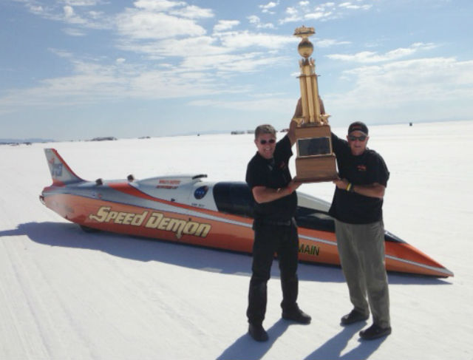
http://www.racecar-engineering.com/news/speed-demon-smashes-land-speed-record/
The land-speed record for a wheel-driven car is currently 437.183 mi/h. (recorded at the Bonneville Salt Flats in October 2012) If the mass of this car was approximately 1.0x10³ kg, what was its kinetic energy?

Slide 21
Work-Kinetic Energy Theorem
The amount of work done on a system is equal to its change in kinetic energy
W = ΔK
$$W=\frac{1}{2}m\left(v^{2}−u^{2}\right)$$

Slide 22
Question 5.4 Lifting a Book
You lift a book with your hand in such a way that it moves up at constant speed. While it is moving, what is the total work done on the book?
a) mg × Δ r
b) F_{HAND} × Δ r
c) (F_{HAND} + mg) × Δ r
d) zero
e) none of the above
F_{HAND}
Δr
v = const
a = 0
mg
Notes:
Answer: d

Slide 23
Sample problem:
A hammer head of mass 0.50 kg is moving with a speed of 6.0 m·s⁻¹ when it strikes the head of a nail sticking out of a piece of wood. When the hammer head comes to rest, the nail has been driven a distance of 1.0 cm into the wood. Calculate the average frictional force exerted by the wood on the nail.

Slide 24
Sample Problem: solution

Slide 25
Sample problem #2
A car (m = 1150 kg) experiences a force of 6.00 x 10³ N over a distance of 125 m. If the car was initially traveling at 2.25 m·s⁻¹, what is its final velocity?

Slide 26
Question 5.5a Kinetic Energy I
By what factor does the kinetic energy of a car change when its speed is tripled?
a) no change at all
b) factor of 3
c) factor of 6
d) factor of 9
e) factor of 12
Notes:
Answer: d

Slide 27
Question 5.5b Kinetic Energy II
Car #1 has twice the mass of car #2, but they both have the same kinetic energy. How do their speeds compare?
a) 2v₁ = v₂
b) √ 2v₁ = v₂
c) 4v₁ = v₂
d) v₁ = v₂
e) 8v₁ = v₂
Notes:
Answer: b

Slide 28
Question 5.6a Free Fall I
Two stones, one twice the mass of the other, are dropped from a cliff. Just before hitting the ground, what is the kinetic energy of the heavy stone compared to the light one?
a) quarter as much
b) half as much
c) the same
d) twice as much
e) four times as much
Notes:
Answer: d

Slide 29
Question 5.6b Free Fall II
a) quarter as much
b) half as much
c) the same
d) twice as much
e) four times as much
In the previous question, just before hitting the ground, what is the final speed of the heavy stone compared to the light one?
Notes:
Answer: c

Slide 30
Question 5.7 Work and KE
A child on a skateboard is moving at a speed of 2 m/s. After a force acts on the child, her speed is 3 m/s. What can you say about the work done by the external force on the child?
a) positive work was done
b) negative work was done
c) zero work was done
Notes:
Answer: a

Slide 31
Gravitational Potential Energy* (E_{P}) *In a uniform gravitational field
The amount of energy that is stored in a body
A measure of how much work CAN be done
Gravitational Potential Energy: the amount of work that can be done on a body as a result of its position above a reference point (in Earth’s gravitational field)
E_{p} = mgΔh
Where m = mass (kg)
g = acceleration due to gravity (9.81 m·s⁻²)
And h = height (m) above reference level

Slide 32
Rotational Kinetic Energy
The energy an object has because of its motion around an axis
We will cover this in an exceptional amount of detail next fall when we cover rotational mechanics. ☺
For now, just recognize that it’s energy that is involved in anything that is rolling or spinning.

Slide 33
The Principle of Energy Conservation
The total amount of energy a body possesses will remain constant, although the type of energy may be transformed from one form to another
Note: many times the energy transforms into a “useless” form, so it appears that energy has been lost…when it really hasn’t!
Conservation of Mechanical Energy:
$$\sum{E_{i}}=\sum{E_{f}}$$
$${\left[E_{K}+E_{P}\right]}_{i}={\left[E_{K}+E_{P}\right]}_{f}$$

Slide 34
Journal Entry
Use ONLY energy concepts to answer these questions:
A car slides down an icy (nearly frictionless) hill that has a elevation change from top to bottom of 14.0 m. What is its speed when it hits the snowbank at the bottom of the hill?
If the 1100 kg car came to a stop in a distance of 1.2 m, what was the average force exerted on the car by the snowbank?

Slide 35
Question 5.2a Friction and Work I
A box is being pulled across a rough floor at a constant speed. What can you say about the work done by friction?
a) friction does no work at all
b) friction does negative work
c) friction does positive work
Friction acts in the opposite direction to the displacement, so the work is negative. Or using the definition of work (W = F (Δr)cosθ ), because θ = 180º, then W < 0.
N
Displacement
f
Pull
mg

Slide 36
Question 5.2b Friction and Work II
Can friction ever do positive work?
a) yes
b) no
Consider the case of a box on the back of a pickup truck. If the box moves along with the truck, then it is actually the force of friction that is making the box move.

Slide 37
Question 5.2c Play Ball!
In a baseball game, the catcher stops a 90-mph pitch. What can you say about the work done by the catcher on the ball?
a) catcher has done positive work
b) catcher has done negative work
c) catcher has done zero work
The force exerted by the catcher is opposite in direction to the displacement of the ball, so the work is negative. Or using the definition of work (W = F (Δr)cosθ ), because θ = 180º, then W < 0. Note that because the work done on the ball is negative, its speed decreases.
Follow-up: What about the work done by the ball on the catcher?

Slide 38
Question 5.3 Force and Work
a) one force
b) two forces
c) three forces
d) four forces
e) no forces are doing work
A box is being pulled up a rough incline by a rope connected to a pulley. How many forces are doing work on the box?
Any force not perpendicular to the motion will do work:
displacement
N
T
N does no work
T does positive work
f
f does negative work
mg does negative work
mg

Slide 39
Question 5.4 Lifting a Book
You lift a book with your hand in such a way that it moves up at constant speed. While it is moving, what is the total work done on the book?
a) mg × Δ r
b) F_{HAND} × Δ r
c) (F_{HAND} + mg) × Δ r
d) zero
e) none of the above
The total work is zero because the net force acting on the book is zero. The work done by the hand is positive, and the work done by gravity is negative. The sum of the two is zero. Note that the kinetic energy of the book does not change either!
F_{HAND}
Δr
v = const
a = 0
mg
Follow-up: What would happen if F_{HAND} were greater than mg?

Slide 40
Question 5.5a Kinetic Energy I
By what factor does the kinetic energy of a car change when its speed is tripled?
a) no change at all
b) factor of 3
c) factor of 6
d) factor of 9
e) factor of 12
Because the kinetic energy is mv², if the speed increases by a factor of 3, then the KE will increase by a factor of 9.
Follow-up: How would you achieve a KE increase of a factor of 2?

Slide 41
Question 5.5b Kinetic Energy II
a) 2v₁ = v₂
b) √ 2v₁ = v₂
c) 4v₁ = v₂
d) v₁ = v₂
e) 8v₁ = v₂
Car #1 has twice the mass of car #2, but they both have the same kinetic energy. How do their speeds compare?
Because the kinetic energy is mv², and the mass of car #1 is greater, then car #2 must be moving faster. If the ratio of m₁/m₂ is 2, then the ratio of v² values must also be 2. This means that the ratio of v₂/v₁ must be the square root of 2.

Slide 42
Question 5.6a Free Fall I
Two stones, one twice the mass of the other, are dropped from a cliff. Just before hitting the ground, what is the kinetic energy of the heavy stone compared to the light one?
a) quarter as much
b) half as much
c) the same
d) twice as much
e) four times as much
Consider the work done by gravity to make the stone fall distance d:
ΔKE = W_{net} = F d cosθ
ΔKE = mg d
Thus, the stone with the greater mass has the greater
KE, which is twice as big for the heavy stone.
Follow-up: How do the initial values of gravitational PE compare?

Slide 43
Question 5.6b Free Fall II
a) quarter as much
b) half as much
c) the same
d) twice as much
e) four times as much
In the previous question, just before hitting the ground, what is the final speed of the heavy stone compared to the light one?
All freely falling objects fall at the same rate, which is g. Because the acceleration is the same for both, and the distance is the same, then the final speeds will be the same for both stones.

Slide 44
Question 5.7 Work and KE
A child on a skateboard is moving at a speed of 2 m/s. After a force acts on the child, her speed is 3 m/s. What can you say about the work done by the external force on the child?
a) positive work was done
b) negative work was done
c) zero work was done
The kinetic energy of the child increased because her speed increased. This increase in KE was the result of positive work being done. Or, from the definition of work, because W = ΔKE = KE_{f} – KE_{i} and we know that KE_{f} > KE_{i} in this case, then the work W must be positive.
Follow-up: What does it mean for negative work to be done on the child?

