Slide 1
Peer Grading
Uniform Acceleration Lab: Car and Ramp

Slide 2
Peer Grading Procedures
Use a different, bright color of ink or pencil (not red, but green, blue, etc.)
When earning points, clearly check it off on the rubric. If they miss points, circle the check box or highlight the text.
Provided constructive feedback on formatting and work for use on future labs
Be honest! Any discrepancy will be not help you improve and may result in losing points on the next lab ☹

Slide 3
Final Draft Quality: +3
Missing any of the following criteria: -1 each
Full lab report typed and computer processed
Correct order (see score sheet)
Appropriate Heading and Title:
Fill In “Final Draft Quality” Score:
+ / 3

Slide 4
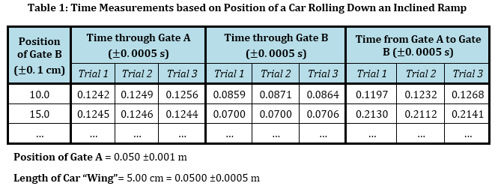
Table 1: +5.5
Missing any of the rubric criteria: -½ each
Title and #
Distinct Column Headings
Uncertainties
Units
3 Trials
All required values
Trials UNDER columns
NO CALCULATED VALUES!
(No, not even averages)
Gridlines
Correct Precision

Slide 5
Table 2: +2
Missing any of the rubric criteria: -½ each
Title and #
Gridlines
Headings with units
All CALCULATED VALUES!

Slide 6
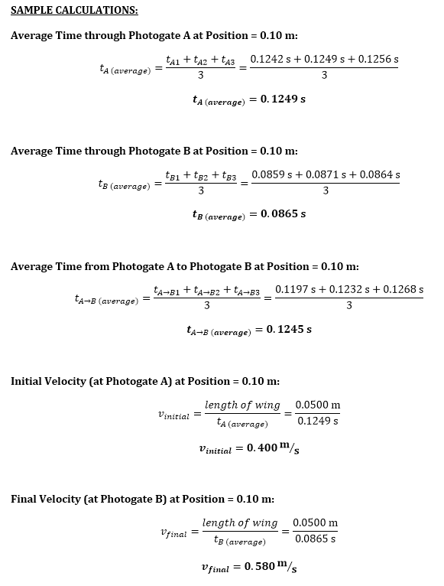
Sample Calculations: +2.5
(½ each)

Slide 7
Graph 1: +3
(½ each)
Title and #
Equation for the curve
Best Fit CURVE
Axes Labels
Variables on the correct axis!
Units

Slide 8
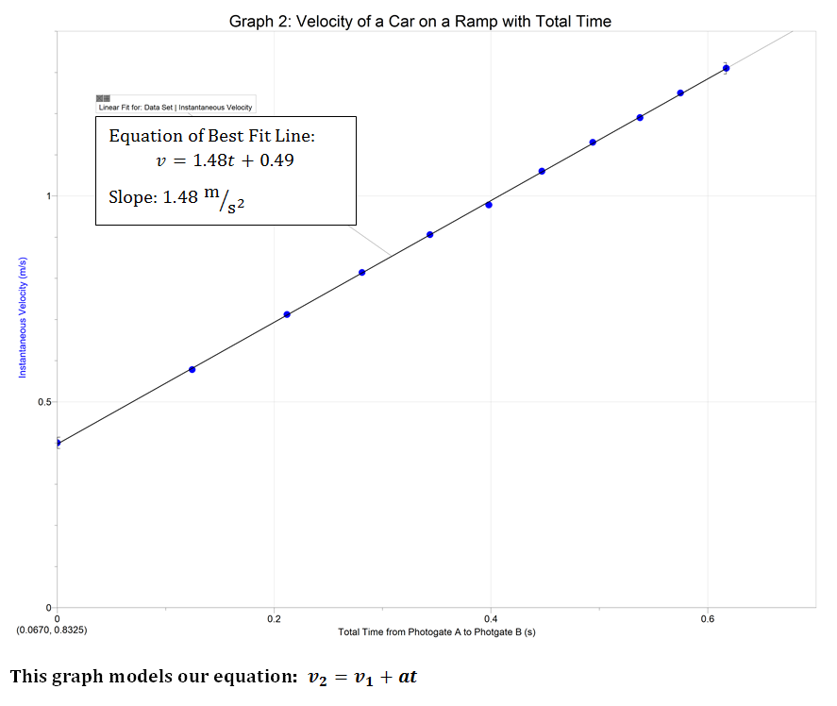
Graph 2: +3
(½ each)
Title and #
Equation for the line
Slope of the line
Best Fit LINE
Axes Labels with Units
Fill In “Tables and Graphs” Score:
+ / 16
Variables on the correct axis!

Slide 9
Graph 3
½ points for each item
½ X 5 = 2.5points

Slide 10
Graph 4
½ points for each item
½ X 5= 2.5 points

Slide 11
Analysis Questions: +1.5
(+½)
6.
(+½)
7.
(+1/2 )
Calculation Required for Credit

Slide 12
Conclusion: +1.5
+ 1
1.5
Fill In “Analysis and Conclusion” Score:
+ / 3

Slide 13
Total Score
At the bottom of the green score sheet:
Include CB: ______________ (your name)
At the top of the green score sheet :
TOTAL POSSIBLE SCORE: + / 25

