Slide 1
Car Crash Lab
A long term project to summarize our mechanics unit!

Slide 2
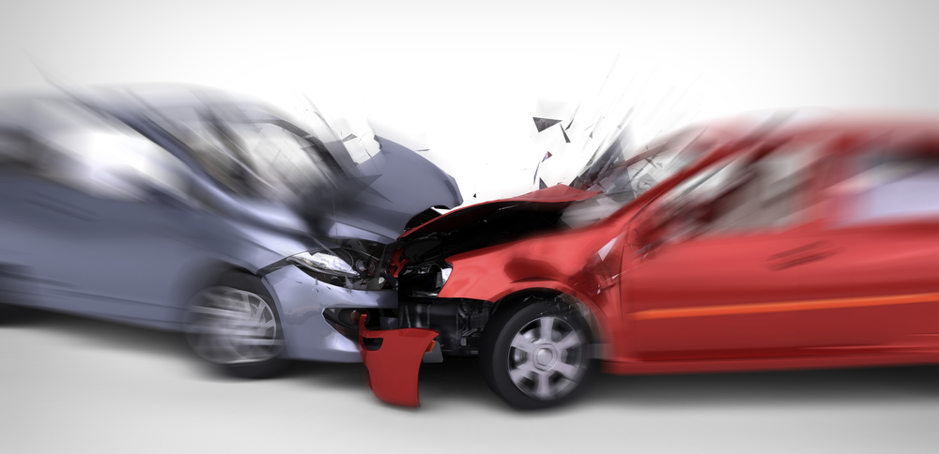
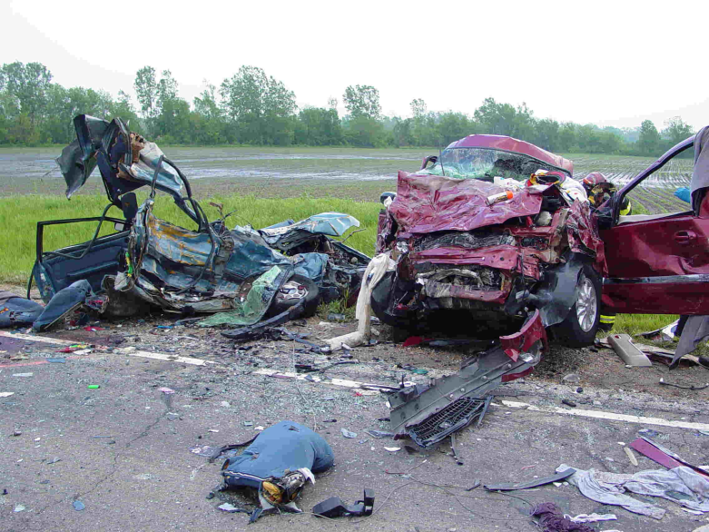
Background Information
More than 30,000 people are killed each year in the US from traffic accidents and many, many more are injured.
This number would be even higher if much technological advancement was not made over the last 50 years or so related to vehicle safety.

Slide 3
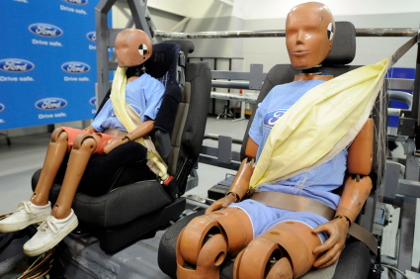
Background Information
In particular passenger restraint systems and vehicle crumple zones play a key factor that has allowed many to survive what would have previously been a fatal car crash.
As a physics class we are going to take the things we have learned about collisions and apply that to a good crumple zone/occupant restraint design.
You and your partner will be working as a mechanical engineering design and fabrication team. Your job as an engineer is to design a safer vehicle body.

Slide 4
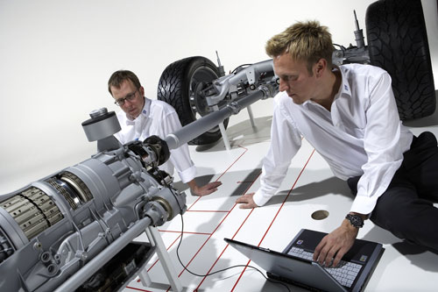
Science vs. Engineering?
What’s the difference?
Scientists generally do their work with a driving question (or sometimes a hypothesis) in mind. They want to increase knowledge and understanding.
Engineers rely on their understanding of scientific principles to solve specific practical problems. Before an engineer sets out to design a product or part he/she will write down a set of requirements that the design must accomplish.

Slide 5
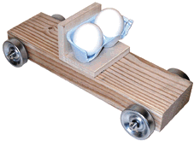
Project Specifications
Cars must fit (and be attached to) a car base, which will be provided. The body of your car will be attached the day of testing, and will be removed for another team to use when you are done. You MUST share the bases!
Car bases are of specific dimensions. Be sure you have measured the base before constructing your car body, and remember which one you are using!

Slide 6
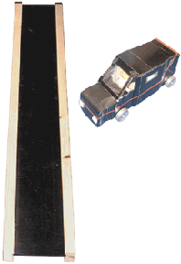
Project Specifications
The only power the car will have will come from the force of gravity rolling it down a ramp. The ramp will be set at the same angle for all teams (50°).
No braking systems will be allowed (including purposefully added amounts of air resistance…) will be allowed.

Slide 7
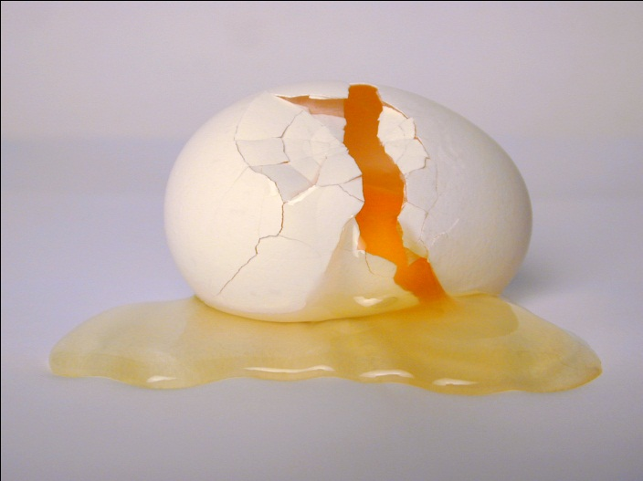
Project Specifications
BOTH eggs must survive the crash in order to receive full credit for the “survival” portion of the grade.
Eggs will be provided on the day of testing by your teacher. No eggs from home may be used.
Cars will get only one (1) official crash in order to test the design and the survivability of the occupants.
You may work with one partner, but no more than 2 people per group

Slide 8
Restraint System
You will be graded on 2 aspects: do your eggs remain in their seats; and do they survive un-cracked.
Occupants must be held in a safe and secure position during and after the collision. They may not just be taped into position, but must be held there realistically.
You can make 2 “bucket seats” out of egg cartons. You must figure out how to efficiently secure the seats to the car base in the appropriate location (the wood L on the car base).

Slide 9
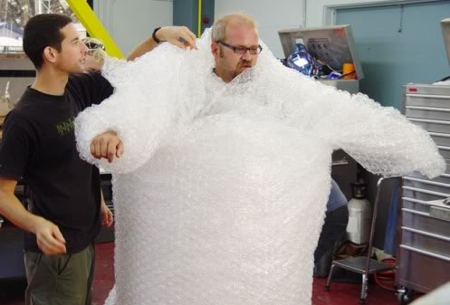
Restraint System
Treat your eggs as though they have eyes and arms and legs—all of which a driver must have access to in order to drive.
Therefore, they may not be completely covered as part of your “restraint”—there must be “leg room”☺, including at least 6 cm of empty space directly in front of the egg before any kind of padding may be included.

Slide 10
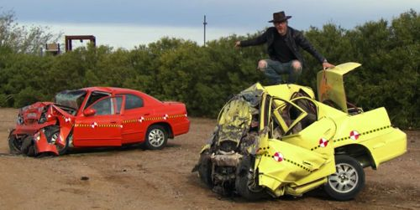
Crumple Zone
The design must be adequate for the predictable forces and energy transfers at impact. The hood area of your car should actually crumple, and ideally there will be little to no bouncing of your car. If your car bounces off the track, you run the risk of your eggs’ deaths as a result.
Your front bumper may not extend more than 10.0 cm from the front of the wooden car base.

Slide 11
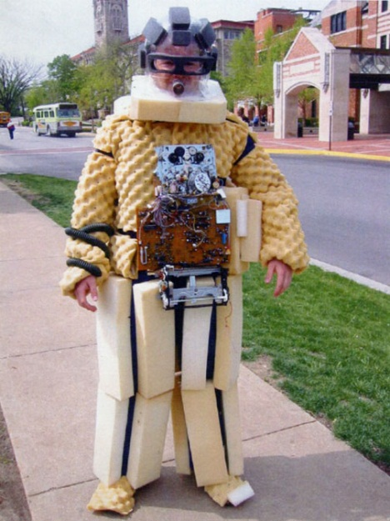
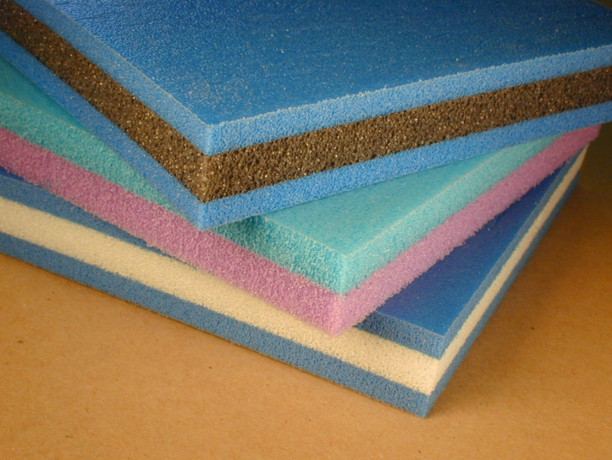
Crumple Zone
Your crumple zone must be a part of the car body design (work it into the hood somehow) and can also include something under the hood to help absorb some of the energy—just not foam. Be creative with your designs!
The material limitations include the prohibition of any foam or foam-like material, sponges, bubble wrap, and the like. NO LIQUIDS or anything that can damage the equipment.

Slide 12
Body Design and Ergonomics
Design of a realistic car body, and effective construction. The car body should be 1 whole piece that includes the hood/crumple zone area, the passenger area, and the trunk/back area.
This car body will be taped securely onto the wooden car base, so measure carefully! (You don’t want any part of the car rubbing against the wheels!)

Slide 13
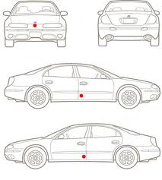
Body Design and Ergonomics
The fundamentals of the car body should be realistic: at least 2 doors are required (for entry/exit of the driver and passenger); good visibility (large windshield, side windows, rear window) is required, and a realistic amount of leg room and head room should be considered as well.

Slide 14
Important Dates!
March 12: Project introduced; partners selected
Work on pre-construction research and planning initial design (i.e. rough draft blue prints)
March 12 through March 15: Most of these days will be work/construction days. Plan to bring your construction materials, use class time wisely, and clean up after yourselves. Leaving a mess in your work area will result in loss of points.
March 13: rough draft blue prints and pre-construction research questions will be checked (progress stamp)
March 15: Projects due and testing begins! All cars must be done and brought in to class by this date!
March 18: Testing day #2
Monday, March 21: INDIVIDUAL Portfolios and Analysis due

Slide 15
Pre-Construction Research
What is a crumple zone? Describe how auto-makers design their cars so that there is a crumple zone.
What standards does the insurance institute for highway safety use when they determine “safety ratings” for passenger vehicles?
Describe the details of how seatbelts work and are useful in a car crash.
How do airbags work, and how do they add to the safety of passengers in a car crash?
What kinds of things must you consider when designing your car?

Slide 16
Blue Print Requirements
Include Group # and name(s)
You will draw two labeled and scaled diagrams:
One will be a top down view
The other will be a side view
Include the scale used to make the drawing (i.e.: 1 cm = 5 cm)
Label all base measurements and include approximate dimensions for your constructed design.
Include a key to the materials used in your design and be sure the diagrams clearly show what you plan to use
Remember to include and label all required elements (i.e.: crumple zone, restraint system, 2 doors, 4 windows, leg room, etc.)

Slide 17
Rubric (available online)

Slide 18
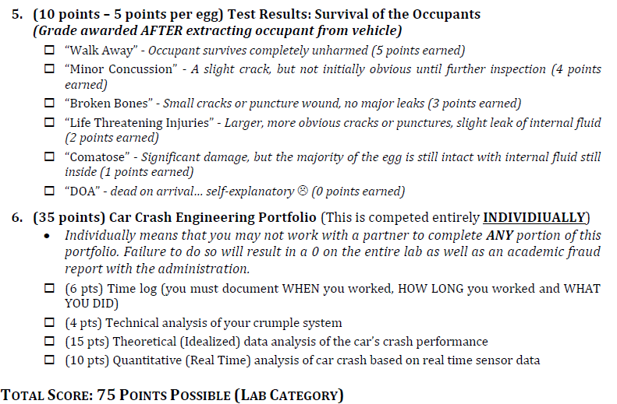
Rubric (continued)

