Slide 1
Collisions Revisited!
Momentum and Energy in Elastic and Inelastic Collisions

Slide 2
Reminder: Conservation of Momentum
In a closed system, the total momentum of all objects in the system will remain constant
In other words…the total momentum in the system right before an “event” will be equal to the total momentum right after the “event”

Slide 3
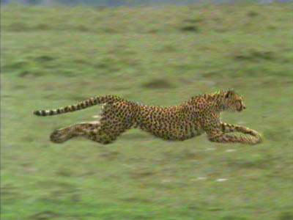
Reminder: Kinetic Energy (E_{K})
The energy a body has because it is moving
Units: Joules (J)
Cheetah Breaks Speed Record - Beats Usain Bolt by Seconds
Notes:
http://news.nationalgeographic.com/news/2012/08/120802-cheetah-sarah-cincinnati-zoo-fastest-record-science-usain-bolt-olympics/#

Slide 4
Types of Collisions and Conservation
TYPE
Kinetic Energy
Momentum
Elastic: Objects bounce off each other undamaged
Conserved
Conserved
Inelastic: Objects impact and separate, but there has been damage done to each
NOT conserved
Conserved
Objects impact and STICK TOGETHER as one larger mass with the same, slower velocity
NOT conserved
Conserved
Perfectly Inelastic:

Slide 5
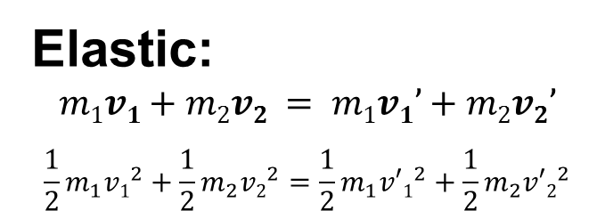
Types of Collisions and Conservation
TYPE
Kinetic Energy
Momentum
Elastic:
$$m1v1+m2v2 = m1v1’+m2v2’$$
$$\frac{1}{2}m_{1}{v1}^{2}+\frac{1}{2}m_{2}{v2}^{2}=\frac{1}{2}m_{1}{v′1}^{2}+\frac{1}{2}m_{2}{v′2}^{2}$$
Conserved
Conserved
Inelastic:
$$m1v1+m2v2 = m1v1’+m2v2’$$
NOT conserved
Conserved
Perfectly Inelastic:
$$m1v1+m2v2 =(m1+m2)v’$$
NOT conserved
Conserved

Slide 6
Example problem 1:
A freight train is being assembled in a switching yard. Boxcar #1 has a mass of 6.5 x 10⁴ kg, and Boxcar #2 has a mass of 9.2 x 10⁴ kg. If car 1 is moving with a velocity of +0.80 m/s, and car 2 hits it from behind with a velocity of +1.2 m/s, with what velocity will the two cars move with together after coupling?

Slide 7
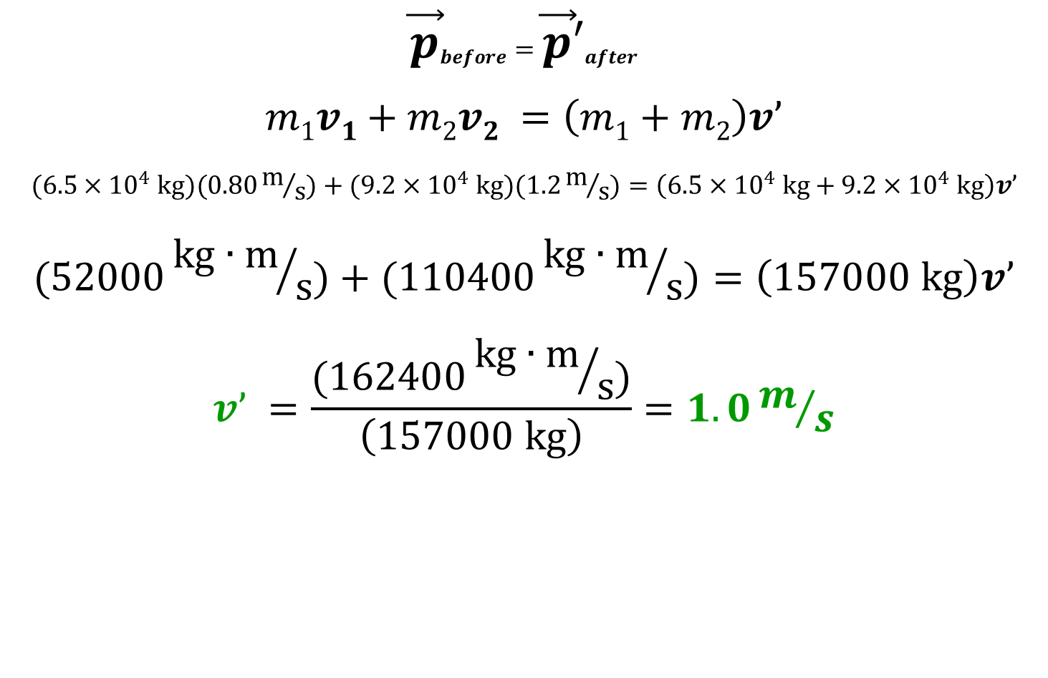
Example problem 1: solution
$${\vec{p}}_{before}={\vec{p}′}_{after}$$
$$m1v1+m2v2 =\left(m1+m2\right)v’$$
$$(6.5×{10}^{4} kg)(0.80m/s)+(9.2×{10}^{4} kg)(1.2m/s)=\left(6.5×{10}^{4} kg+9.2×{10}^{4} kg\right)v’$$
$$(52000{kg∙m}/s)+(110400{kg∙m}/s)=\left(157000 kg\right)v’$$
$$v’ =\frac{(162400{kg∙m}/s)}{\left(157000 kg\right)}=1.0m/s$$

Slide 8
Example Problem 2:
Starting from rest, two ice skaters push off against each other on smooth, level ice. Skater 1 has a mass of 54 kg and moves away from her friend (mass = 88 kg) with a velocity of 2.5 m/s. Find the “recoil” velocity of the second skater.

Slide 9
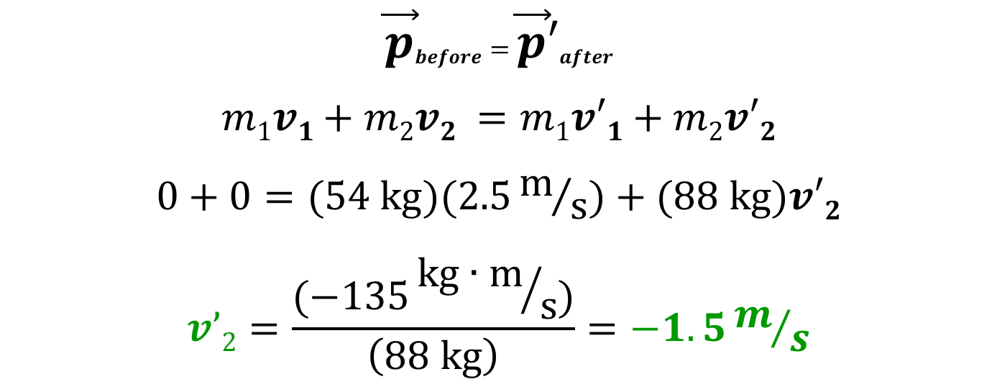
Example Problem 2: Solution
$${\vec{p}}_{before}={\vec{p}′}_{after}$$
$$m1v1+m2v2 =m1v′1+m2v′2$$
$$0+0=(54 kg)(2.5m/s)+(88 kg)v′2$$
$$v’2=\frac{(−135{kg∙m}/s)}{\left(88 kg\right)}=−1.5m/s$$

