Slide 1
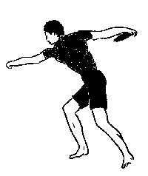
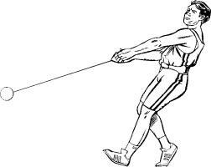
PHYSICS: Discus and Hammer
Sample PowerPoint

Slide 2
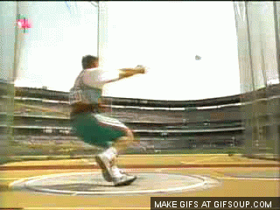
The Basics of Discus and Hammer Throwing:
The goal of throwing is to send the discus or hammer
the farthest distance.
In order to do this, the thrower spins within a
designated circle before releasing the discus or
hammer.
This technique is shown by the GIF to the right.
To leave the circle is to be disqualified.
The men’s hammer weighs 7.26 kg, while the men’s discus weighs 2 kg.

Slide 3
Technique: Impulse-Momentum Theorem
One of the most common techniques to furthering the distance a discus or hammer travels is to increase the speed of the throw.
The Impulse-Momentum Theorem states:
Force∙∆time = mass∙∆velocity
Thus saying that a decrease in time will allow for an increase in force, which would create an increase in velocity.
The faster the discus or hammer travels, the farther it will go.
Two ways to decrease time are:
1. By decreasing the amount of time taken to spin
2. By decreasing the amount of time taken to release the hammer or discus from hand
By decreasing the amount of time taken to spin through the circle, the more force the thrower can apply to the discus or hammer.
As well, by decreasing the amount of time taken to release the discus or hammer from hand, the more force the thrower can apply to the tool.

Slide 4
Technique: Conservation of Momentum
Another common technique used by throwers is to switch feet right after they throw the discuss or hammer in order to decrease their momentum.
The separation of discus/hammer and thrower creates a decrease in mass and therefore an increase in velocity.
The Law of the Conservation of Momentum states that the momentum within a system must be maintained.
When the thrower releases the discus or the hammer, the two become separate systems, but with the same momentum.
As both have the same momentum, but both have lost mass, both objects experience an increase in velocity, to make up for loss of mass.
The discus or hammer will experience a greater increase in velocity as it has a smaller mass than that of the thrower, and thus has to make up for a greater amount of mass.
The discus or hammer flies straight out until it lands, where it disperses its momentum into the ground.
The thrower continues to travel in the direction of their spin. To get rid of their momentum (and stay within the circle) the thrower switches feet, dispersing their momentum into the ground as well.

Slide 5
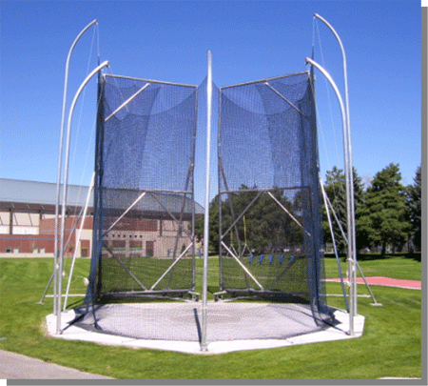
Safety: Impulse-Momentum Theorem
All discus and hammer arenas are encircled by a net, in order to stop the spectators from being hit, should the thrower improperly release or drop the discus or hammer.
The net, rather than being taut, hangs loose from curved poles as
shown by the picture to the right.
By hanging loose, the net moves with the discus or hammer slightly
before stopping it.
This movement increases the amount of time the net takes to stop the hammer.
The Impulse-Momentum Theorem states:
Impulse = ΔMomentum = Force∙∆time
Thus, by increasing the amount of time taken to apply a force – in this case used to decrease momentum – less force is required by the net to stop the discus or hammer.
Hammer cages have stronger nets and more hang to them, in order to counteract the heavier weight of the hammer (The men’s hammer weighs 7.26 kg while a men’s discus weighs only 2 kg)

Slide 6
Safety: Conservation of Momentum
The Law of the Conservation of Momentum states that the momentum within a system must be maintained.
Therefore, when the discus or hammer hits the inside of the cage they become a single system.
The momentum within the system is maintained as the momentum is transferred from discus/hammer to the cage.
The mass and size of the net allow for the discus/hammer’s momentum to be safely dispersed through the entire system.

