Slide 1
Electromagnetic Waves!
The EM and Visible Spectra

Slide 2
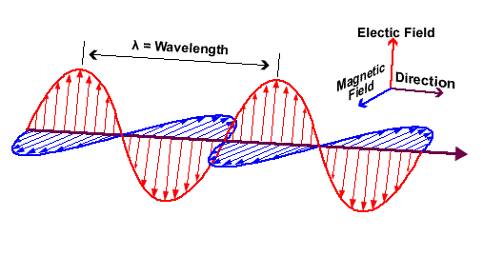
Electromagnetic Waves
Electromagnetic (EM) waves are waves caused by oscillations occurring simultaneously in electric and magnetic fields
A 2D transverse
wave
They DO NOT require any medium in order to propagate
As energy increases, frequency increases
This is DIFFERENT than mechanical waves in which increases energy increases amplitude
Notes:
A wiggling electron wiggles the E field. A wiggling E field will induce a wiggling B field!

Slide 3
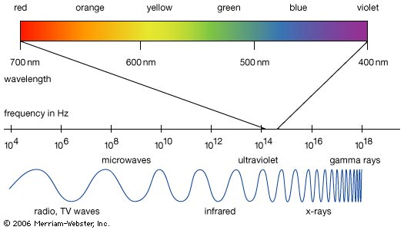
Electromagnetic Spectrum
Gamma Rays
High energy radiation that comes from nuclear decay process
Uses: cancer treatment, sterilization
X-Rays
Penetrates soft tissue
Uses: medical imaging, airport security, telescopes
Ultraviolet
Causes damage to skin tissue
Uses: sun tans, preventing currency forgery, sterilization
Notes:
Higher frequencies are more dangerous and can travel through more dense materials
When EM waves enter a medium, they get slowed down.

Slide 4
Electromagnetic Spectrum
Visible Light
Frequencies than stimulate the retina of the human eye: 400 nm (violet) – 700 nm (red)
Uses: seeing, lasers, CD and DVD players, printers
Infrared
Radiation associated with heat
Uses: remote controls, heal injuries, thermal imaging
Microwaves
Uses: cooking, cell phones, radar, speed cameras
Radio Waves
Uses: various forms of communication

Slide 5
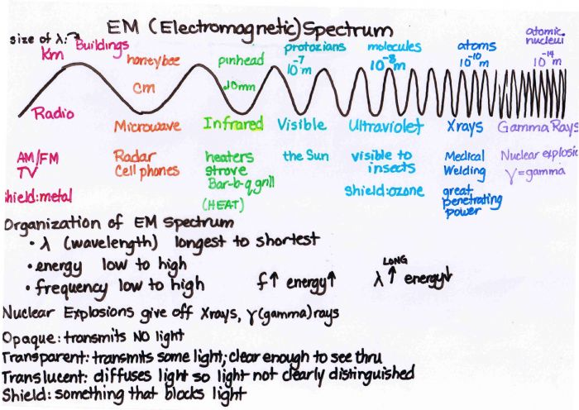

Slide 6
Speed of Light
Light travels in straight lines in a uniform medium or a vacuum
Our eyes will ALWAYS assume light has traveled in a straight line to reach our eyes
All EM waves travel at the same speed
c = 3.00 x 10⁸ m/s
Galileo hypothesized that light has a finite speed
Ole Roemer quantifies speed of light in 1676 using the orbital period of Io (Jupiter's moon)

Slide 7
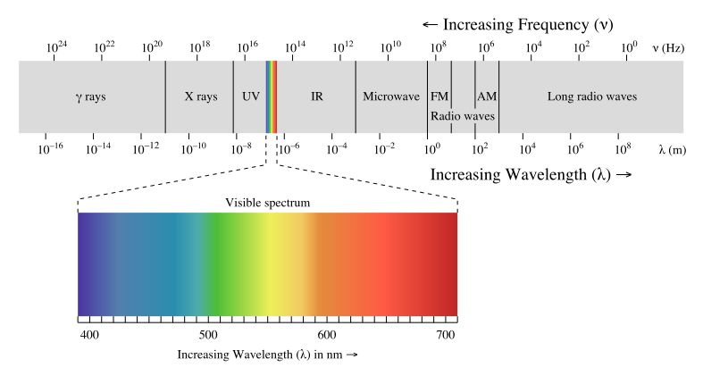
Visible Light
Light is kind of weird
It acts like as an EM wave
And it acts like a stream of particles (photons)
Light is the only thing we can actually see
Visible light is a small portion of the EM spectrum

Slide 8
Light as a Particle
Light can propagate in a straight line (lasers)
Light is emitted in “packets” of energy called photons
Each photon is a particle-like packet with a discrete (quantum) amount of energy
Higher intensity light (brighter) means more photons
Higher frequency light means that each photon carries more energy

Slide 9
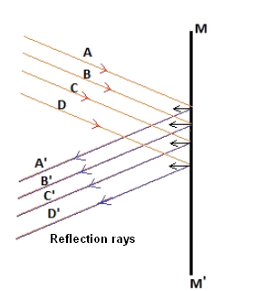
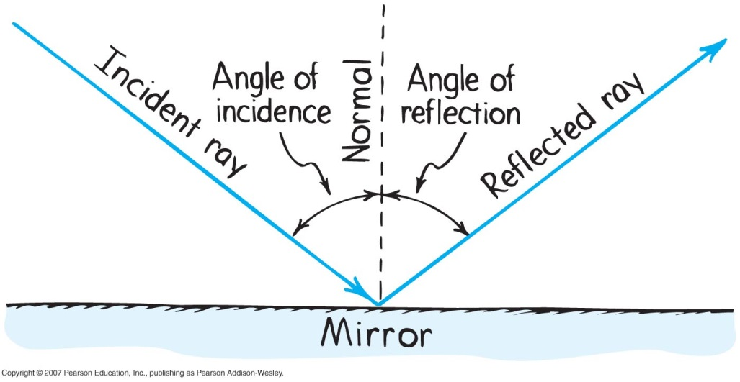
Light as a Wave
Light demonstrates the wave properties we’ve been talking about in the unit.
Light waves are reflected
In regular (specular) reflection, incident light rays are parallel to each other and reflect parallel to each other
Remember the law of reflection!
Angle of incidence = angle of reflection

Slide 10
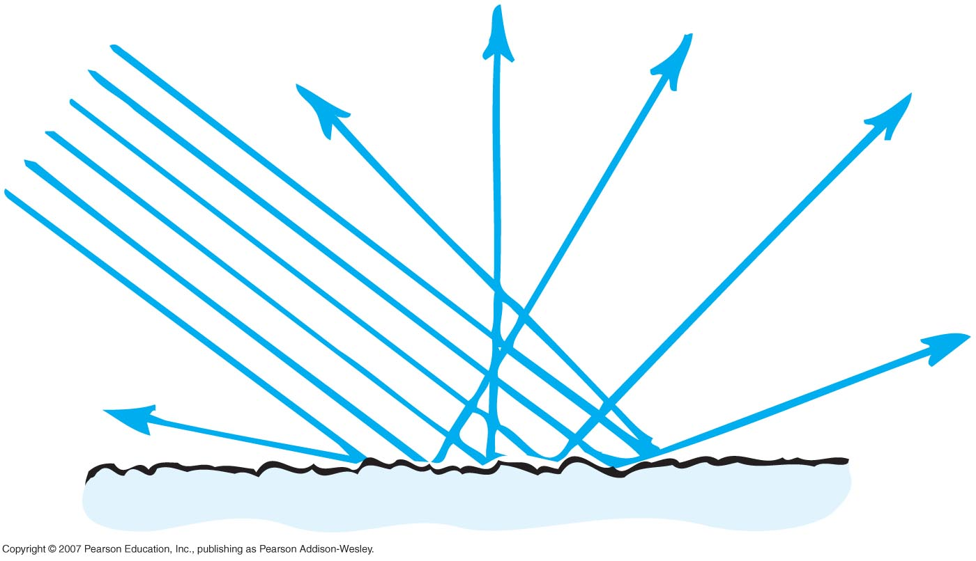
Reflection (continued)
Diffuse reflection occurs when light is scattered when it reflects off a surface
At a microscopic level, most surfaces are very rough

Slide 11
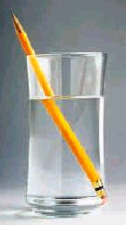
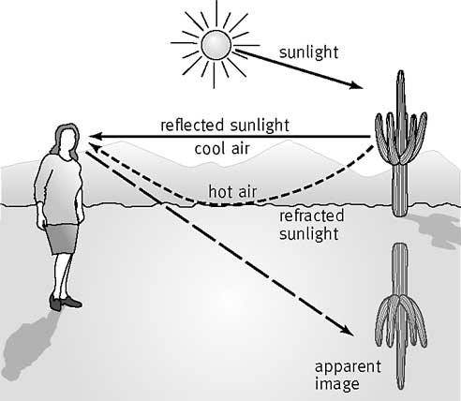
Refraction
Light also bends when it enters a new medium
For example, light travels faster in air than in water, so this pencil looks broken
Also what causes mirages

Slide 12
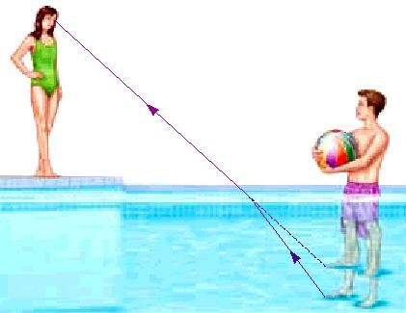
The girl sees the boy’s foot closer to the surface than it actually is.
Air (20°C)
If the boy looks down at his feet, will they seem closer to him than they really are?
No! He is looking straight down and not at an angle. There is no refraction for him.

Slide 13
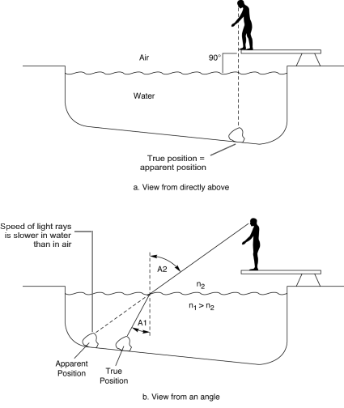

Slide 14
Light Wave Refraction
At a boundary between two media, the ratio of the sines of the angles made by a wave with respect to the normal line will be a constant.
$$\frac{\sin{θ_{1}}}{\sin{θ_{2}}}=constant$$
The constant is the refractive index (n) or index of refraction, a property of the medium itself.
It is the ration of the speed of light in a vacuum (c) and the speed of light in the medium.
It has no units, they cancel out!
For example, n_{water} = 1.3, so light moves 76.9% as fast in water as it does in a vacuum like space.
$$n=\frac{c}{v}$$

Slide 15
Law of Refraction
Snell’s Law:
Using these two ideas, we get the law of refraction, also known as Snell’s Law:
$$n_{1}\sin{θ_{1}}=n_{2}\sin{θ_{2}}$$
n₁ is the index of refraction of the incident medium,
n₂ is the index of refraction of the refractive medium,
θ₁ is the angle of incidence
θ₂ is the angle of refraction

Slide 16
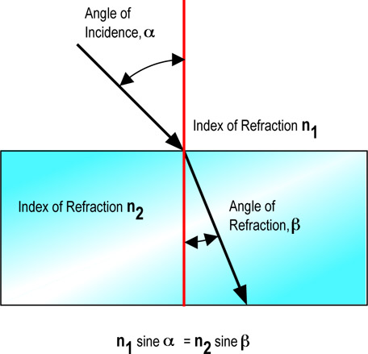

Slide 17
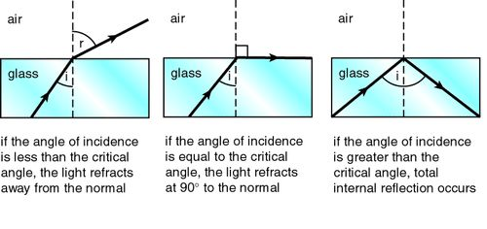
Critical Angle
The critical angle is the angle of incidence in the more optically dense medium at which the angle of refraction in the less optically dense medium is exactly 90°.

Slide 18
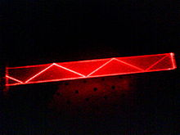
Total Internal Reflection
Total internal reflection occurs when light falls on a surface of a less optically dense medium at an angle of incidence equal to or greater than the critical angle of the substance.
There is no refracted ray; occurs at critical angle.
Only occurs when a light ray passes from a more optically dense substance into a less optically dense substance.
The principle behind fiber optics and binoculars

Slide 19
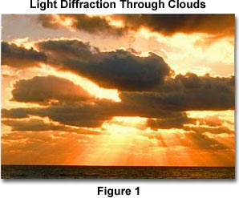
Diffraction
Light can also be diffracted, meaning it bends around edges and barriers:

Slide 20
Polarizing Light
You can polarize light by making it vibrate in only one plane, not 2 like it usually does
Used in sunglasses
This cuts down the intensity of light
2 polarizing materials places at 90° angles will block out all light

Slide 21
Light Interacting with Bodies
Luminous bodies emit light (i.e. – the Sun)
Luminous Flux (P) is the rate at which visible light is emitted from a source
Units: Lumen (lm)
A typical 100 W light bulb emits ~1750 lm
Illuminated bodies are actually reflecting light from another source (i.e. – the Moon)
Illuminance (E) is the rate at which light falls on a surface
Units: Lumens per square meter (lm/m²) = Lux (lx)
Area used is that of a sphere 4πr²
Luminous Intensity (I) is the luminous flux that falls on 1 m² area 1 meter from a source
Units: Candela (cd) – “candle power”

