Slide 1
Errors and Uncertainties
LT: I can make the difference between random and systematic errors

Slide 2
Types of Experimental Errors:
Random Errors:
A result of variations in the performance of the instrument and/or the operator
Do NOT consistently occur throughout a lab
Some examples:
Vibrations or air currents when measuring mass
Inconsistent temperature (i.e. of the air) throughout a lab
Irregularities in object being measured (i.e. the wire is not the same thickness at all points along its length)
Human parallax error

Slide 3
Types of Experimental Errors:
So what can be done about random errors?
Don’t rush through your measurements! Be careful!
Take as many trials as possible—the more trials you do, the less likely one odd result will impact your overall lab results

Slide 4
Types of Experimental Errors:
Systematic Errors:
Errors that are inherent to the system or the measuring instrument
Results in a set of data to be centered around a value that is different than the accepted value
Some Examples:
Non-calibrated (or poorly calibrated) measuring tools
A “zero offset” on a measuring tool, requiring a “zero correction”
Instrument parallax error

Slide 5
Types of Experimental Errors:
What can be done to reduce these?
Unfortunately, nothing…HOWEVER:
We can account for the systematic errors sometimes:
i.e. if there’s a zero offset, make sure all your data has been adjusted to account for that.
Recognizing systematic errors will impact the size of your absolute uncertainty (more details soon ☺)

Slide 6
Are These “Errors”?
Misreading the scale on a triple-beam balance
Incorrectly transferring data from your rough data table to the final, typed, version in your report
Miscalculating results because you did not convert to the correct fundamental units
Miscalculations because you use the wrong equation

Slide 7
Are These “Errors”?
NONE of these are experimental errors
They are MISTAKES
What’s the difference?
You need to check your work to make sure these mistakes don’t occur…ask questions if you need to (of your lab partner, me, etc.)
Do NOT put mistakes in your error discussion in the conclusion

Slide 8
Accuracy vs. Precision
Accuracy:
How close a measured value is to the actual (true) value.
Precision:
Precision is how close the measured values are to each other.

Slide 9
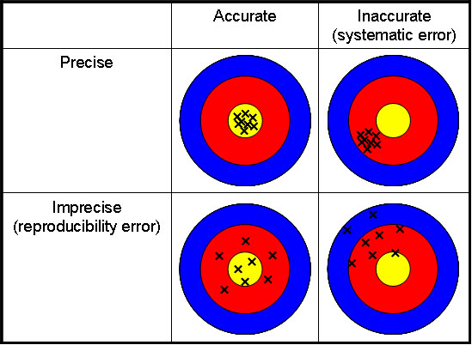
Accuracy vs. Precision

Slide 10
Measuring in Physics
When I record a measurement in physics, I write down all of the numbers I’m sure of – PLUS one estimated place.
Example:
I’m certain of: 4.9 cm (not quite to 5 yet)
I estimate: It reached 3/10ths of the space between markings
My measurement is recorded as: 4.93 cm

Slide 11
Absolute Uncertainty
The smallest uncertainty in a measurement is ± half the smallest division
Example:
I’m certain of: 2.3 cm
I estimate: 2/10ths of the space between markings
½ the smallest division: 0.05 cm
My measurement is recorded as: 2.32 ± 0.05 cm

Slide 12
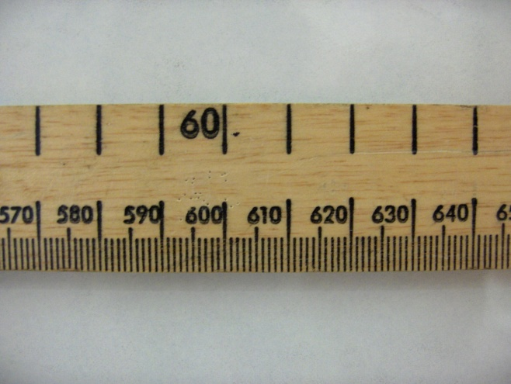
Absolute Uncertainty
Consider a ruler: The uncertainty is +/- ½ a division
It has an uncertainty of ±0.5mm
Now consider the time taken for a ball to drop:
Drop no. | Drop 1 | Drop 2 | Drop 3 | Uncertainty
Time taken to fall/s | 0.46 | 0.43 | 0.50 | The maximum value – the average 0.46 (+/- 0.04)

Slide 13
How Accurate or Precise Am I?
How precise is my measurement?
$$Percent Uncertainty=\left|\frac{Uncertainty}{Average Value}\right|×100\%$$
How accurate is my measurement?
$$Percent Error=\left|\frac{Actual Value−Predicted Value}{Actual Value}\right|×100\%$$

