Slide 1
Geophysics!
Waves in Nature

Slide 2
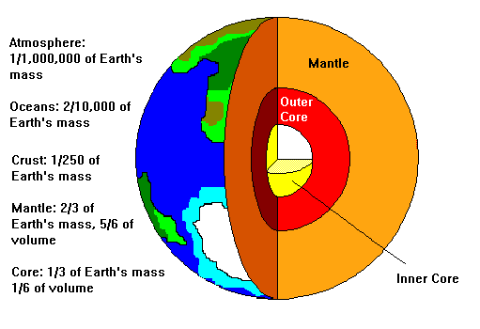
Earth’s Structure

Slide 3
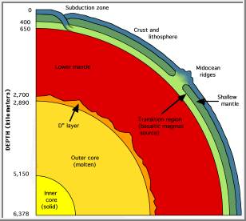
Earth’s Layers
Inner Core:
Solid,
Mainly Iron and Nickel
~4500 °C
Outer Core:
Liquid
Mainly Iron and Nickel
~3200°C
Mantle:
Asthenosphere
Top layer
Liquid-like solid
Most of the mantle is solid
Crust:
Relatively thin
Solid

Slide 4
Plate Interactions
Plate Tectonics: The study of the large-scale movement and deformation of the earth’s outer layers.
Behavior at plate boundaries:
Divergent
Plates are moving away from each other
Transform
Plates move past each other
Looks like a spreading ridge (i.e. -San Andreas Fault)
Convergent
Plates are coming together
Ocean meeting continental = subduction zone
Continental meeting continental = mountain

Slide 5
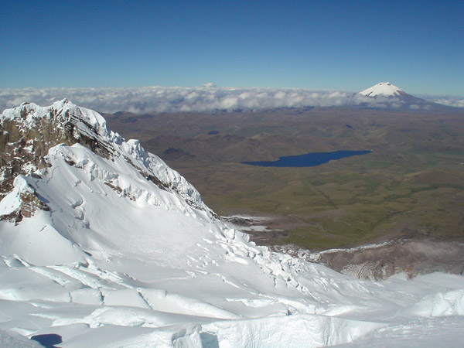
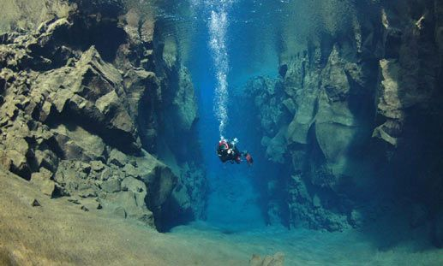
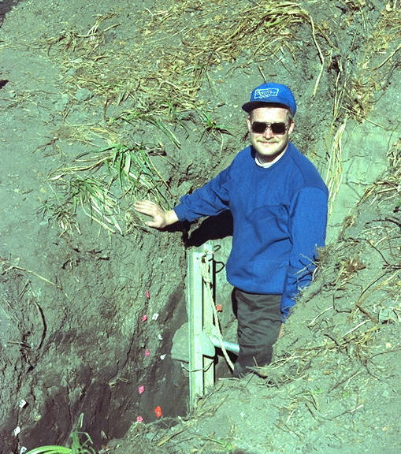
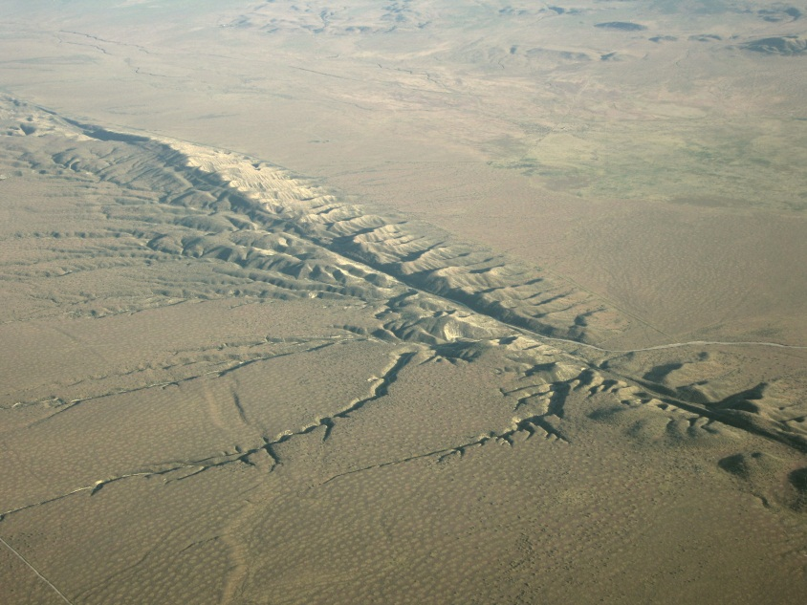
Examples!

Slide 6
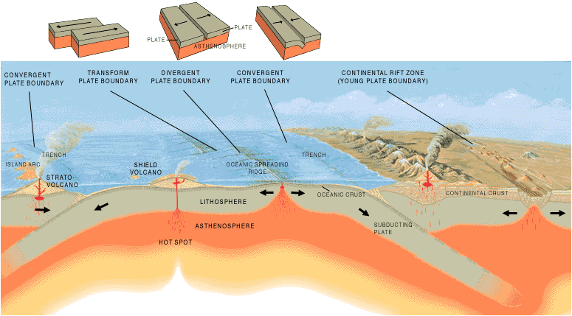

Slide 7
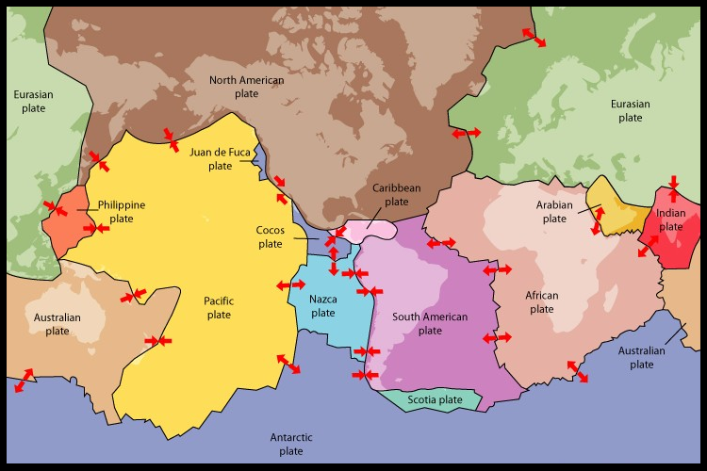
Global Plate Boundaries

Slide 8
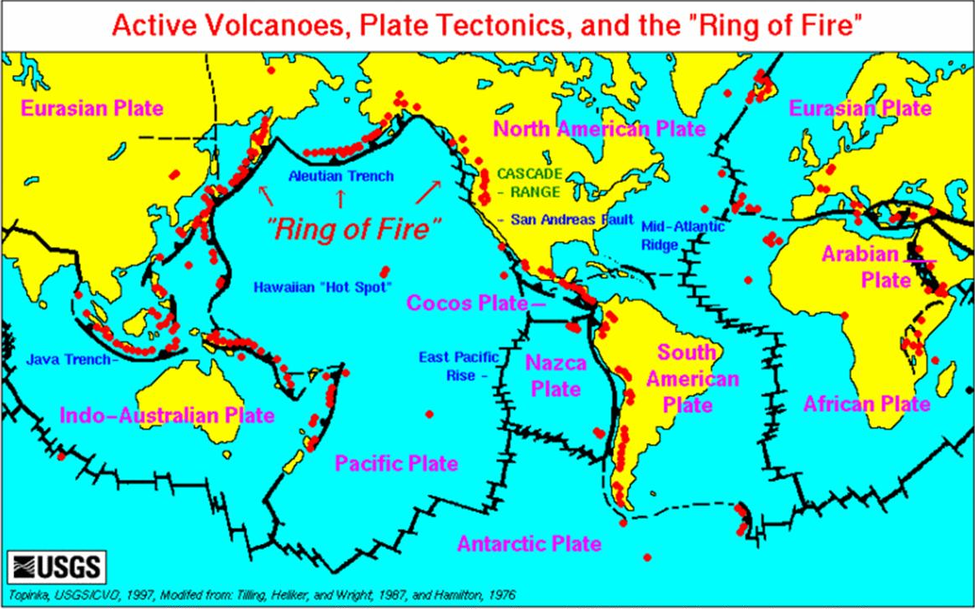

Slide 9
Earthquakes!
An earthquake is a sudden movement occurring to release stress that builds up between plate boundaries
Elastic deformation occurs in the rock under stress (after, it rebounds to its original position)
Focus: the point where the earthquake occurs
Epicenter: the point on the earth’s surface directly above the focus.
Earthquakes can be caused by:
Tectonic activity
Volcanic activity
Large shifting masses

Slide 10
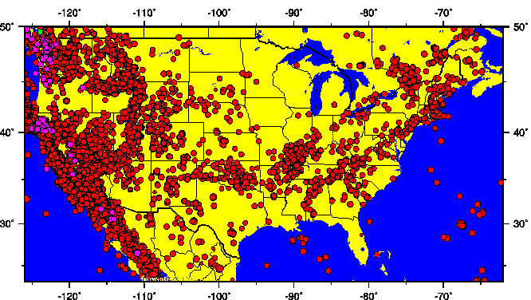
Earthquakes in the U.S.

Slide 11
Seismology
Seismology is the study of earthquakes and the propagation of seismic waves.
Primary Waves (P-Waves):
Longitudinal Waves
These waves arrive first
Travel through solid, liquid, and gas
Secondary Waves(S-Waves):
Transverse Waves
These waves arrive after the p-waves
Only travel through solids
Surface Waves:
Travel along the surface boundary between media
These waves are the slowest, but are responsible for the damage in large earthquakes

Slide 12
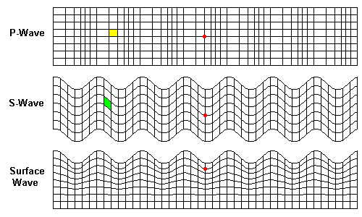
Seismic Waves
Primary Waves (P-Waves):
Longitudinal Waves
Secondary Waves(S-Waves):
Transverse Waves
Surface Waves:
Travel along the surface boundary between media

Slide 13
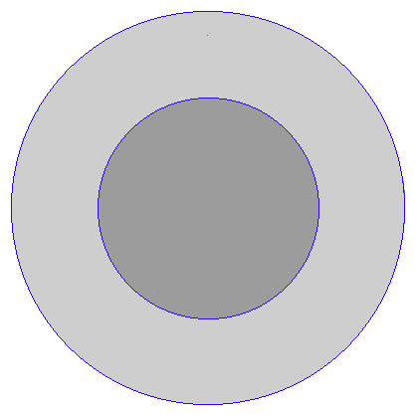
Refraction in Action!
Below we see the ray paths for p-waves :

Slide 14
Refraction in Action!
Below we see the wave fronts for p-waves :

Slide 15
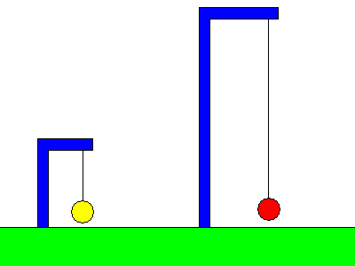
Seismographs
Seismographs record magnitude and duration of the earthquake
How do they work?
Varies by design (pendulum, electric,
etc.)
HOWEVER, the basics are the same:
The main housing of the seismograph is fixed to the earth, so it will shake with seismic activity.
The recorder is attached to a free hanging object (like the pendulum in the animation).
The inertia of the recorder keeps it from moving with the housing, thus recording the movement of the earth due to the seismic waves!

Slide 16
Seismographic Scales
Richter Scale: used to determine the magnitude (energy released) of an earthquake
Factors that affect the damage done:
Magnitude
Closeness to population
Duration
Geology
Structural design

Slide 17
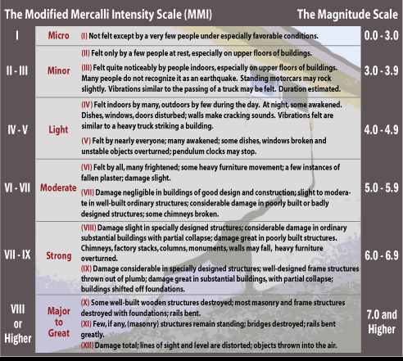
Seismographic Scales
Modified Mercalli Scale: used to determine the intensity (damage, effects) of an earthquake

Slide 18
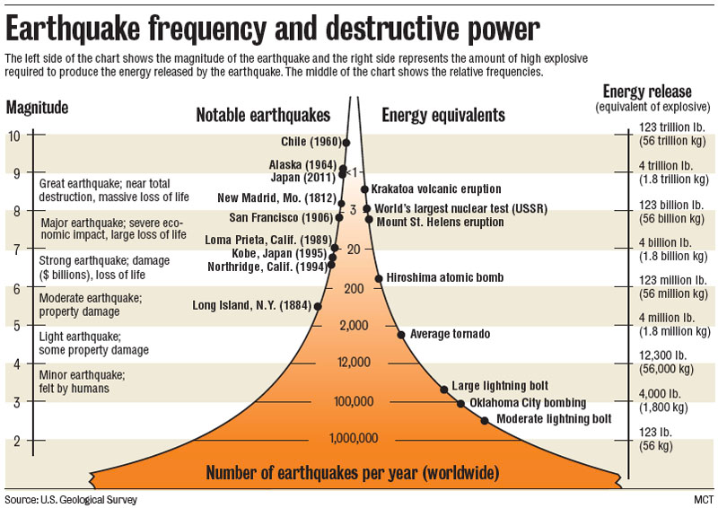

Slide 19
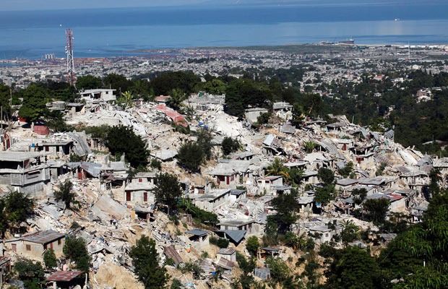
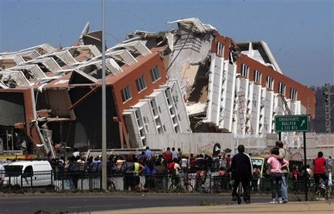
Haiti (2010)
Chile (2010)
Magnitude: 7.0
Deaths: ~200,000
Damage: $14 billion
Magnitude: 8.8
Deaths: ~700
Damage: $30 billion
The importance of earthquake resistance structures!

Slide 20
Water Waves
Traditional water waves act as surface waves
Refraction occurs around headlands (land jutting out into the water)
Waves bend inward toward the headland and focus the energy there
Long term effects include a rounding out of angular coastline features, erosion of headlands, and deposition of sediment in lower energy locations such as bays

Slide 21
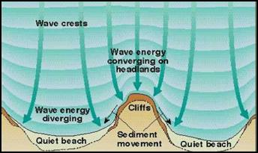
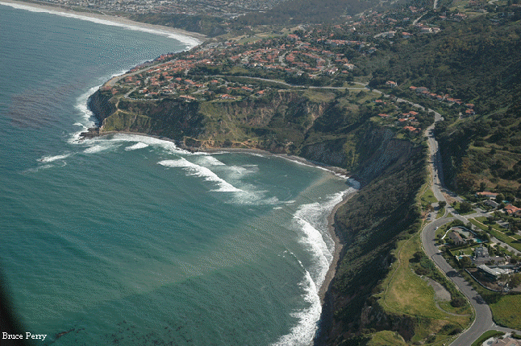
Water Wave Refraction

Slide 22
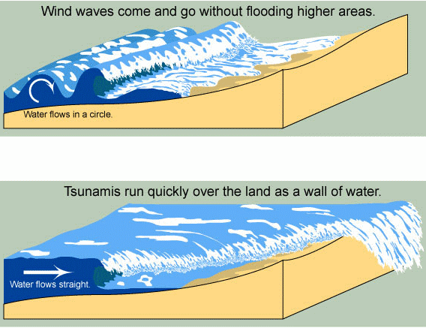
Water Waves vs. Tsunamis

Slide 23
Tsunamis
Tsunamis are long sea waves
Travel up to 1000 km/hr (600+ mph)
Wavelengths can be hundreds of kilometers!
Develop large amplitude when approaching land (15+ meters)
Causes of tsunamis:
Earthquakes causing tectonic displacement
Volcanic eruptions causing seismic activity
Landslides above or below water
Asteroids (very rare)
Water is pulled swiftly seaward between swells

Slide 24
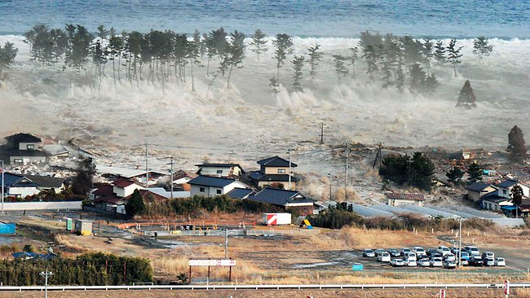
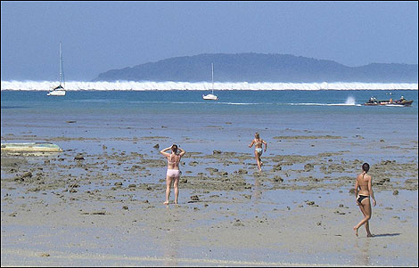
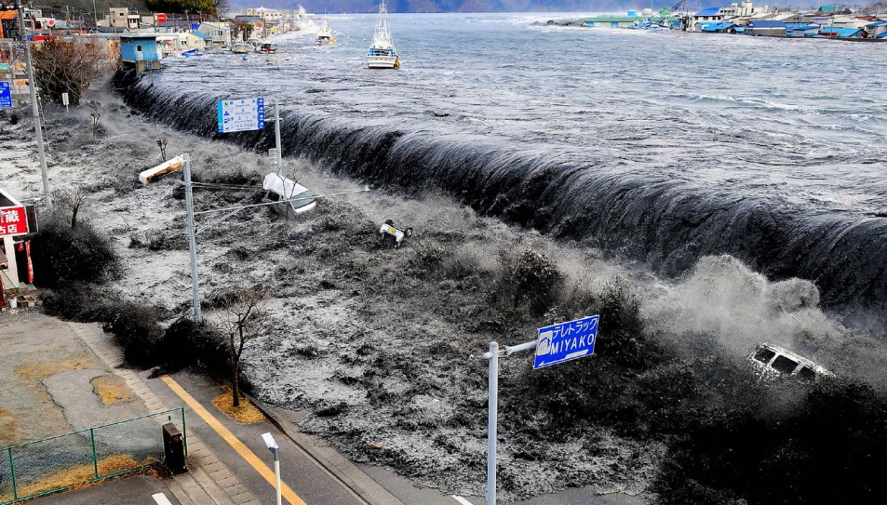
Tsunami Images
Two images on the right are the Japan Tsunami in 2011.
Below is Sri Lanka in 2004.

Slide 25
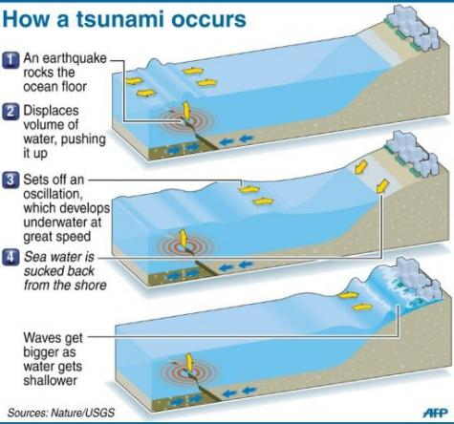

Slide 26
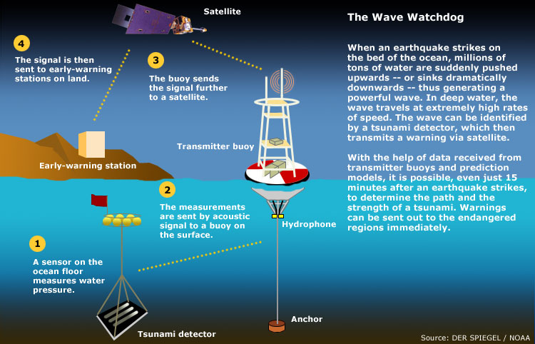
Tsunami Warning Systems

Slide 27
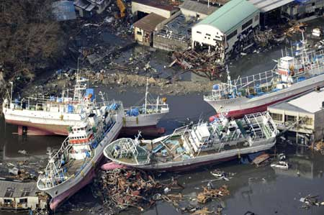
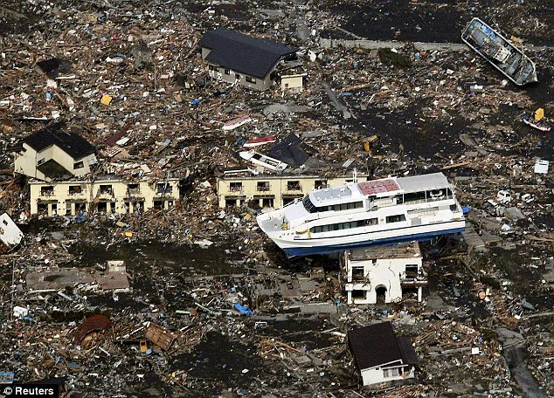
Sumatra (2004)
Japan (2011)
Magnitude: 9.2
Deaths: ~300,000
Damage: $10 billion
Magnitude: 9.0
Deaths: ~18,000
Damage: $300 billion
The importance of tsunami warning systems!

