Slide 1
Post-lab: Graphing Motion
Uniform Motion and Uniform Accelerated Motion
Read pages 27-36

Slide 2
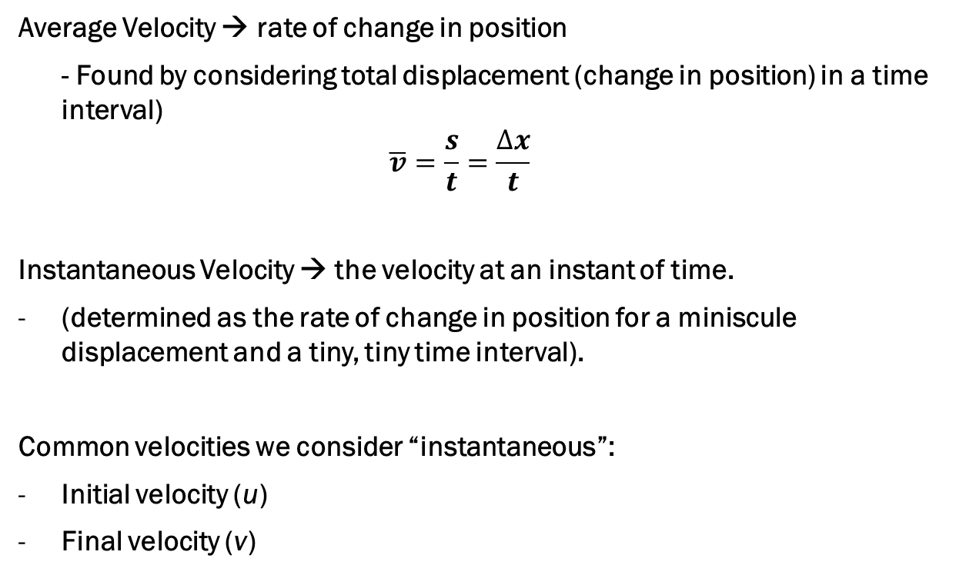
Average and Instantaneous Velocity
Average Velocity → rate of change in position
- Found by considering total displacement (change in position) in a time interval)
$$\overline{v}=\frac{s}{t}=\frac{∆x}{t}$$
Instantaneous Velocity → the velocity at an instant of time.
(determined as the rate of change in position for a miniscule displacement and a tiny, tiny time interval).
Common velocities we consider “instantaneous”:
Initial velocity (u)
Final velocity (v)

Slide 3
Uniform Motion
Implies a constant velocity throughout the object’s motion
Constant velocity:
Displacement through equal time intervals will be equal
Initial and final velocities are identical
Can be in positive or negative direction, but stays in same direction

Slide 4
Sketch the following graphs for uniform motion:
Position-time graph
Velocity-time graph
Acceleration-time graph

Slide 5

Acceleration
The rate of change in velocity of a moving object
$$a=\frac{∆v}{t}=\frac{v−u}{t}$$

Slide 6
Uniform Accelerated Motion
Implies a constant acceleration throughout the object’s motion
Constant acceleration:
Change in velocity through equal time intervals will be equal
Displacements are NOT equal through equal time intervals
Can be in positive or negative direction, but stays in same direction
Acceleration Direction | Velocity Direction | Effect to motion
Positive (+) | Positive (+) | Speed up
Positive (+) | Negative (-) | Slow down
Negative (-) | Positive (+) | Slow down
Negative (-) | Negative (-) | Speed up
Zero (0) | Any direction | Constant velocity

Slide 7
sketch—position time graph:
Neatly draw a set of axes for a position-time graph
Sketch a graph to show a constant, positive velocity for a biker. Assume the biker started at position x = 0.00 m
In a different color, sketch the graph for a biker moving with the same constant velocity, but starting at position x = 15.00 m
In a third color, sketch the graph for a biker traveling at the same speed, but in the opposite direction. This biker starts at position 50.00 m

Slide 8
Sketch #2
Draw a position-time graph to show a jogger who ran 50.0 m in 10.0 s, then rested for 15.0 s, then sprinted another 60.0 m (in the same direction) in 8.0 s.
Label your axes with scales appropriate to the motion being represented in the graph
How do you show the different velocities?

Slide 9
Sketch #3
Create a velocity-time graph to show the same information that you just represented in the previous position-time graph
Put scales on your axes
Show, specifically, how you can verify the displacement of the runner.

Slide 10
Sketch #4
Sketch a velocity-time graph showing a car that accelerates uniformly from rest to a final velocity of 25.0 m·s⁻¹ in 6.00 s.
Show and determine what the displacement of the car during its acceleration is.
What is the acceleration of the car, and how do you find it from the graph?

