Slide 1
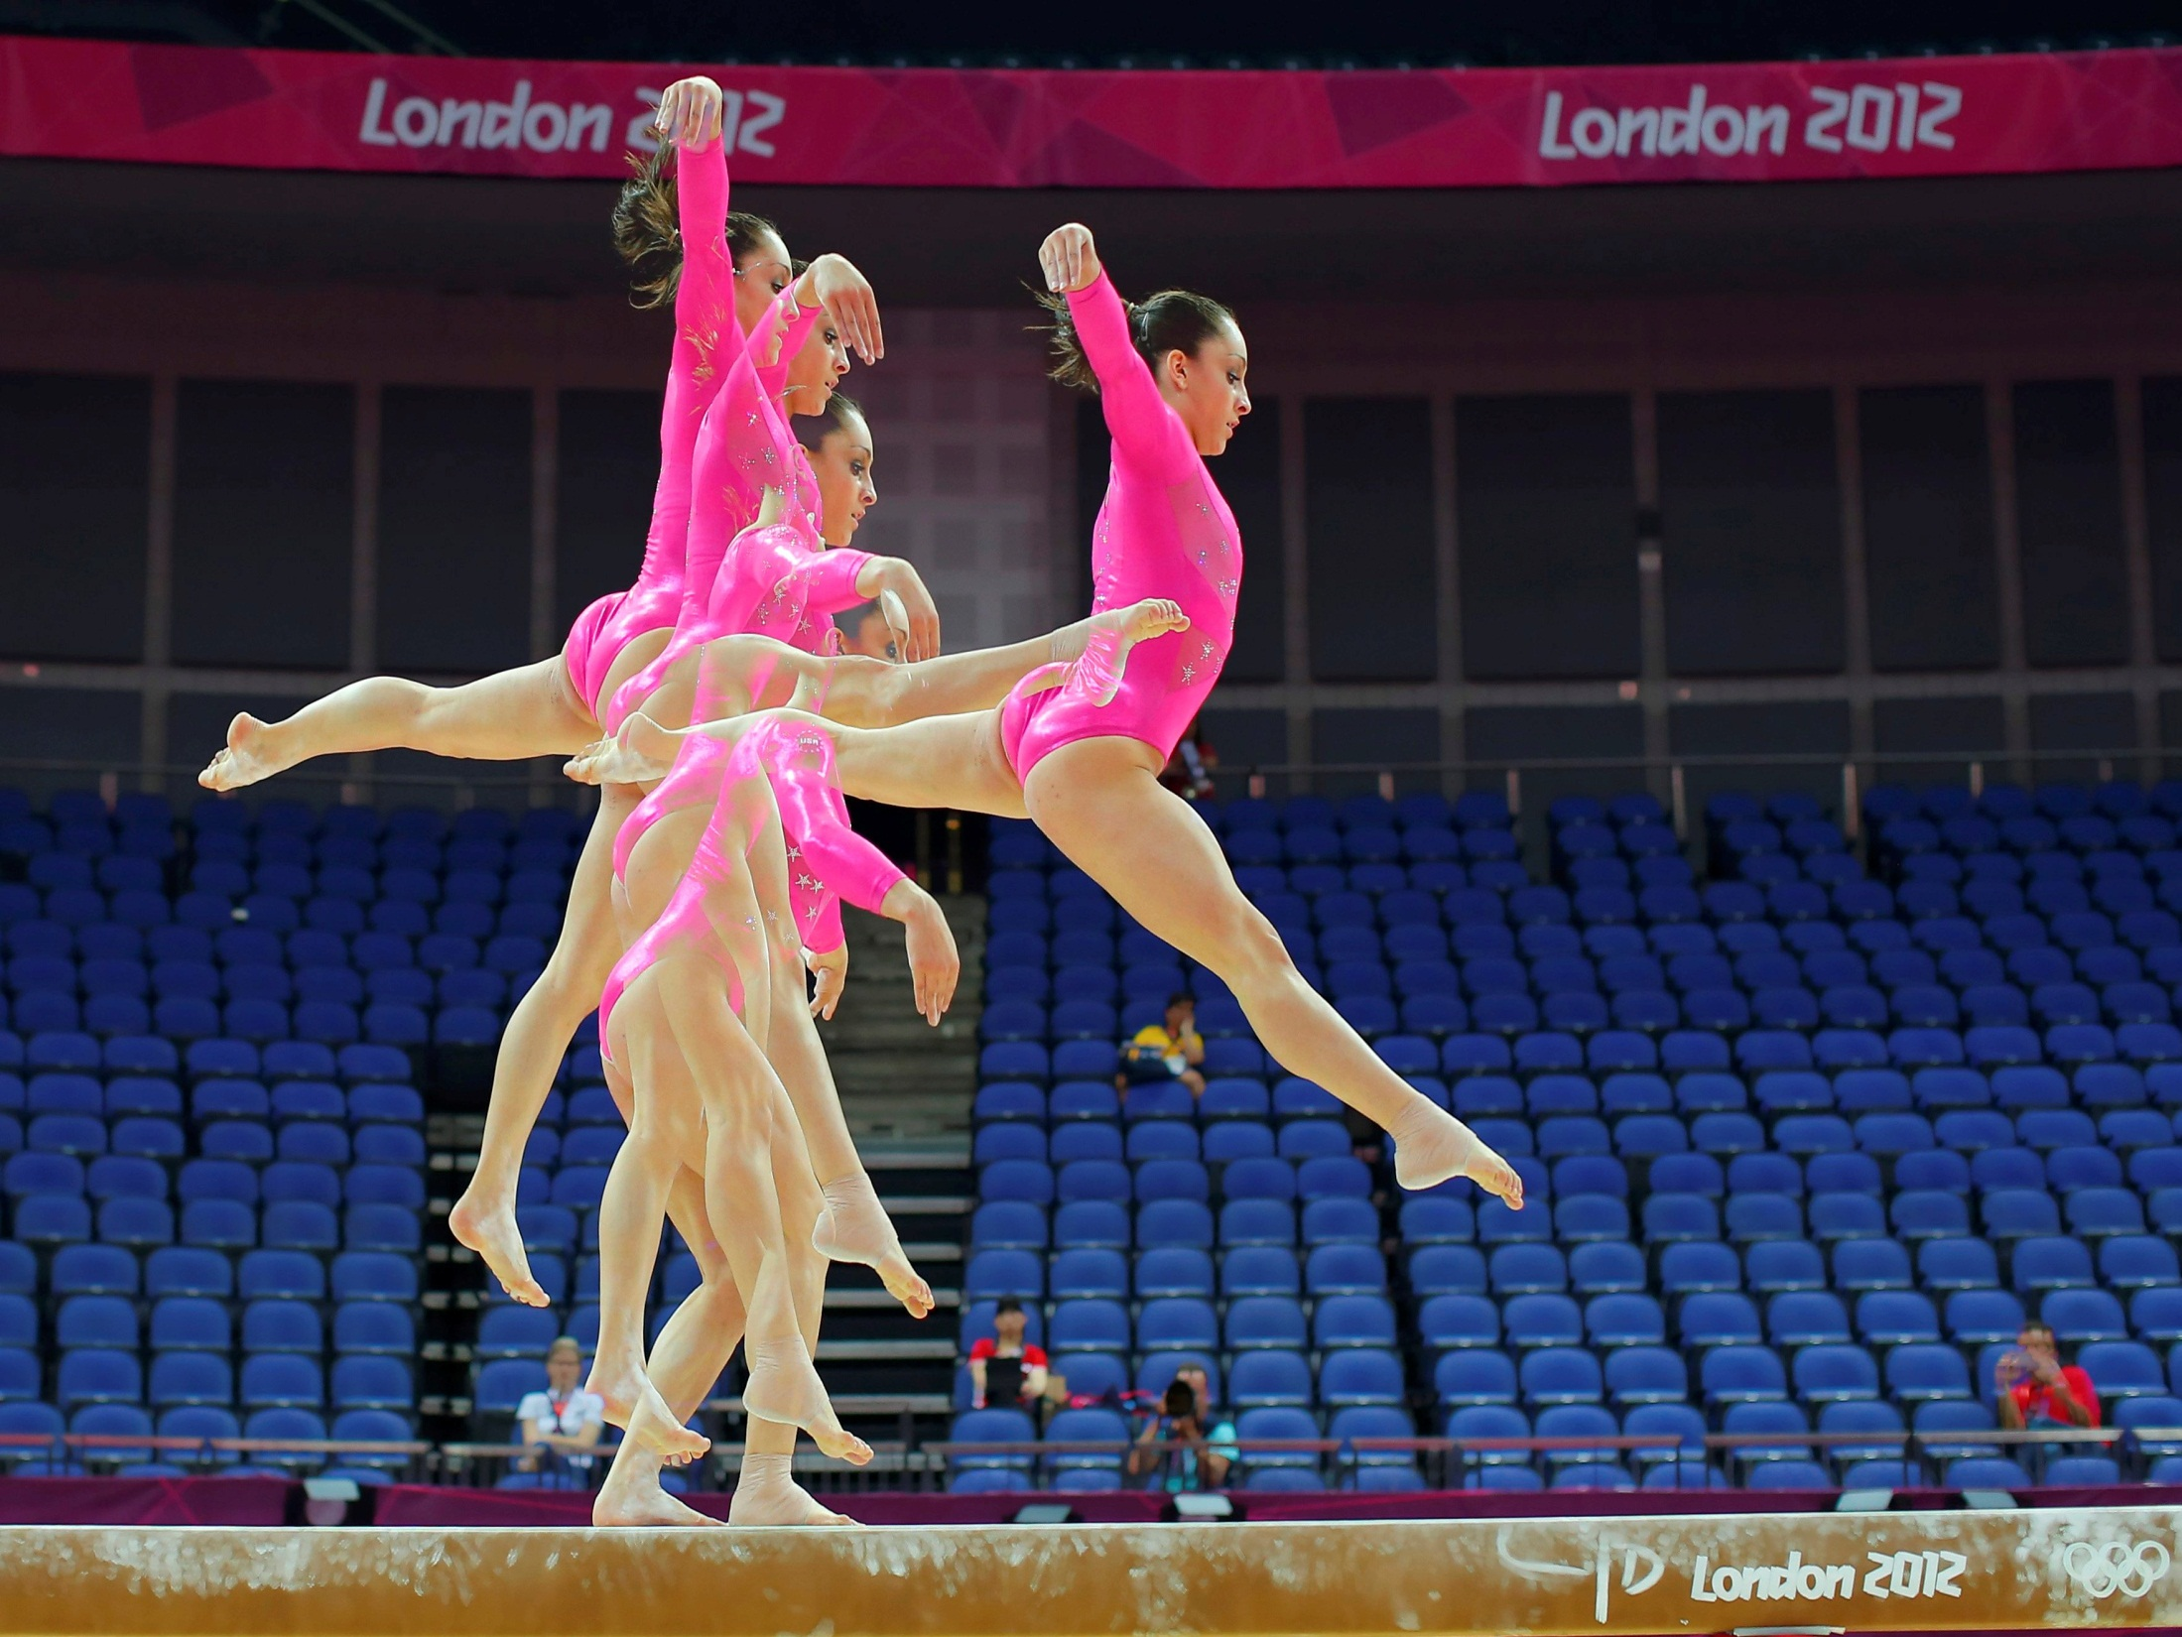
Physics: Gymnastics
By Student A and Student B

Slide 2
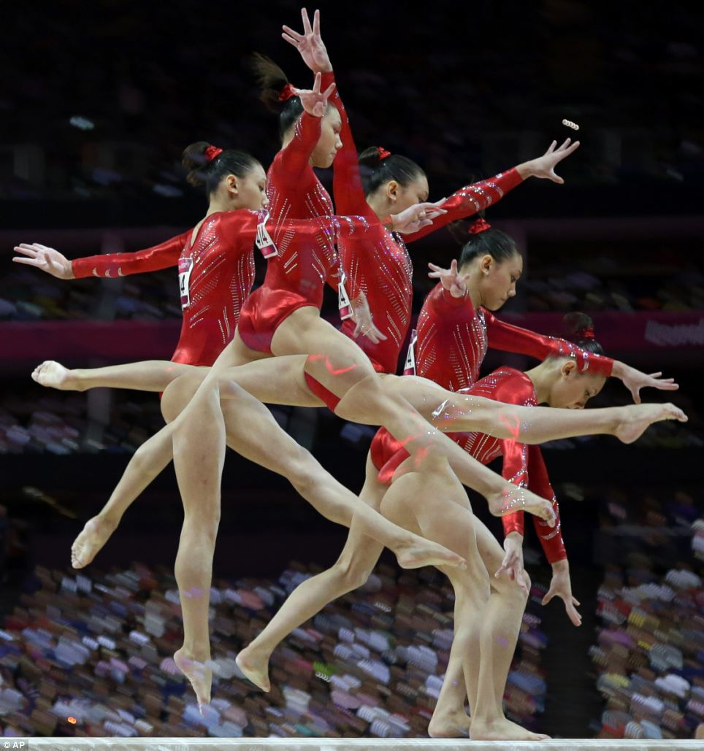
Basics of Gymnastics
Gymnastics is about perfection. A gymnast has many goals, including sticking her landings and staying on the apparatuses.
In order to perform her best, a gymnast must gain the most amount of momentum from everything she pushes off of during her flips, cartwheels, and tumbling.
In this picture, Kyla gained enough momentum from jumping on the beam to leap into splits in the air.

Slide 3
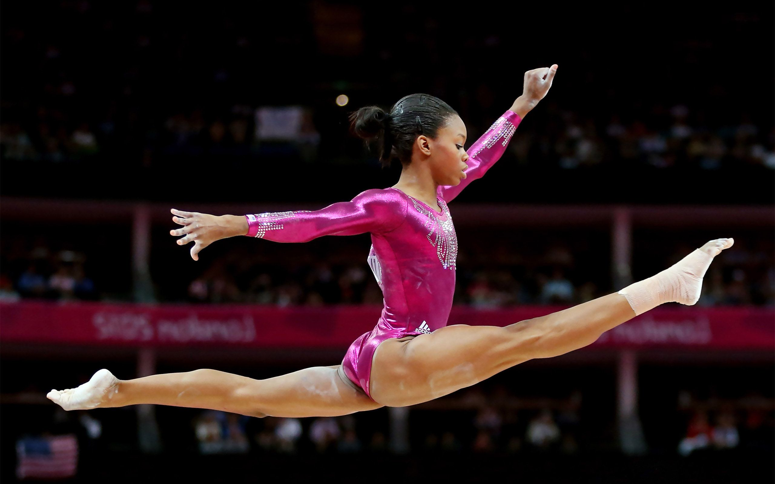
Impulse-momentum Theorem

Slide 4
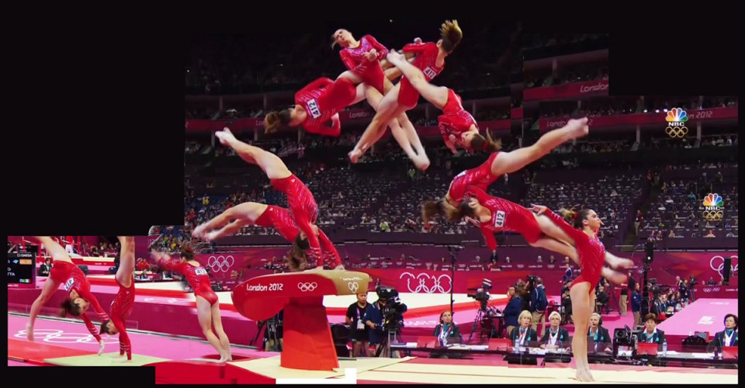
Technique: High speeds
The Impulse-Momentum Theorem states: Force∙∆time = mass∙∆velocity
Momentum through high speeds is one of the most important techniques in gymnastics. Gymnasts work up speed in order to get enough power and height to land their moves
They run at high speeds and then use their power to push off the floor, increasing velocity and momentum

Slide 5
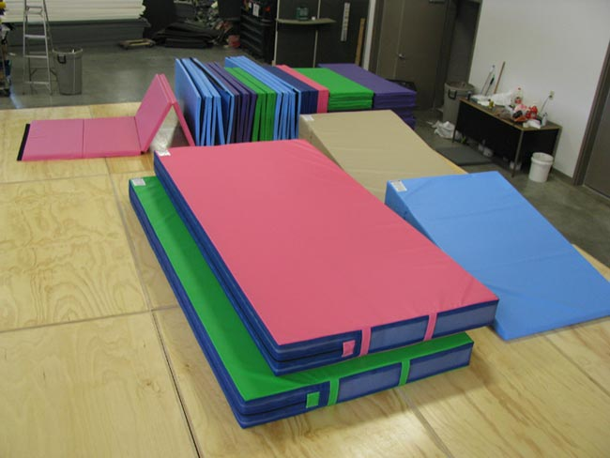
Safety: Gymnastic mats
Gymnasts perform on gymnastic mats to protect themselves when they collide with the mat
Much like the air bag example we discussed in class, gym mats are used by gymnasts to lessen the effect of the force they receive because the mat prolongs time in the equation Impulse = ΔMomentum = Force∙∆time

Slide 6
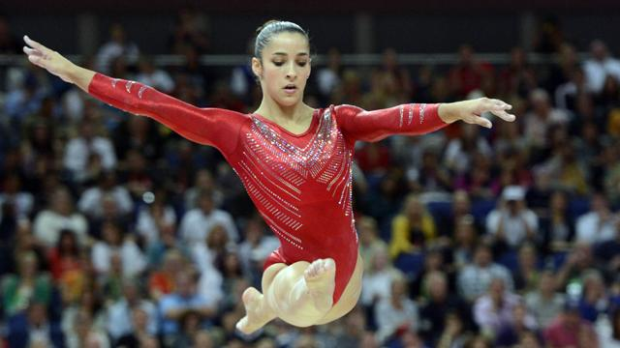
Conservation of Momentum
Conservation of Momentum

Slide 7
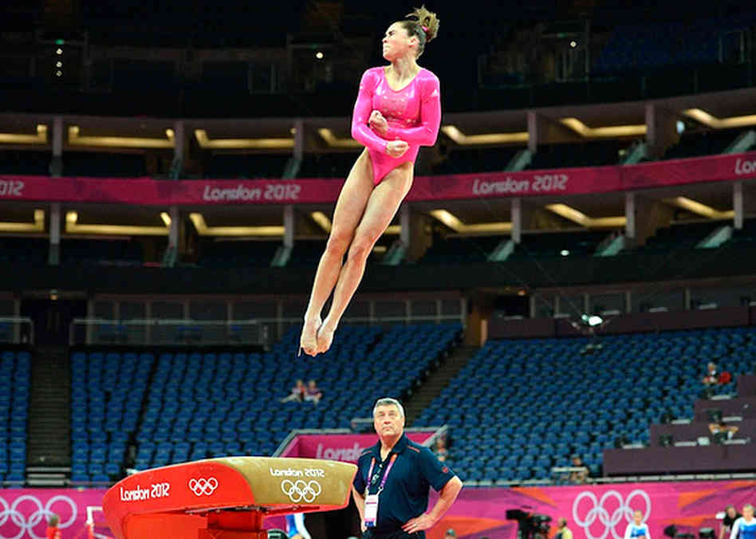
Technique: Vault Jump
When the gymnast jumps and makes a temporary handstand on the vault, she applies a force to the vault.
The hard vault in turn applies a strong reaction force on the gymnast that allows her to then push off the vault with the same momentum.
The momentum is conserved because the momentum first exerted on the vault is never lost, but rather reused.

Slide 8
Safety: Uneven Bars
Covered in soft material and chalk so that when a gymnast flips while on the bars and needs to grab hold of them when returning, the force of the impact is diminished somewhat because the momentum is transferred to the bars.
Strong reaction force not exhibited back on gymnast so that she stays on the bars, rather than falling off and getting hurt

