Slide 1
Reflection, Refraction, Diffraction, and Interference
LT- understand
the law of reflection
the law of refraction
examples of diffraction and interference

Slide 2
Wave Interference
Waves can move through each other, which means that they can be in the same place at the same time!
When waves are at the same place at the same time, the amplitudes of the waves simply add together and this is really all we need to know!

Slide 3
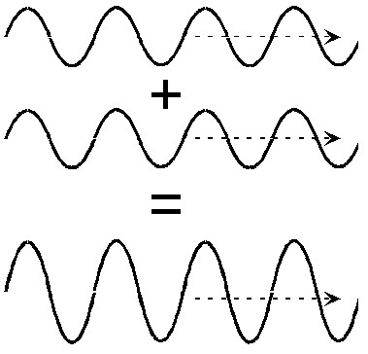
Constructive Interference
If we add these two waves together, point-by-point, we end up with a new wave that looks pretty much like the original waves but its amplitude is larger.
This situation, where the resultant wave is bigger than either of the two original, is called constructive interference. The waves are adding together to form a bigger wave.

Slide 4
Constructive Interference

Slide 5
Destructive Interference
Now what happens if we add these waves together?
When the first wave is up, the second wave is down and the two add to zero.
In fact, at all points the two waves exactly cancel each other out and there is no wave left!
The sum of two waves can be less than either wave, alone, and can even be zero. This is called destructive interference.

Slide 6
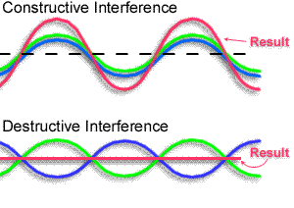
Superposition Principle
When the peaks of the waves line up, there is constructive interference. Often, this is described by saying the waves are “in-phase”.
Phase, itself, is an important aspect of waves, but we will not use this concept in this course.

Slide 7
Superposition Principle
Similarly, when the peaks of one wave line up with the valleys of the other, there is destructive interference and the waves are said to be “out-of-phase”.
Phase, itself, is an important aspect of waves, but we will not use this concept in this course.

Slide 8
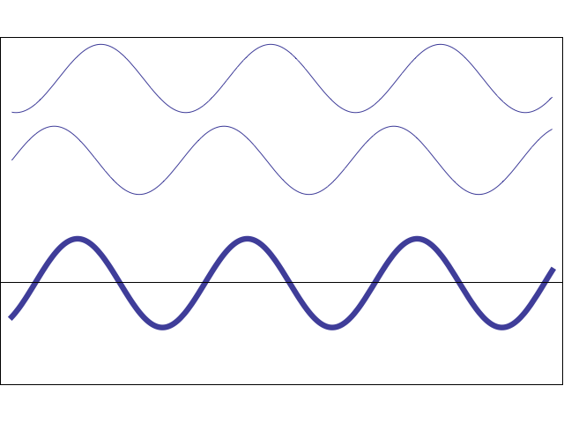
Superposition Principle

Slide 9
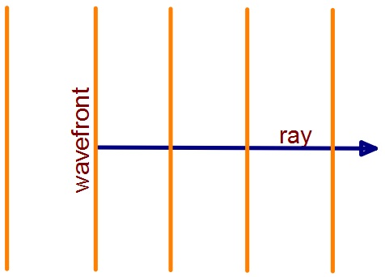
New Terms!
Wavefront: the "actual" wave - easy to see with a water wave.
Ray: a vector arrow, drawn perpendicular to the wave front, that indicates the direction in which a wave is moving

Slide 10
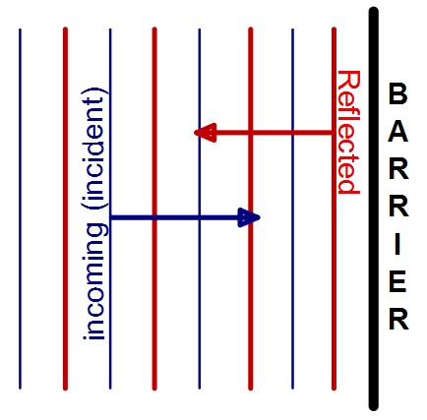
Wave Reflection
Reflection – When a wave reaches a boundary of the medium, it will return back along its original path of motion
This occurs when a wave front hits a barrier (i.e. wall, boundary into a new medium, etc.) and bounces back into the same part of the medium from which it originally came.

Slide 11
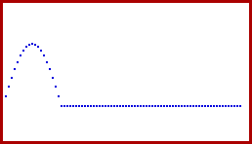
Free End Reflection
Let’s consider a wave in a rope.
If the end of the rope is free to move, we say it is a free end.
When the wave reached the end, it is reflected back along the rope in the same direction that it came from.

Slide 12
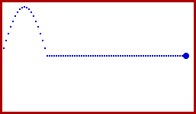
Fixed End Reflection
Now, let’s say the rope is tied to an object.
If the end of the rope is unable to move, we say it is a fixed end.
When the wave reaches the end, the pulse is INVERTED when it reflects off the boundary.

Slide 13
What if the waves hit the barrier at an angle?
Let's say that some water waves hit a wall at an angle of 35° from the normal to the wall.
What will the angle BETWEEN the incident water wave and the reflected water wave be?

Slide 14
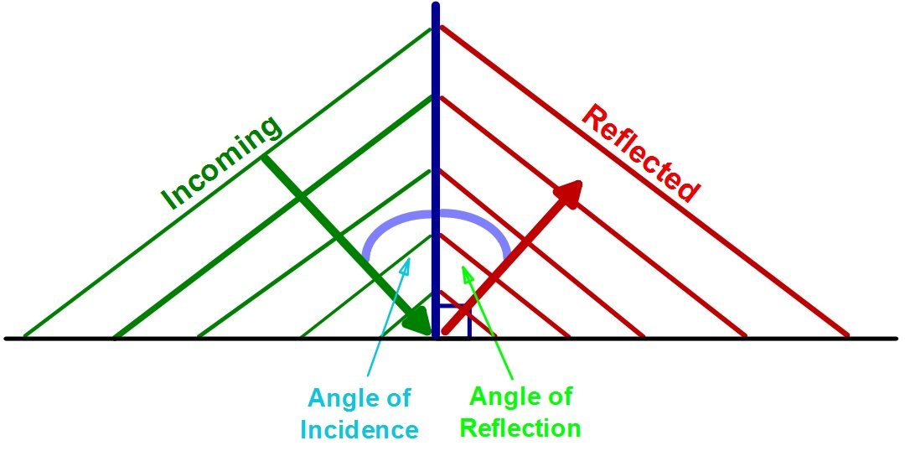
Law of Reflection
The angle at which an incoming wave hits a barrier, when measured to a line normal to the barrier, will be the same as the angle at which the reflected wave leaves the barrier, when measured to a line normal to the barrier. In other words:
The angle of incidence is equal to the angle of reflection

Slide 15
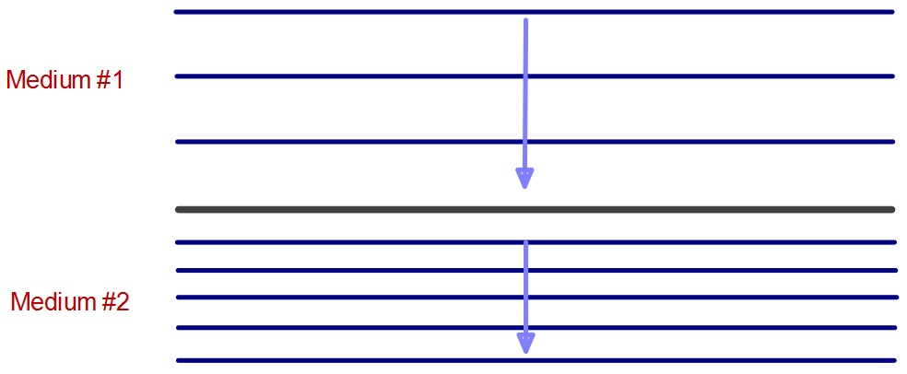
Refraction
Refraction is the change of direction, or bending, of waves when they move between mediums.
A wave will change velocity when it enters a new medium. As a result, the wavelength will change.
Has the frequency of the wave changed at all?
Notes:
NO! Frequency remains constant (and therefore period does as well).

Slide 16
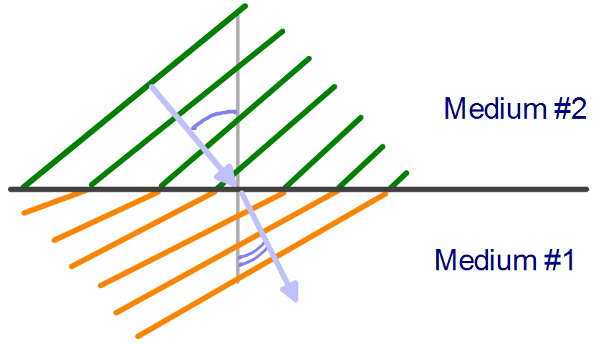
If the wave enters the new medium at an angle, the change in velocity will cause the wave to change its direction of propagation.
In which medium is the wave moving at a faster velocity?
#1
#2
Notes:
Medium #2

Slide 17
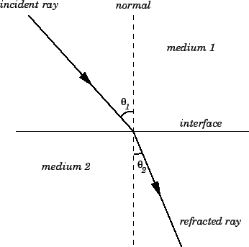
Refraction
Refraction is the change of direction, or bending, of waves when they move between mediums.
Notes:
NO! Frequency remains constant (and therefore period does as well).

Slide 18
The Law of Refraction
The law of refraction states that the incident ray,
the refracted ray, and the normal to the interface,
all lie in the same plane. Furthermore,

Slide 19
The Law of Refraction
n1=refractive indice of medium 1
n1=c/v1 where c= the light speed in vacuum
V1=wave speed in medium 1
n2=refractive indice of medium 2
n2=c/v2
V2=wave speed in medium 2

Slide 20
When a wave enters a new medium at an angle and its velocity INCREASES, the wave will bend:
______________ the normal
When a wave enters a new medium at an angle and its velocity DECREASES, the wave will bend:
______________ the normal
Away
Toward
Notes:
Away
Toward

Slide 21
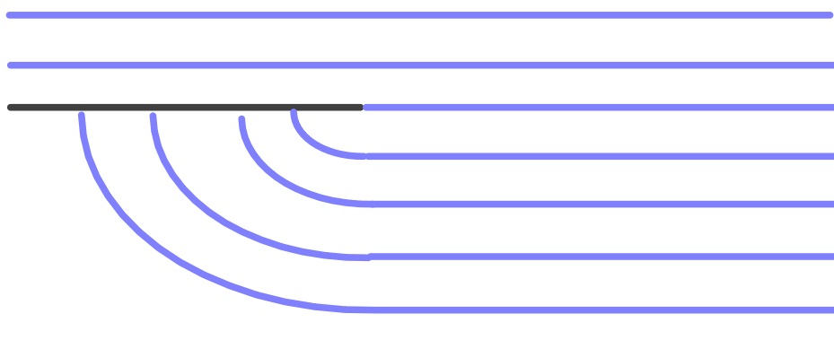
Diffraction
Diffraction occurs when a wave passes by the edge of a barrier and the wavefront bends around the edge
Part of the wavefront is blocked and reflected back, so the energy from the wavefront that does get past the barrier spreads out into the rest of the medium - creating a circular wave front

Slide 22
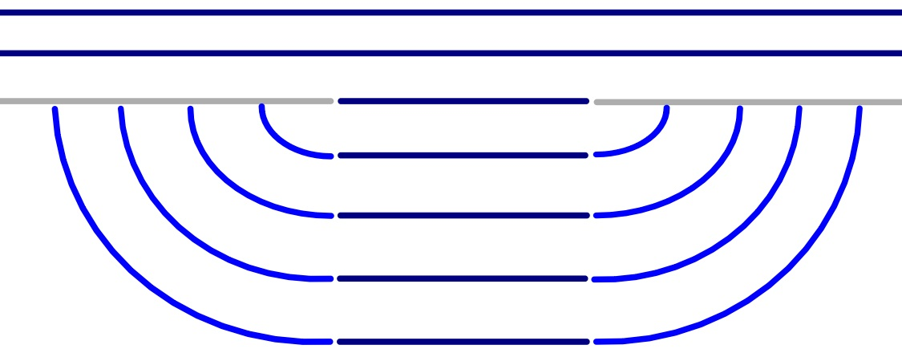
What will happen to the appearance of the waves as the opening between the two barriers gets smaller?

Slide 23
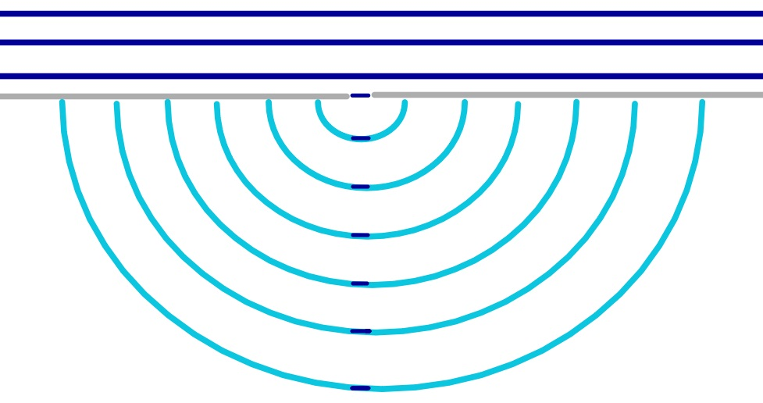
The smaller the opening, the more circular the diffracted wave fronts become

Slide 24
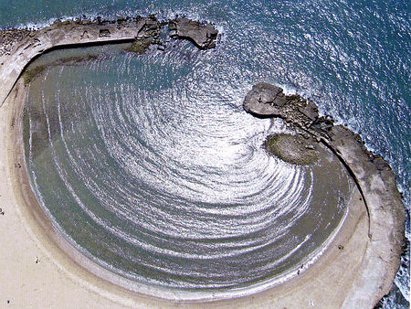
Which wave phenomena/behavior is most prominently being shown in this photograph?
Notes:
The most significant property of water that would affect the speed of waves traveling on its surface is the depth of the water. Water waves travel fastest when the medium is the deepest. Thus, if water waves are passing from deep water into shallow water, they will slow down.

