Slide 1
Activity: pt. 2—Landscaping Dilemma
Fred’s Landscaping has been hired to seed a field the size of a football field completely with grass seed (the field’s owner doesn’t like sod for some reason).
Fred wants to purchase the right number of bags of grass (they are 3 lb. bags) so that he doesn’t have extra.
How many bags of grass seed should he purchase?

Slide 2
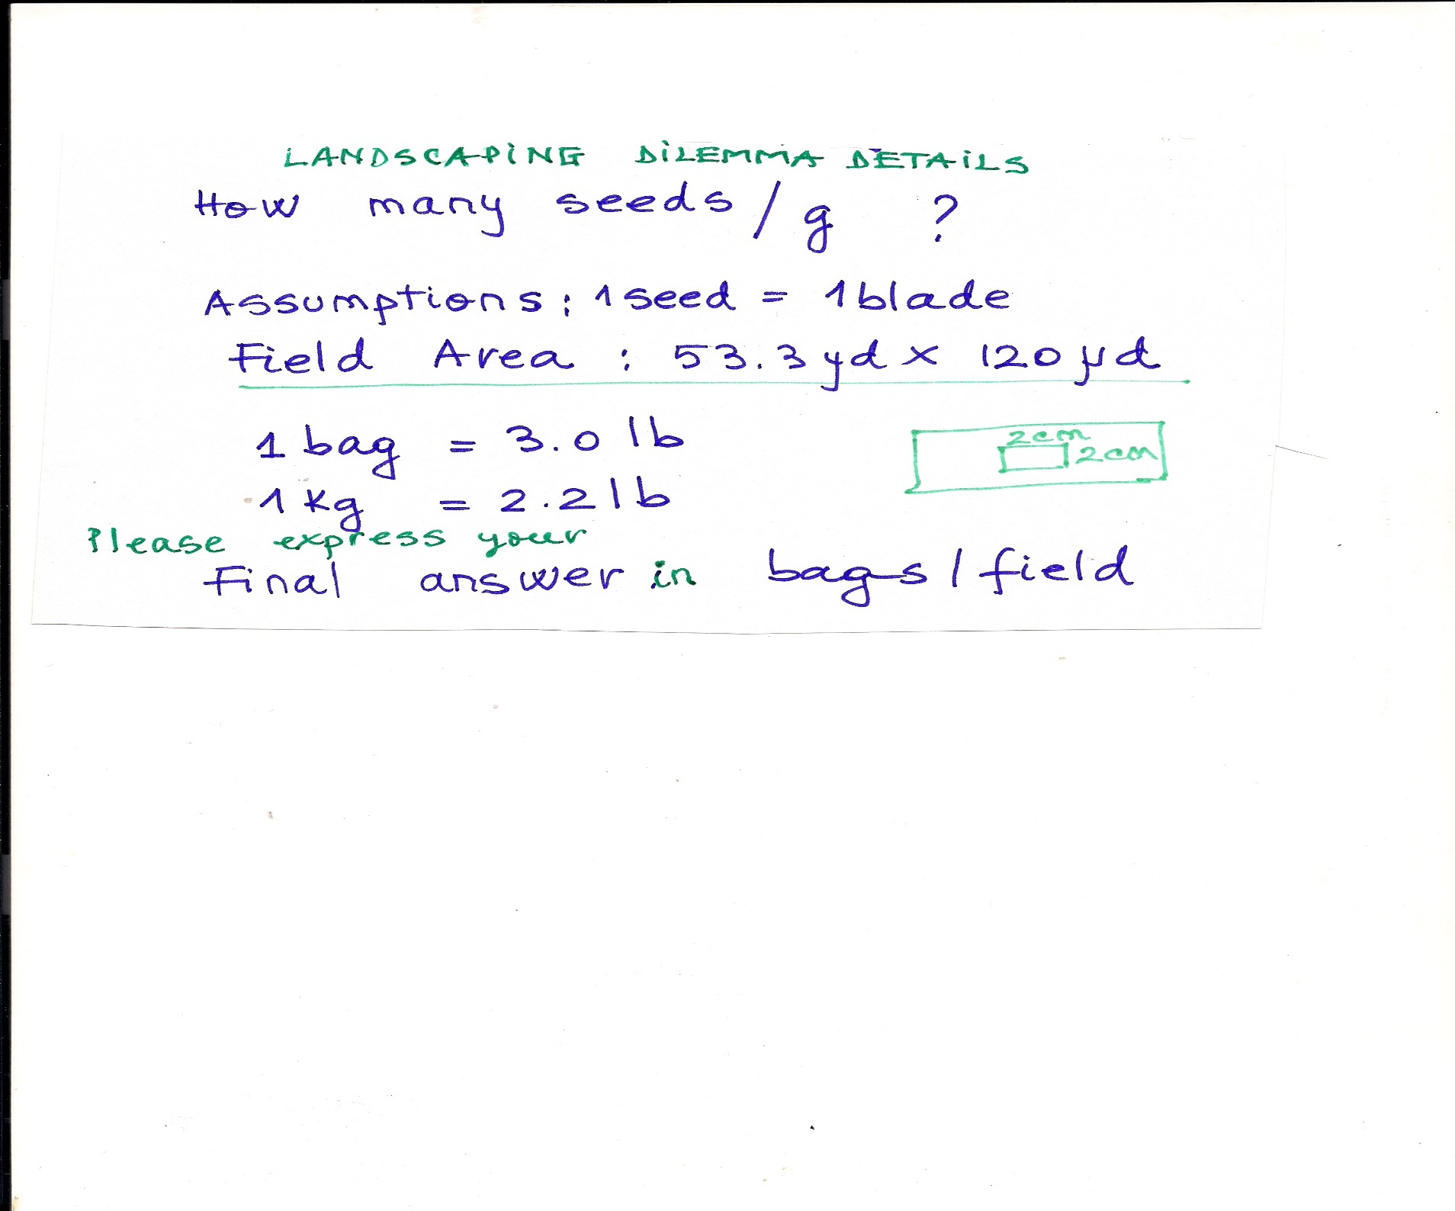
Details and assumptions

Slide 3
Landscaping Dilemma—Journal entry 9/18/17
How many bags should Fred purchase?
How confident are you?
What could have happened that would have affected your results?

