Slide 1
Throwing Eggs!
Warm-up:
Imagine that you are in an egg-throwing competition. How do you catch the egg thrown by your partner so that it doesn’t break (be specific)? Why?

Slide 2
Video Demos
Demo 1: Catching an Egg in a sheet
Turn and talk: What difference does it make in the end result if you throw an egg into a loose sheet rather than at a brick wall? Why?
Demo 2: Pile driver
Turn and talk: What would you need to do in order to drop a large weight onto something fragile so that nothing breaks? Why?

Slide 3
Turn and Talk: Which will reach a higher height? Why?
A popper is placed on a flat, hard surface and released so that it hops into the air.
The same popper is placed on a thumb and released so that it hops into the air.

Slide 4
Momentum and Impulse
Newton’s 2nd Law of Motion, revisited

Slide 5
ConcepTest 6.1 Rolling in the Rain
An open cart rolls along a frictionless track while it is raining. As it rolls, what happens to the speed of the cart as the rain collects in it? (Assume that the rain falls vertically into the box.)
a) speeds up
b) maintains constant speed
c) slows down
d) stops immediately
Notes:
Answer: c

Slide 6
Question 6.3b Velocity and Force
A net force of 200 N acts on a 100-kg boulder, and a force of the same magnitude acts on a 130-g pebble. How does the rate of change of the boulder’s velocity compare to the rate of change of the pebble’s velocity?
a) greater than
b) less than
c) equal to
Turn and Talk: Why did you pick your choice?
Notes:
Answer: b

Slide 7
What is Momentum?
A “Quantity of Motion”
Mathematical definition:
Momentum is the product of an object’s mass in kilograms and its velocity in meters per second.
Momentum is a vector quantity
$$p=mv$$
Units of momentum = kg·m·s⁻¹

Slide 8
Question 6.3a Momentum and Force
A net force of 200 N acts on a 100-kg boulder, and a force of the same magnitude acts on a 130-g pebble. How does the rate of change of the boulder’s momentum compare to the rate of change of the pebble’s momentum?
a) greater than
b) less than
c) equal to
Turn and Talk: Why did you pick your choice?
Notes:
Answer: c

Slide 9
Change in Momentum
Remember: Momentum is a vector quantity!
$$∆p=p_{2}−p_{1}=m∙∆v$$
Example:
A 2.25 kg rubber raft floats in a pool at 1.50 m·s⁻¹ when it hits the wall and bounces back along its original path at a speed of 0.85 m·s⁻¹. What is the change in momentum of the raft?
$$∆p= p_{2}−p_{1}$$
$$∆p=m∙∆v=\left(2.25\right)∙\left(−0.85−1.50\right)$$
$$∆p=−5.29 kg∙m∙s^{−1}$$

Slide 10
Question 6.4 Collision Course
a) the car
b) the truck
c) they both have the same momentum change
d) can’t tell without knowing the final velocities
A small car and a large truck collide head-on and stick together. Which one has the larger momentum change?
Notes:
Answer: c

Slide 11
What causes a change in momentum?
In order to get a change in momentum, the most likely scenario is having an object change its velocity.
What is happening when an object experiences a change in velocity? How does that happen?
When a change in velocity occurs, the object is accelerating
To accelerate, a net force must be applied…

Slide 12
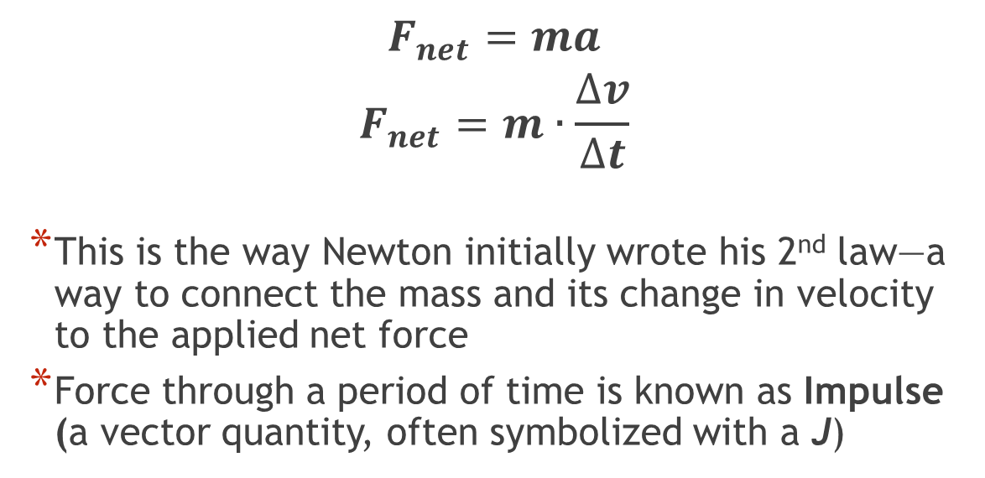
Newton’s 2nd law…again
$$F_{net}=ma$$
$$F_{net}=m∙\frac{∆v}{∆t}$$
This is the way Newton initially wrote his 2nd law—a way to connect the mass and its change in velocity to the applied net force
Force through a period of time is known as Impulse (a vector quantity, often symbolized with a J)

Slide 13
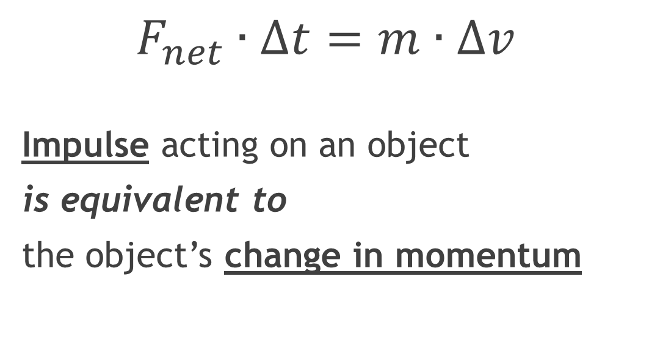
Impulse-Momentum Theorem
$$F_{net}∙∆t=m∙∆v$$
Impulse acting on an object
is equivalent to
the object’s change in momentum

Slide 14
Practice problems coming up!

Slide 15
Practice Calculation #1
A rocket sled, m = 725 kg, is accelerated from rest to a speed of 62.5 m·s⁻¹ in 0.855 s.
What average force was exerted on the sled?
What is the change in the sled’s momentum?
What was the impulse acting on the sled?
What was the sled’s acceleration?

Slide 16
Practice Problem #2 Use the Impulse-Momentum Theorem
A golfer drives a 0.046 kg ball from an elevated tee, giving the ball a horizontal speed of 40.0 m·s⁻¹. Assuming a contact time of 1.0 ms, What is the magnitude of the average force exerted by the club on the ball during this time?

Slide 17
Practice Problem #3
A 70.0 kg worker jumps stiff-legged from a height of 1.00 m onto a concrete floor.
What is the magnitude of the impulse he feels on landing, assuming a sudden stop in 8.00 ms?
What is the magnitude of the average force acting on the worker to bring him to a stop?

Slide 18
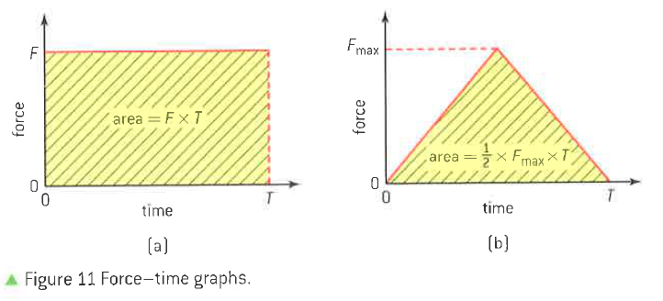
Graphical Analysis of Impuse
What data would be useful to plot if you were to graphically represent the change of momentum of an object and the impulse that caused that change of momentum?

