Slide 1
Projectile Motion Practice

Slide 2
William Tell is said to have shot an apple off his son's head with an arrow. If the arrow was shot with an initial speed of 55.0 m/s and the boy was 15.0 m away, at what launch angle did Bill aim the arrow? (Assume that the arrow and apple are initially at the same height above the ground.)

Slide 3
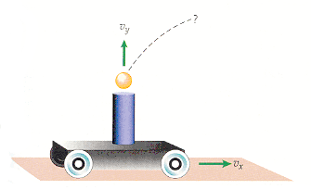
A wheeled car with a spring-loaded cannon fires a metal ball vertically, as shown in the figure below. Answer the following if the vertical initial speed of the ball is 5.00 m/s as the cannon moves horizontally at a speed of 0.750 m/s.
(a) How far, horizontally, from the launch point does the ball fall back into the cannon?

Slide 4
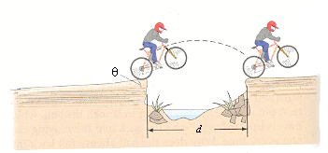
A ditch d = 1.60 m wide crosses a trail bike path, as shown in the figure below. An upward incline of θ = 18.0° has been built up on the approach so that the top of the incline is level with the top of the ditch. What is the minimum speed a trail bike must be moving to clear the ditch? (Add 1.40 m to the range for the back of the bike to clear the ditch safely.)

Slide 5
Example #3
A pitched ball is hit by a batter at a 45.0° angle and just clears the outfield fence, 98.0 m away. Assuming that the fence is at the same height as the pitch, find the velocity of the ball it left the bat.

Slide 6
The place kicker on a football team kicks a ball from ground level with an initial speed of 8.30 m/s at an angle of 29.0° above the horizontal. How long is the ball in the air before it lands on the ground again? You may neglect air resistance.

Slide 7
A seagull flying horizontally over the ocean at a constant speed of 2.30 m/s carries a small fish in its mouth. It accidentally lets go of the fish, and 2.45 s after letting go the fish lands in the ocean.
Determine:
The horizontal component of the velocity at the moment before impact with the ocean
The vertical component of the velocity at the moment before impact with the ocean
The overall velocity (including angle) and the moment of impact with the ocean.

Slide 8
Nate hits a golf ball from a tee with an initial velocity of 20 ms⁻¹ at an angle of 34° from the horizontal.
(a) What is the maximum height reached by the ball?
Assuming the golf ball lands at the same elevation (height) as it began: (b) What is the total hang time of the golf ball?
(c) How far from the tee will it strike the ground (ignoring air resistance)?

Slide 9
A tennis player serves a tennis ball such that it is moving horizontally when it leaves the racquet. When the ball travels a horizontal distance of 13 m, it has dropped 52 cm from its original height when it left the racquet. What was the initial speed of the tennis ball? (Neglect air resistance.)

Slide 10
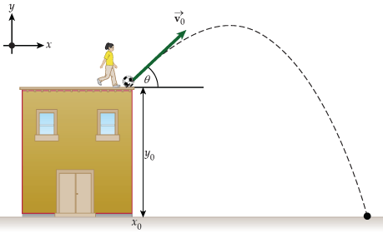
You are walking around your neighborhood and you see a child on top of a roof of a building kick a soccer ball. The soccer ball is kicked at 51° from the edge of the building with an initial velocity of 19 m/s and lands 69 meters away from the wall.
How tall is the building that the child is standing on?
What is the total time the ball is in the air?

Slide 11
A football is kicked from ground level with an initial velocity of 23.8 m/s at angle of 52.0° above the horizontal. How long is the football in the air before it hits the ground? Ignore air resistance.

Slide 12
An Olympic diver is on a diving platform 11.5 m above the water. To start her dive, she runs off of the platform with a speed of 1.26 m/s in the horizontal direction. What is the diver's speed just before she enters the water?

Slide 13
A child uses a rubber band to launch a bottle cap at an angle of 47.5° above the horizontal. The cap travels a horizontal distance of 1.30 m in 1.40 s. What was the initial speed of the bottle cap, just after leaving the rubber band?

Slide 14
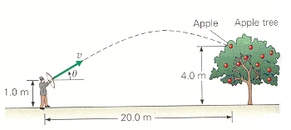
William Tell is shooting at an apple that hangs on a tree, as shown in the figure below. The apple is a horizontal distance of 20.0 m away and at a height of 4.00 m above the ground. If the arrow is released from a height of 1.00 m above the ground and hits the apple 0.500 s later, what is the arrow's initial velocity? (magnitude and angle)

