Slide 1
Uncertainties!
Let’s Review…

Slide 2
Question 1
A stone falls from rest to the bottom of a water well of depth d. The time t taken to fall is 2.0 ±0.2 s. The depth of the well is calculated to be 20 m using d = (1/2)at ². The uncertainty in a is negligible.
What is the absolute uncertainty in d?
A. ± 0.2 m
B. ± 1 m
C. ± 2 m
D. ± 4 m

Slide 3
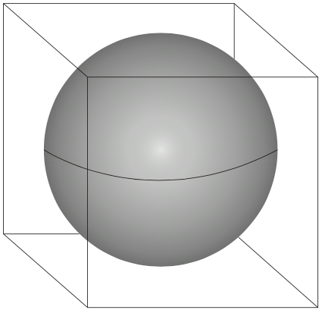
Question 2
A sphere fits inside a cube.
The length of the cube and the diameter of the sphere are 10.0±0.2cm.
What is the ratio: $\frac{\%uncertainty of the volume of the sphere}{\%uncertainty of the volume of the cube}$
A. $\frac{3}{4π}$
B. 1
C. 2
D. 8

Slide 4
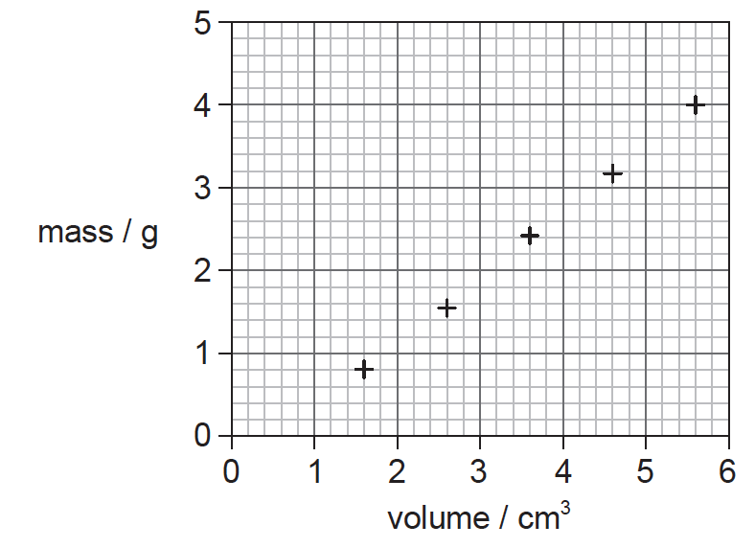
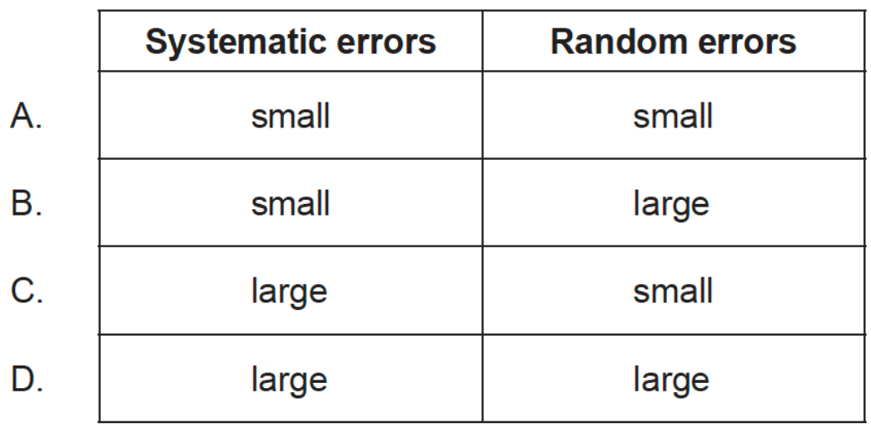
Question 3:
The graph shows a set of experimental results to determine the density of oil. The results have systematic errors and random errors.
Using the information on the graph, what can be said about the measurements used to find the density of oil?

Slide 5
Question 4:
The maximum acceleration a_{max} of an oscillator undergoing simple harmonic motion (SHM) has a percentage uncertainty of 12%. The amplitude x₀ of the oscillation has a percentage uncertainty of 20%. If $k=\sqrt{\frac{a_{max}}{x_{o}}}$ ,what is the percentage uncertainty in the constant k?
A. 4%
B. 8%
C. 16%
D. 32%

Slide 6
Question 5
The radius of a sphere is measured with an uncertainty of 2%. What is the uncertainty in the volume of the sphere?
A. 2% B. 4% C. 6% D. 8%

Slide 7
Question 6
The volume V of a cylinder of radius R and height H is given by V = πR²H. The volume of the cylinder was measured with an uncertainty of 10% and the height was measured with an uncertainty of 6%. What is the uncertainty in the radius of the cylinder?
A. 1% B. 2% C. 4% D. 8%

Slide 8
Question 7
The sides of a square are measured to be 5.0 ± 0.2 cm. Which of the following gives the area of the square and its uncertainty?
A. 25.0 ± 0.2 cm² B. 25.0 ± 0.4 cm² C. 25 ± 2 cm² D. 25 ± 4 cm²

Slide 9
Question 8
The length of the side of a cube is 10.0 ±0.3cm. What is the uncertainty in the volume of the cube?
A. ±0.027 cm³
B. ±2.7 cm³
C. ±9.0 cm³
D. ±90 cm³

Slide 10
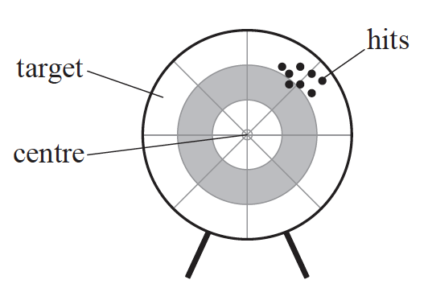
Question 9
Aiming for the centre of a target, an archer fires arrows which produces a pattern of hits as shown below.
The pattern suggests the presence of:
A. random and systematic uncertainties. B. random uncertainties but no systematic uncertainties. C. systematic uncertainties but no random uncertainties. D. neither random nor systematic uncertainties.

