Slide 1
What Information Can We Take from Graphs?
Finding displacement from a v-t graph AND
Finding acceleration from a d-t graph

Slide 2
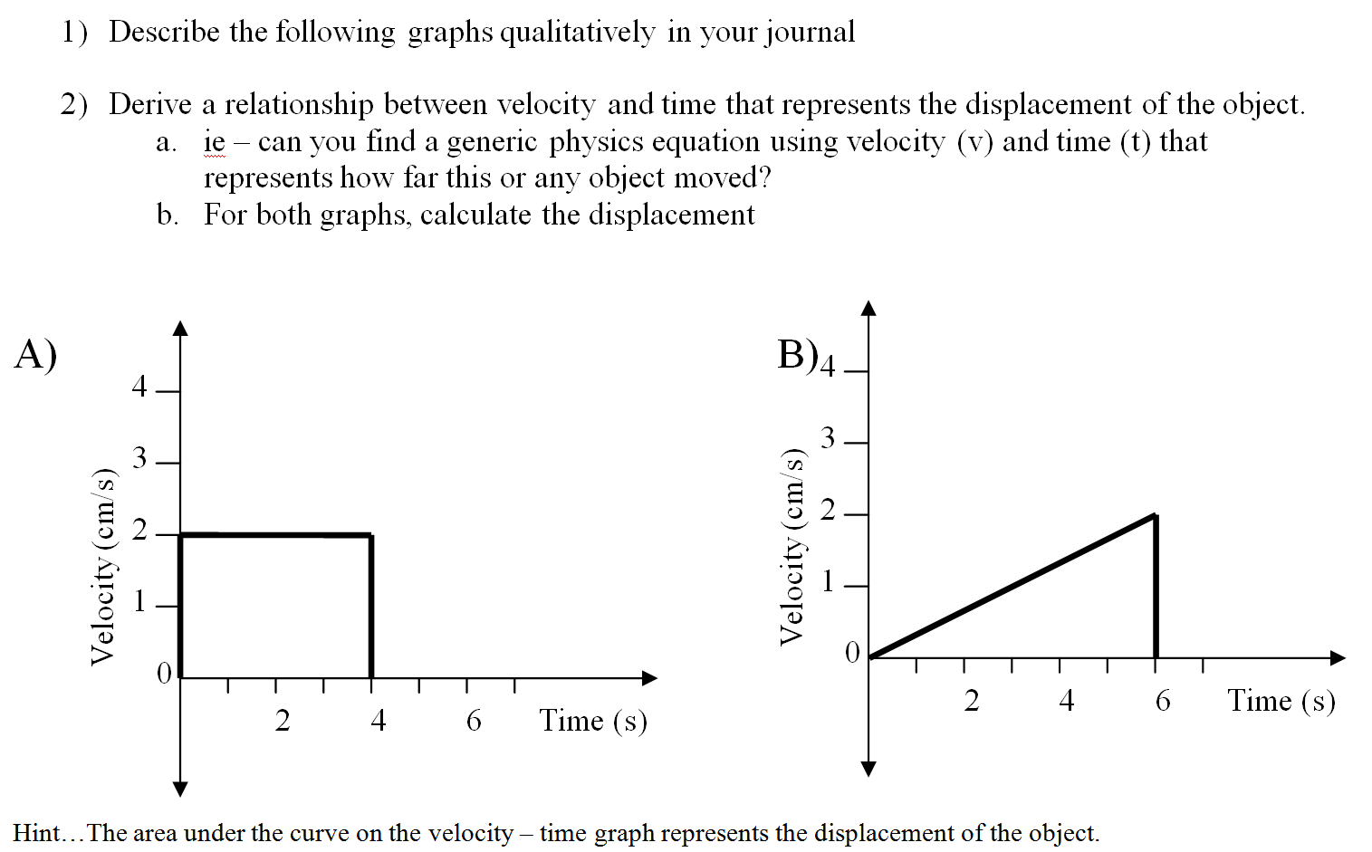
IN CLASS PRACTICE PROBLEMS

Slide 3
ANSWER KEY

Slide 4
ANSWER KEY

Slide 5
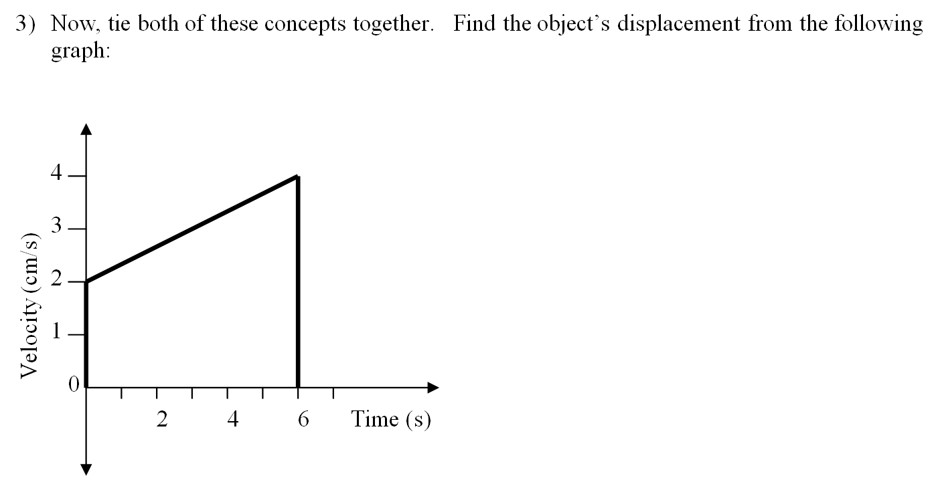

Slide 6
ANSWER KEY

Slide 7
NOTES

Slide 9
Group Work – Acceleration from a d-t graph
Table 1:
Displacement of a plane taking off
Graph the data on a d-t graph
Smoothly sketch a best-fit curve
Find 4 points on the curve (evenly spaced apart) and calculate the instantaneous velocity (show tangent line and all work)
Fill in this table
Sketch a v_{inst}-t
graph
Calculate the slope
(with units!)
Fill in the blank: The slope tells us the ________ of the plane.
Displacement (m) | Time (s)
0 | 0
6 | 1
22 | 2
50 | 3
88 | 4
138 | 5
198 | 6
270 | 7
352 | 8
v_{inst} (m/s) | Instant in time (s)

Slide 10
ANSWER KEY

Slide 11
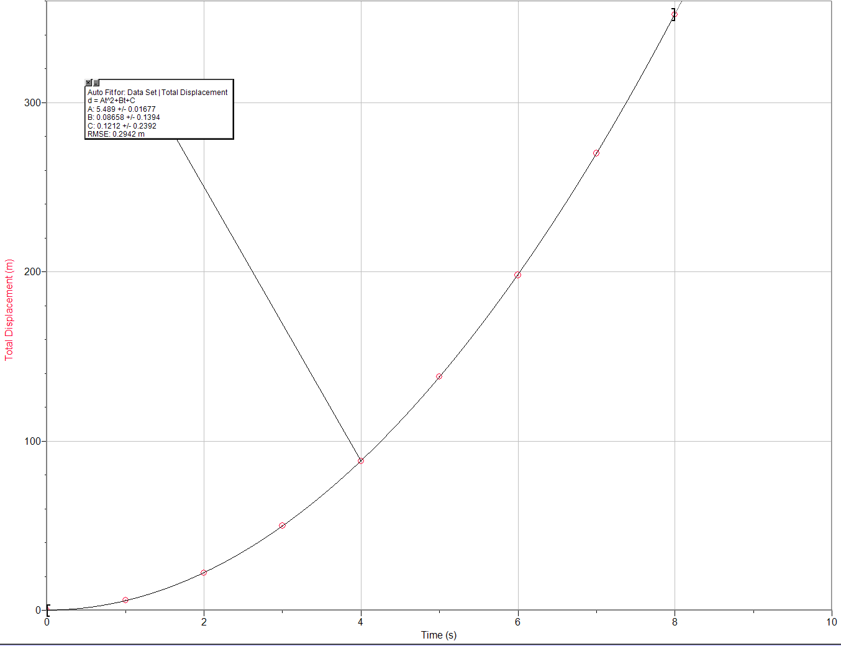
ANSWER KEY
v_{inst} (m/s) | Instant in time (s)
23 | 2
44 | 4
65 | 6
79 | 8

Slide 12
ANSWER KEY
The slope tells us the acceleration of the plane.

